Slide 1
CCR (COMPUTER CONTROLLED RAILROAD)
A Senior Capstone Project by
Brice Hilgemann

Slide 2
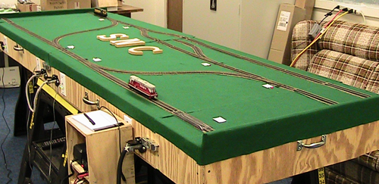
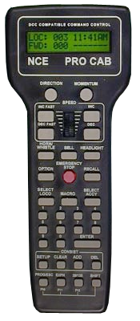
Project Definition
Design and implement interfaces for the CCR that campus visitors can use to control trains.
TRACK IMAGE HERE

Slide 3
Project Requirements
Allow PC control of the model railroad
Consider multiple interfaces – PC, Mobile, WiFi
Create easy-to-understand interfaces
Provide continual feedback and logs
Implement a simplified OS to handle multiple trains and prevent collisions

Slide 4
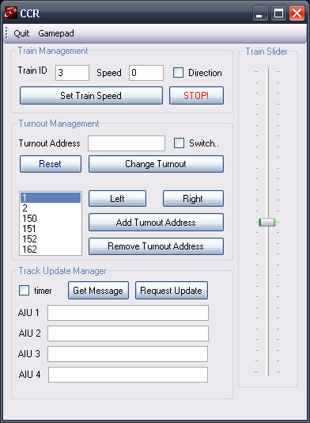
Previous Projects
Strengths
Powerful
Adaptable
Weaknesses
AIU issues
Collision prevention
Organization

Slide 5
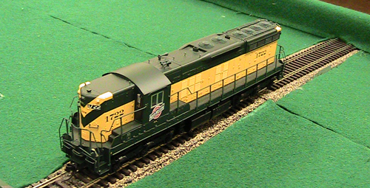
Initial Strategy
Get familiar with hardware
Review previous code and methods
Understand previous project specifications and goals behind project
Create simplified interfaces
Implement OS principles/strategies from CS370
Test and confirm reliability
Documentation!

Slide 6
Language Selection and Abilities
C-Sharp and .NET Framework
Monitor object
Asynchronization communication and threading
Visuals (Form objects)
Event-driven
MSDN documentation and support

Slide 7
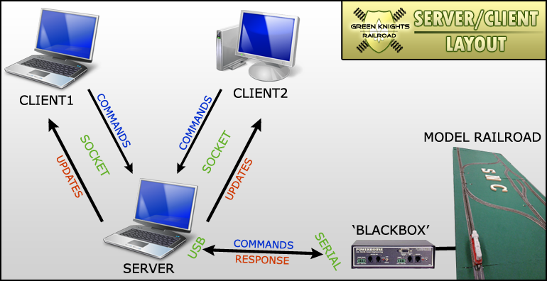
Solutions
Client/Server Design

Slide 8
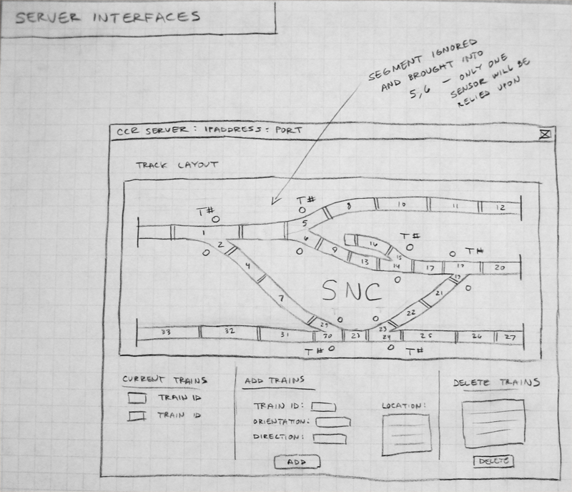
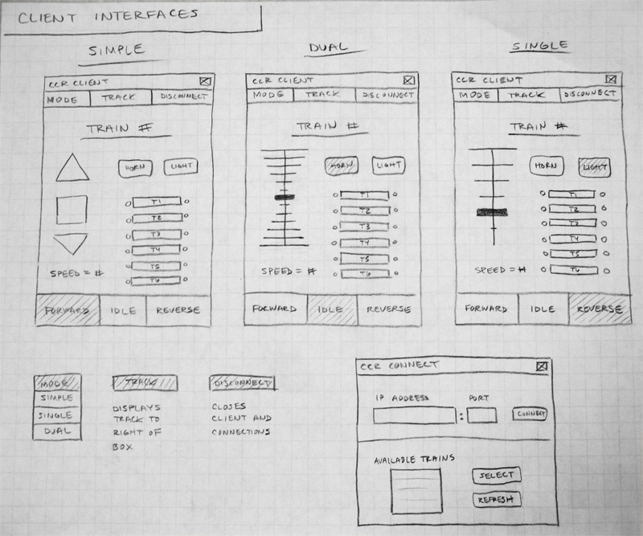
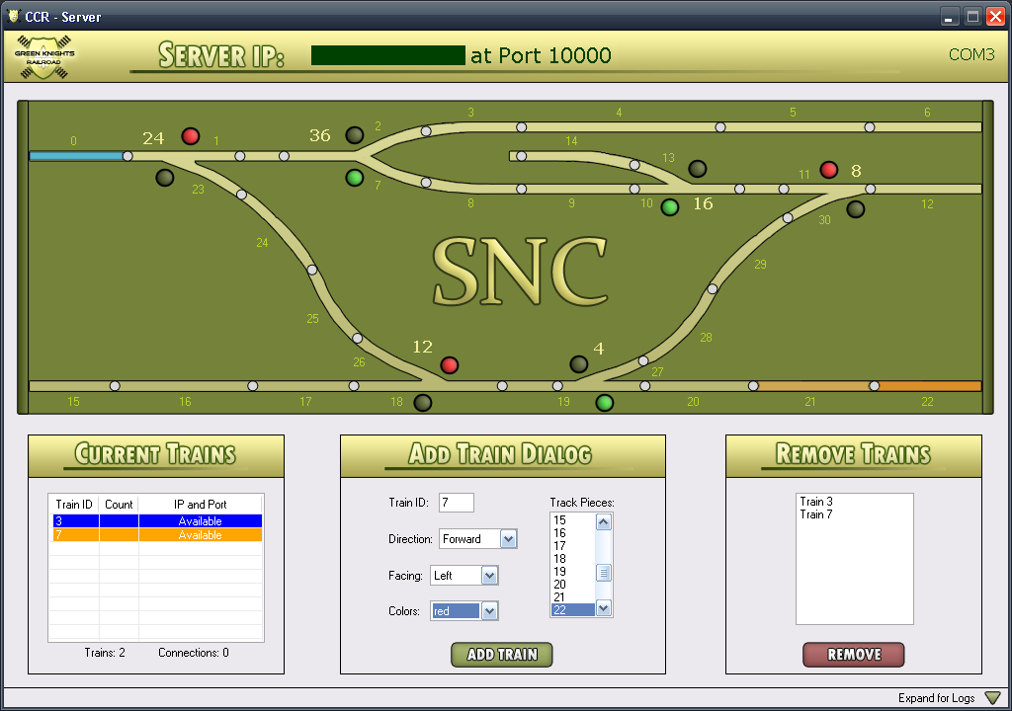
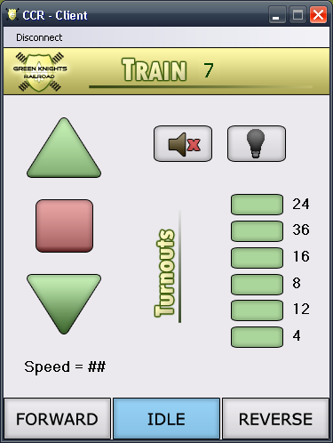
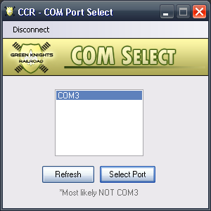
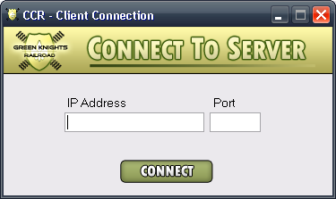
Diagrams to Application

Slide 9
Protocol for Communication
Protocol to Server
CMD FORMAT | DESCRIPTION
[ 1 ] ; [ TRAIN ID ] | Increase speed or up arrow issued
[ 2 ] ; [ TRAIN ID ] | Decrease speed or down arrow issued
[ 3 ] ; [ TRAIN ID ] | Stop train has been issued
[ 4 ] ; [ TRAIN ID ] | Direction forward has been issued
[ 5 ] ; [ TRAIN ID ] | Direction backward has been issued
[ 6 ] ; [ TO # ] | Toggle turnout has been issued
[ 7 ] ; [ TRAIN ID ] ; [ DIRECTION ] ; [ ORIENTATION ] ; [ COLOR ] ; [ TRACK ] | User wants to Add a train from the server – get basic information from form and call with protocol to add
[ 9 ] ; [ TRAIN ID ] | Toggle light has been issued
[ 10 ] ; [ TRAIN ID ] | Toggle horn has been issued
Protocol to Client
CMD FORMAT | DESCRIPTION
[ 0 ] | There are no trains available – disconnect
[ 1 ] ; [ TRAIN ID ] ; [ SPEED ] ; [ DIRECTION ] ; [ LIGHT ] ; [ HORN ] ; [ BLOCKED ] ; [ TO_NEAREST ] ; [ NBR TOS ] ; [ TO# ST ]... | General update of train information sent from the server to the client to update images and status indicators
[ 2 ] | Train has been deleted or client has been disconnected from server
[ 3 ] ; [ TRAIN ID ] ; [ NBR TOS] ; [ TO # ]... | Beginning train information for setting labels

Slide 10
Behind the Scenes Structures
Structures that hold ownership
Prevent collisions
Used in sending updates
Used for visuals
Monitors hold integrity
Example: Turnout Structure
Turnout # | Turnout State | Turnout Owner
4 | top | none
8 | bottom | none
12 | top | none
16 | top | none

Slide 11
Exceptions
Real-time communication lapses
AIU processing
Infrequent sensor misses
Derailments
Track shortages

Slide 12
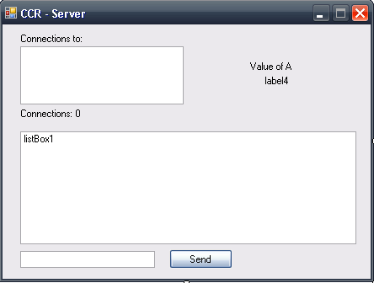
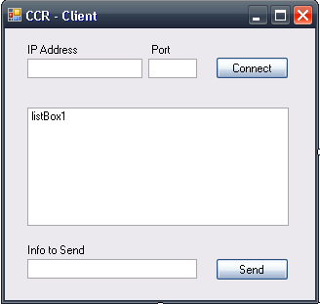
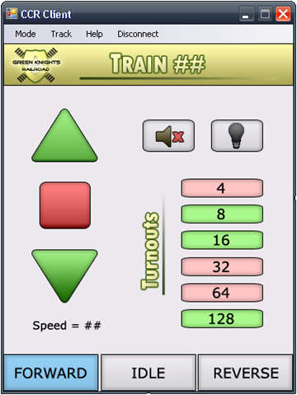
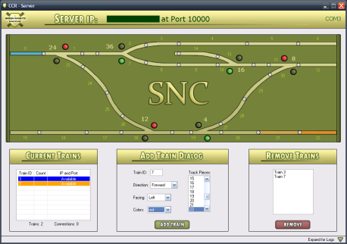
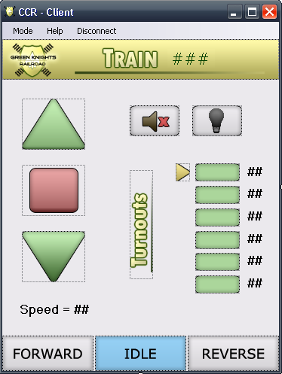
Methodology
Rapid prototype development
Scaffolding
Modularity and Flexibility
Back-up and make small changes
Create diagrams and flow charts
Document throughout development

Slide 13
DEMONSTRATION (COMPUTER CONTROLLED RAILROAD)
Video as Backup

Slide 14
Strategies
MSDN Documentation
Forums and sample programs
Other online resources and examples
Previous CCR Projects
Computer Science Faculty
Assistance
Opinions
Fellow CS Students
Trial and Error
?
?
?

Slide 15
CS Courses and Concepts
CSCI 220 – Data and file structures
CSCI 225 – Byte processing and hardware concepts
CSCI 322 – Language constructs
CSCI 350 – Event-driven functions
CSCI 370 – Mutual exclusion and OS concepts

Slide 16
Extensions
Create your own client
Bring application mobile with .NET Framework and Windows Mobile
Web application
More adaptable to other tracks
or

Slide 17
Advice for Others
Start early
Create realistic goals and a timeline…FAST
Focus on the big picture; don’t get stalled on little problems
Communicate progress/ideas with CS faculty
Create a balance between working on project and other aspirations (like finding a job)
Make it fun!
Good Luck!

Slide 18
Questions? Comments?
Do you want more information?
Visit my site at http://compsci.snc.edu/cs460/hilgbs/

