Slide 1
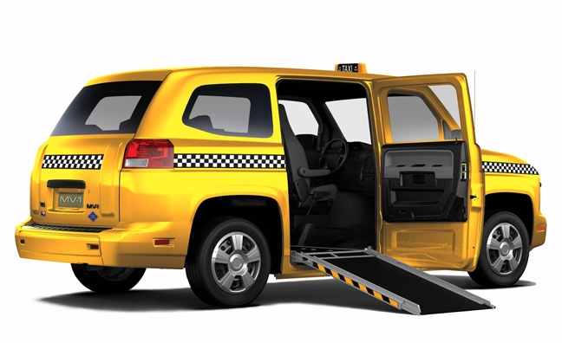
Senior Citizen Taxi Service Driver Application
Eric Sallmann
CS460 – Senior Capstone Experience
Notes:
Hello everyone, thank you for coming. My name is Eric Sallmann and my project for the Senior Capstone Experience is an application that I have coined, Senior Taxi Service Driver Application.
Dr. Pankratz got the idea to develop this project based on a similar taxi service in his hometown that for only $5, they will take senior citizens anywhere within a certain distance outside of the city (and how his mother chooses not to use this service)

Slide 2
Scheduling Rides Project Description
Task: Develop a visual and analytical support system that assists drivers of this taxi service to effectively transport their riders. Drivers, passengers, and destinations are presented visually on a map.
The map is updated after an event: request, pickup, drop off...
Pickups can be requested and cancelled at any time.
Handle multiple taxis.
Save the sequence of events and play back so drivers can select an alternative strategy.
Distances between objects are computed and displayed.
Each taxi has a maximum number of riders. (Do wheelchairs take extra space?)
Some riders have specific scheduled appointments so destination times matter.
Notes:
Application support tool for drivers of taxi service to aid them in picking up and delivering passengers
Makes their jobs easier by directing and managing who to pick up, when, and where
No memorization required by drivers as to customer addresses, destination locations, etc.
NOT A GPS!
More of a guide on who to pick up while giving drivers the freedom to decide who to pick up next
This is to replace having to write down on a notepad who to pick up next and have to decide where to go next based on the driver's own guesses and assumptions.
No need to call HQ on who to pick up next as they will update the database directly with new customers when they call HQ, which will in turn be updated by the tool.

Slide 3
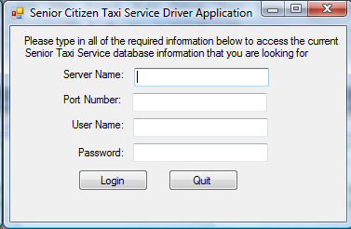
Solutions
Discovered Gmap.Net and GeoCoding.Net
Windows Forms Application via C#.Net
Used database approach
Notes:
Was originally going to make the map manually using C++/C# to draw routes and perform algorithms by hand, talked with Dr. Pankratz, advised me to do more digging out there on a different/easier approach
Discovered Gmap.Net: Uses Google, Yahoo, or other map providers to make a map control to put on applications and extract data from certain locations specified on it.
And GeoCoding.Net: Ability to convert between lat/long coordinates and address information
Found most help from Google searches as there is a lot of documentation on Gmap already out there
That’s where I got help in dealing with how to add markers, get distance/duration between marker locations, deal with directions (removing of html string), and converting address to latitude/longitude
Chose the Google maps option because it was the easiest to work with, I find that it’s the most reliable with lat/long information, and I like the way that it looks with markers visibly on the screen
Chose Windows Forms application because I’m the most familiar with it, most documentation online out there uses it, and it works most effectively/looks better on a form
Went with the database approach because I envisioned this tool being used by a mock taxi service company to update the database directly from their headquarters when customers call in, which would update the driver’s application customer queue. I used Hartford as the mock city to display the location marker information on the map, but if they were to insert new city destination’s data into the database the application could handle that and display those markers on the map instead
The table to the right explains the original tasks that I was planning to implement and at what times to keep me on track for my project
The login form below is used for a driver to login to the application so that only trained members of the taxi company can have an account to get into the application and use it to pick up customers. They are given a username and password along with the companies database information so that they can connect to the database and utilize the contents held in it, by using Windows Forms and C# code.

Slide 4
Exceptions
The things not in bold, I was unable to solve:
The map is updated after an event: request, pickup, drop off...
Pickups can be requested and cancelled at any time.
Handle multiple taxis.
Save the sequence of events and play back so drivers can select an alternative strategy.
Distances between objects are computed and displayed.
Each taxi has a maximum number of riders. (Do wheelchairs take extra space?)
Some riders have specific scheduled appointments so destination times matter.

Slide 5
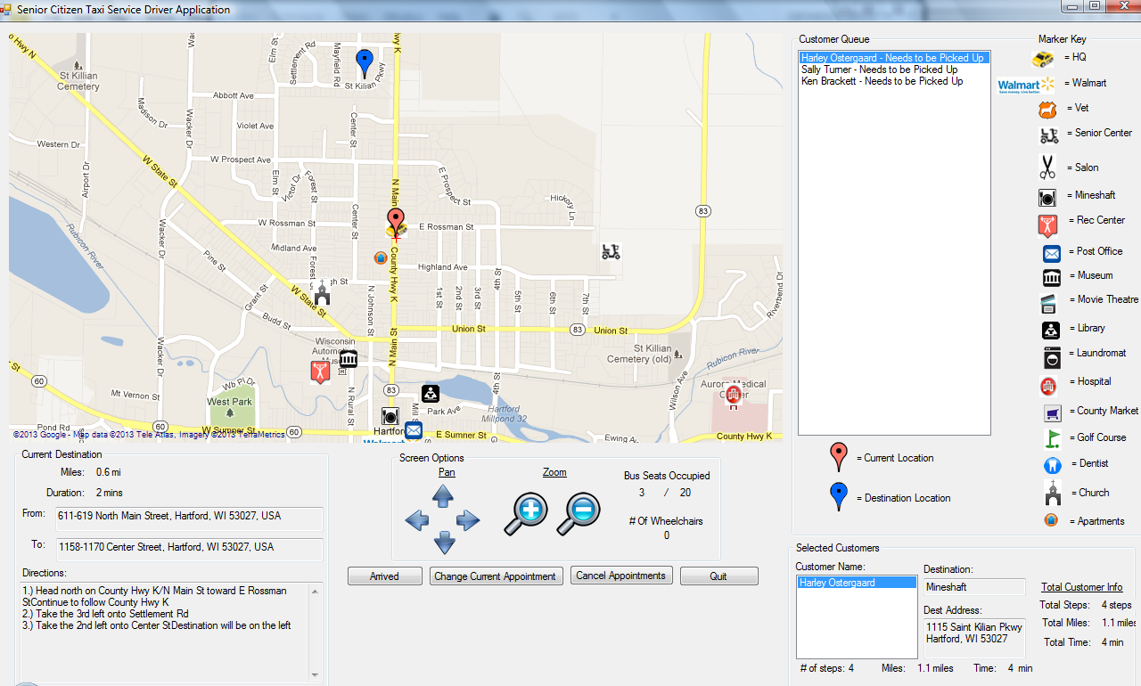
Project Demonstration

Slide 6
CS Concepts Used
Database coursework
Queue data structure
Classes
Functions, Conditional Statements/Loops
Event Programming
Notes:
CS 330: Database Techniques and Concepts – SQL select queries using MySQL and MySQL data client.dll file provided by Dr. Agarwal
CS 220: Advanced Data and File Structures – Utilized the Queue data structure in dealing with customers and the order of their appointments
CS 205: Software Engineering and Elementary Data Structures – Utilized classes for Destinations and Customers, got data for class members from the database and the classes to store their attributes
CS 110: Introduction to Computer Programming – Many functions created and called to perform certain tasks throughout the tool as well as many if/else statements and for/while loops.
CS 350: Event Programming – Never took the class, but understood many of the concepts through my research opportunities and through this project with random event threading, on-click, and Form events

Slide 7
Future Work
Add multiple taxis
Implement tooltips
Handle scheduled appointments
Improve scalability
Make mobile, real GPS technology?
Notes:
For future students that may take on this project: some things that could be improved with the tool include
Implementing multiple taxis being used with the tool and delegating customers between the different taxis. Can view and get information from the routes of different taxis
Implementing tool tips on maps so that if the mouse scrolls over or clicks a marker on the screen will show detailed data of location, how far the taxi is currently from that location, etc.
Make the tool be able to handle scheduled appointments that customers have on the places they go, aka if Sally has a dentist appointment where she needs to arrive in 20 minutes, make her the current customer to drop off over the others in the queue.
Be able to control the application when its size changes so that it’s controls scale down to fit in the form in the same locations on it. Also scale it so that it will be able to fit on any type of a screen’s dimensions
Possibility of making this tool a mobile application, or using real GPS technology to detail the routes and control direction of who to pick up when and where

Slide 8
Recommendations for Future Students
Don’t procrastinate
Don’t let yourself be stuck for too long
Do plenty of research – you will be surprised what you can find out there
Seek advice from peers/faculty
Have fun and learn as much as you can!
Notes:
I found that by spending an hour every day or two goes a long way just implementing small portions of the project rather than just cranking it all out in one swing
There were many times that I was stumped for hours and wasted a bunch of time getting nothing done. I learned that not everything is going to be implemented and that I should focus on getting the necessary features implemented first
Make sure that you do a lot of research on possible options when you receive the project description before getting right into the design specifications and/or implementation of it
I wish I would’ve spent more time seeking aid from my fellow peers and from Dr. Pankratz/McVey on issues I was having and recommend that students do so if they have problems
I enjoyed this project a lot and learned so much from doing it as well. I recommend that future students do the same as it will make the project more successful and take you a long way

Slide 9
Questions

