Slide 1
Backup Car Camera
Derek Wachowski

Slide 2
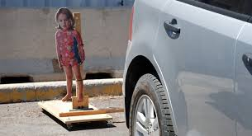
Background
National Highway Traffic Safety Administration Data:
210 people die and 15,000 are injured each year by vehicle backup accidents
Proposed rule to require rearview cameras by 2018

Slide 3
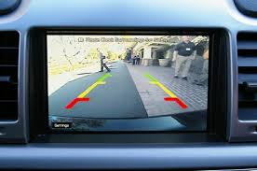
Requirements
-Xbox Kinect hardware
- Include visual and audio alerts to indicate danger to the driver
-Calculated, realistic overlay

Slide 4
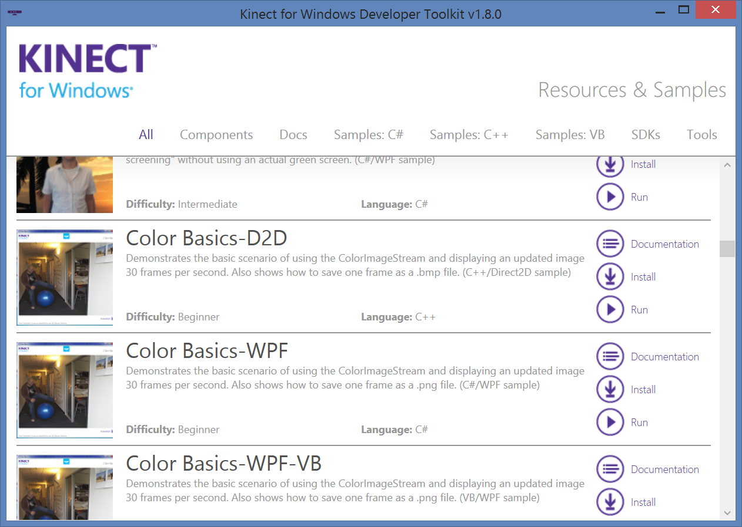
Starting point
- New Capstone topic
- Very distinct from other Kinect based projects
- Learned the Kinect SDK through templates and examples provided by Microsoft

Slide 5
Solutions
Detect depth of nearest on screen object
Visual alerting by color states
Audio alerting by preference
Screenprint option
Safety boundaries change as the vehicle changes speed

Slide 6
Main obstacle - Resource Exhaustion
30 frames per second
300k pixel bitmap array
= limited computation time

Slide 7
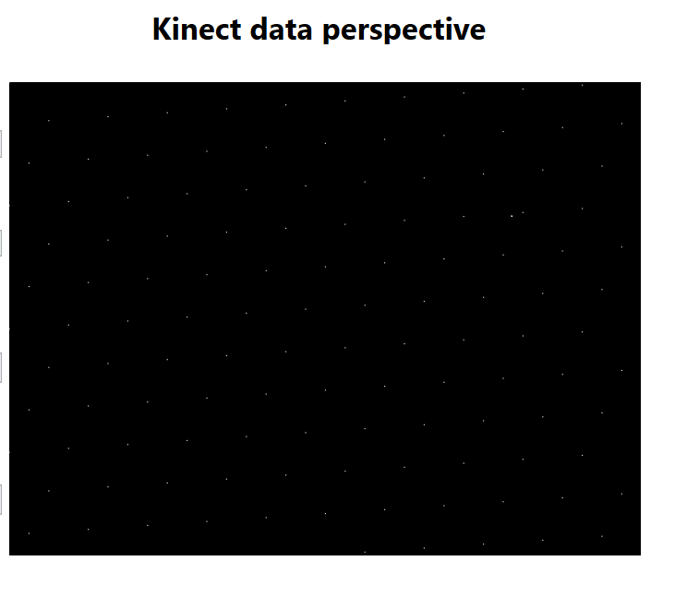
Design Technique
-Evaluate a subset of the pixels
-Only every nth pixel will be doing the work
-Efficiency vs. accuracy

Slide 8
Field of vision logic
-First 1.5 feet is considered “unreliable”
-Red and yellow boundary are dynamic values
? - 3 ft.
Red boundary
Yellow boundary

Slide 9
Live Demonstration

Slide 10
Learning techniques
Learn fundamentals of SDK by example and Microsoft documentation
Experiment and test
Trial and error
msdn.microsoft.com

Slide 11
Computer Science Concepts
Time & space complexity analysis (yes - it really is applicable!)
Object Oriented Programming
Abstraction
All available Data
What the user cares to see

Slide 12
Possible Enhancements
-Utilize a wide angle lens for realistic use
-Make use of the kinect sound array to detect possible danger via audio signs
-Enhance the user interface with advanced augmented reality techniques

Slide 13
Advice to next seniors
Create small pieces and slowly complete the whole picture
Good
Bad

Slide 14
Questions

Slide 15
Works cited
-http://www.usatoday.com/story/money/cars/2014/03/31/nhtsa-rear-view-cameras/7114531/
-Google Images

