Slide 1
Image Mosaics
Veishea Grebin

Slide 2
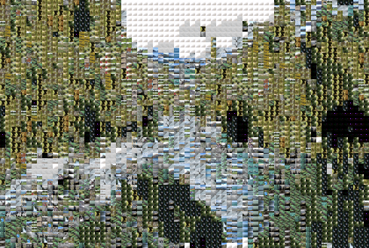
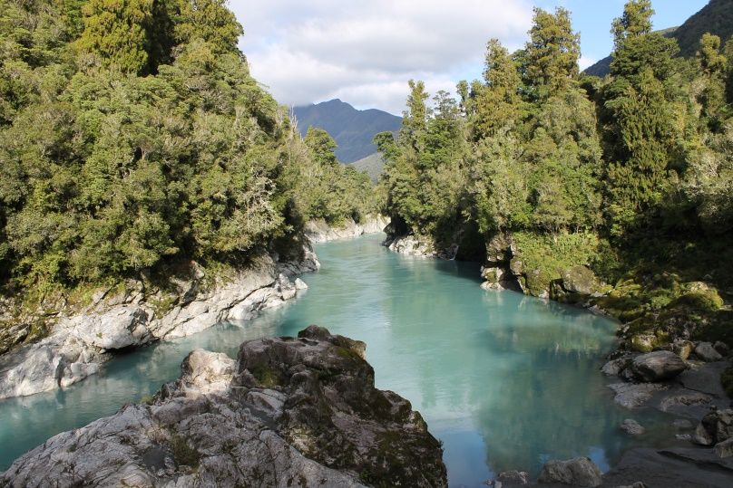
Project Requirements
Create an application that builds a mosaic of little images to represent an original image
Use a genetic algorithm to find the best arrangement
Display the best arrangements to show the algorithm’s progress

Slide 3
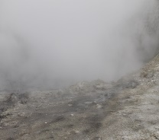
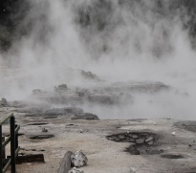
How it works
1. User chooses how many tiles wide the width will be
2. Upload original image
Saves the average red, green and blue values for each tile
3. Upload images to use as tiles
Crops them into squares the same size as the tile in the original image
Save average red, green and blue value for each image uploaded
Width = 4

Slide 4
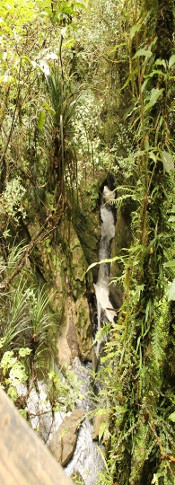
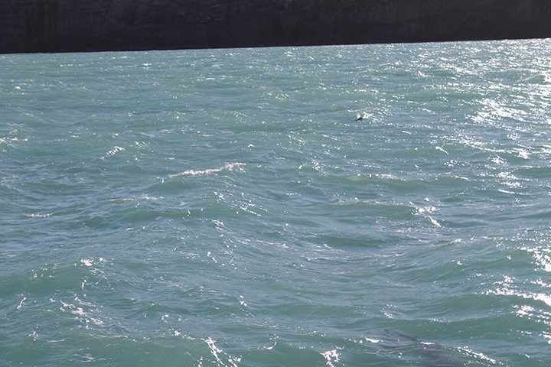
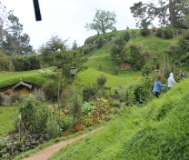
How it works continued…
4. Start the genetic algorithm
Generation 1: Array of 40 children
Fill all children will tiles images
Original
Children (40)
For each tile:
OriginalRed-Child1Red = RedScore
OriginalGreen-Child1Green = GreenScore
OriginalBlue-Child1Blue = BlueScore
RedScore + GreenScore + BlueScore = TileScore

Slide 5
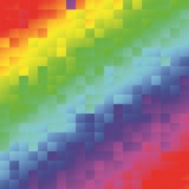
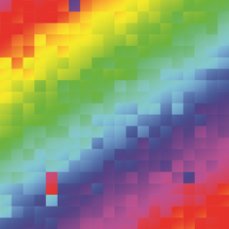
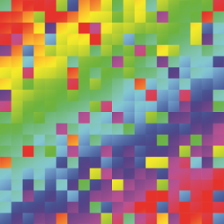
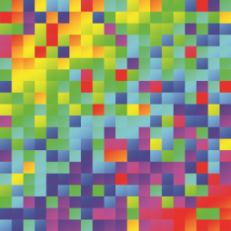
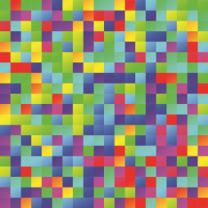
All TileScores for every tile in one child are added
Each child in the generation has a score
Order children from best to worst
Original
Children
Split children into four groups of 10
Group 1 with best scores and Group 4 with worst

Slide 6
Group 3 → Group 4 = New Group 4
Child A Child B = New Child B
1
4
0
3
2
5
4
1
0
2
5
3
1
4
0
3
5
2
Group 2 → Group 3 = New Group 3
Group 1 → Group 2 = New Group 2

Slide 7
Group 1
Keep only if the match at the current square is good enough
Randomly swap bad matches with each other
After rearranging tiles → re-compute scores

Slide 8
Exceptions
Recommendations if the images uploaded are not very good
Progress bar while the algorithm is running
Allowing the user to stop the algorithm at any time
+
= Need more blue and purple images

Slide 9
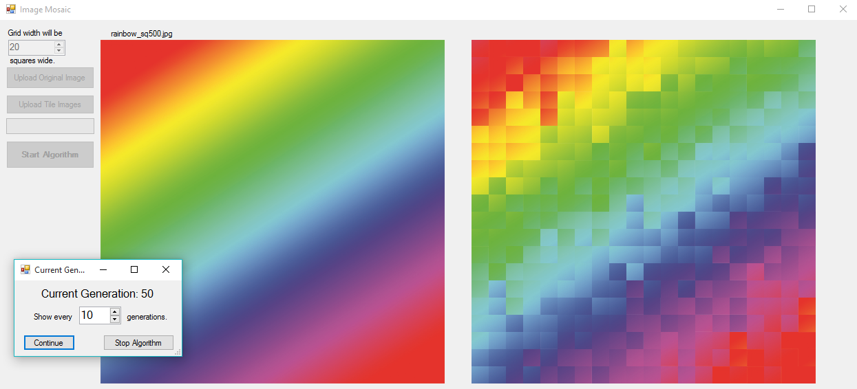
Methodology
Looking at how other software creates image mosaics
Researched genetic algorithms
Started with small experiments
Cropping of original image
Chopped into 3X3 grid and displayed each one
Small generation, small number of tiles

Slide 10
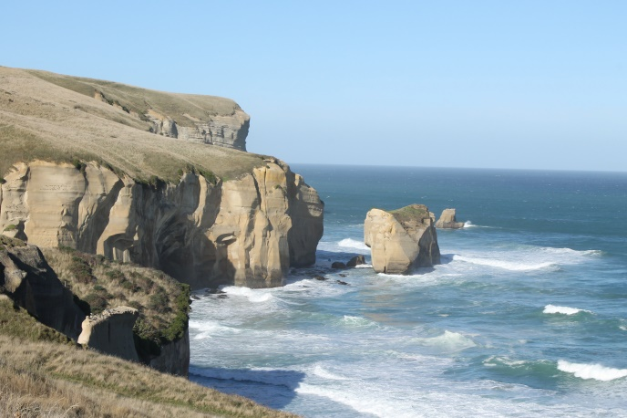
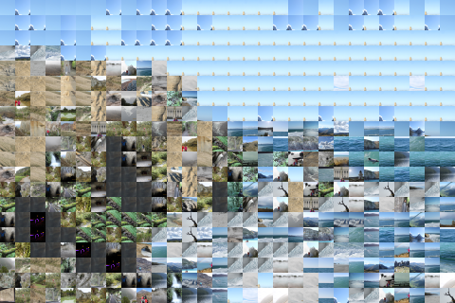
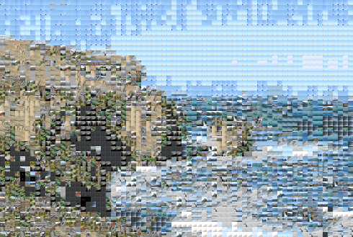
Demo

Slide 11
Learning and Helpful Concepts
MSDN
Stackoverflow
YouTube
Using a small program to test short pieces of code
Sorting of arrays
Using multidimensional arrays, structs, file streams
C# and Windows Forms(CS 350)

Slide 12
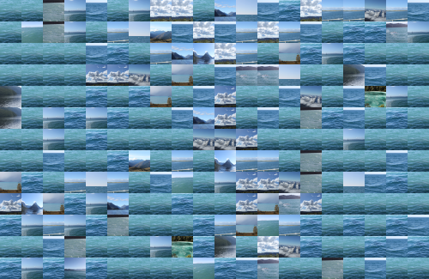
Next time!
Allowing for rectangles or squares as tiles
Using premade tiles
Higher resolution of final image

Slide 13
Advice
Debug and test the application often
Keep a working version

