Slide 1
TWITTER TAG CLOUDS:
A Story of Mutants Who Aren’t Superheroes
Chryssy Joski

Slide 2
In a world where...
… everything starts in chaos…
… randomness is the rule…
… bad chromosomes never see the light of day…
… and good chromosomes are killed at random…
… genetics and mutations are the only hope to make the next generation better…
...and when the future is controlled by one mad computer scientist,
what does it hold?

Slide 3
It’s not the apocalypse… it’s just Twitter.
Definition of project: “Build a tag cloud that represents the ‘theme’ in a large collection of tweets.”
Two main components:
Access, process, and store trending topics on Twitter
Develop a Genetic Algorithm to display a Tag Cloud of data gathered from Twitter

Slide 4
Let’s define some concepts
Tag Phrase
A Tag Phrase is the word or collection of word that make up a single element in the tag cloud. Examples include #WomenInSTEM, computers, and Ada Lovelace.
Tag Cloud
The assembling of Tag Phrases into a graphical rendering. Tag clouds usually reflect the popularity of its Tag Phrases with a visual cue (size, color) and are usually tightly knit so as to resemble a cloud
Genetic Algorithm
A series of steps to produce an optimized solution through mixing elements and mutating those elements as required.
Chromosome
A collection of individual elements in the genetic algorithm. For example, a chromosome could be one layout of all of the tag phrases (the individual elements).
Notes:
These are terms I will be using as I continue the presentation

Slide 5
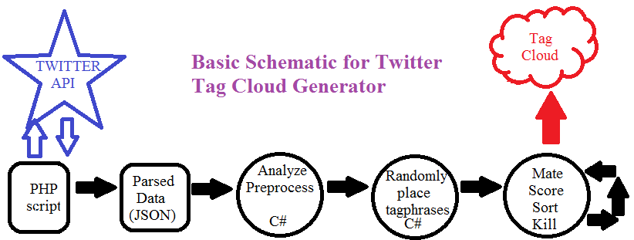
Method to my Madness (an overview)
Step 1: Gather Data from Twitter
Step 2: Process Data in C#
Step 3: Analyze, Mate and Mutate
Notes:
Gather data from Twitter: access Twitter API for top trending topics for a specific region (the US)
API accessed through PHP script; data brought in using JSON (JavaScript Object Notation)
PHP script parses the JSON object, clears out unnecessary information, writes to data file
Process data
Using class I made, stores Tag phrase and volume.
Using volume, determines font size, stores in class.
Draws tag phrase to screen, counts pixels that word uses, stores in class
Draws a bunch of random configurations of tag phrases (each config. Is a chromosome)
Analyze
Mates by mixing top half of one with bottom half of another
Scores each chromosome based on overlap and proximity
BUBBLE sorts based on score
Randomizes for diversity in gene pool.
If too many, kills extra.
Repeats.

Slide 6
Exceptions (aka: Evolution takes a long time)
Efficiency:
A genetic algorithm is not the most efficient way to build a Tag Cloud. Random location generation takes a long time to find an optimized cloud.
Breadth-first search style method would be more efficient.
All Negative Chromosomes:
I did not develop an algorithm that handles making bad chromosomes good. With a large dataset, sometimes there are no good ones at all and I do not account for mutating bad ones.
Large(r) Data:
Trending topics do not have much data associated with each topic.
More data can be gathered by gathering information on one person or topic.
Notes:
I have not run this to completion for a completely optimized tag cloud; it would take about 10 days to run 1000 generations as programmed. Not efficient; partially my code, partially the method. Spiral method would be faster.
This particular API doesn’t provide much data for each tag phrase. APIs for a particular person or topic are inherently richer for large data analysis.

Slide 7
Demonstration
Examples of my Tag Clouds
Notes:
Three examples:
Overlapping cloud
Non-overlapping cloud
Product of Wednesday’s run
Leave slide show to show one-gen run with mouse clicks for volume

Slide 8
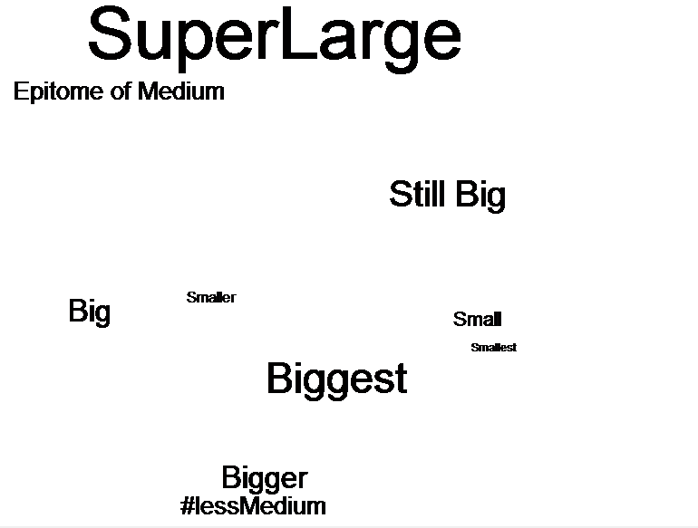
Non-Overlapping
Tag Cloud

Slide 9
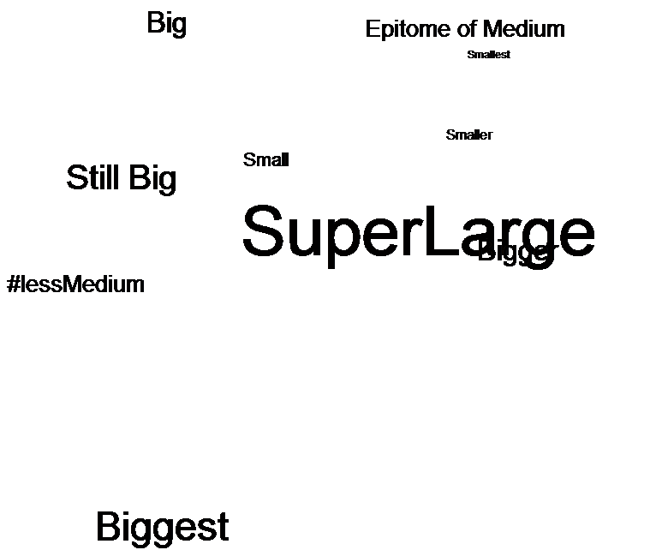
Overlapping
Tag Cloud

Slide 10
Tag Cloud of data from Monday-Wednesday
Notes:
After this slide, leave slideshow to demonstrate Thursday’s one-gen run with mouse click option for volume

Slide 11
Learning & Development
How I became a mutational mad scientist

Slide 12
Mutating my brain: Strategies for Learning
Where:
How:
MSDN
MSDN has great resources. Amazing resources. Just make sure you are looking at the correct language for examples.
Sample Code
None of our projects are assigned in a vaccuum. There will be code similar to what you are working on somewhere online. Github and personal blogs are great resources.
Professors/Peers
We all have our strengths. We all see things differently. No one person (peer or professor) will know everything to solve it, but they are sounding boards.
Blogging
Seriously.
Writing about a problem helps solve it. By identifying & articulating the issues, solving it becomes easier.
Reading
Read about your challenges. Don’t just skim sample code to see if it fits. It may not fit exactly, but if you read it closely, you may learn something valuable.
Trial & Error
Do not be afraid to make mistakes. But when you make them, learn from them.
Notes:
MSDN: full descriptions of tons functions, objects, and all kinds of built-in things. AWESOME.
Sample code: in my reasearch, I should have heard warning bells when I found tons of tag cloud generators, but absolutely no genetic algorithms.
People: Thank Jordan here.
Reading: like Sample code. It exists for a reason.
T&E - don’t sit all afraid. Just do it. Take a chance. But save before you screw stuff up.

Slide 13
Where my Madness Came From...
Elementary Data Structures
Making my own class
Accessors & Mutators
Object Oriented Programming
Programming Languages
Writing PHP scripts
HTML
Event Programming
Writing in C#
Graphical Data Rendering
Theory of Computation
Understanding efficiency
...and other classes
Notes:
Other classes: 110 (sorts, loops, randomizing)
Applications of Discrete Systems: logic

Slide 14
We Can Rebuild This Project.
We Have The Technology.
You Can Make Your Project Better Than It Was.
Breadth-First Search
Don’t use a genetic algorithm for a Tag Cloud.
Use a BFS based algorithm.
Use a Different API
Not enough data with trending topics
Use one person/entity or topic.
Talk to People
Don’t program in a bubble.
Talk to professors, peers, friends.
A B C … or C A B?
Don’t be afraid to work out of order.
Touch all parts as early as possible.
Notes:
Rebuild it: How to improve this project… how to rebuild it.
You can make it better: Tips for future seniors

Slide 15
Thanks!
Any questions?
My project website is:
http://compsci02.snc.edu/cs460/2016/joskch/

Slide 16
Credits
Special thanks to
Presentation templates and images by SlidesCarnival
Dr. Pankratz and Dr. McVey for their guidance
Jordan Henkel for being such a good sounding board and for his help getting my API script working
Joel Joski for keeping my kid out of my hair
Pam Joski for (also) keeping my kid out of my hair
Ginny Joski for being so good about staying out of my hair

