Slide 1
HealthQuest
A Health Tracking Game
By Shelby Kirn

Slide 2
The Assignment
The task: “Develop a game that uses and integrates health data from a mobile device and presents challenges and rewards based on the player’s current health state.”

Slide 3
The Solution
Step One: Learn Java
Step Two: Make an app

Slide 4
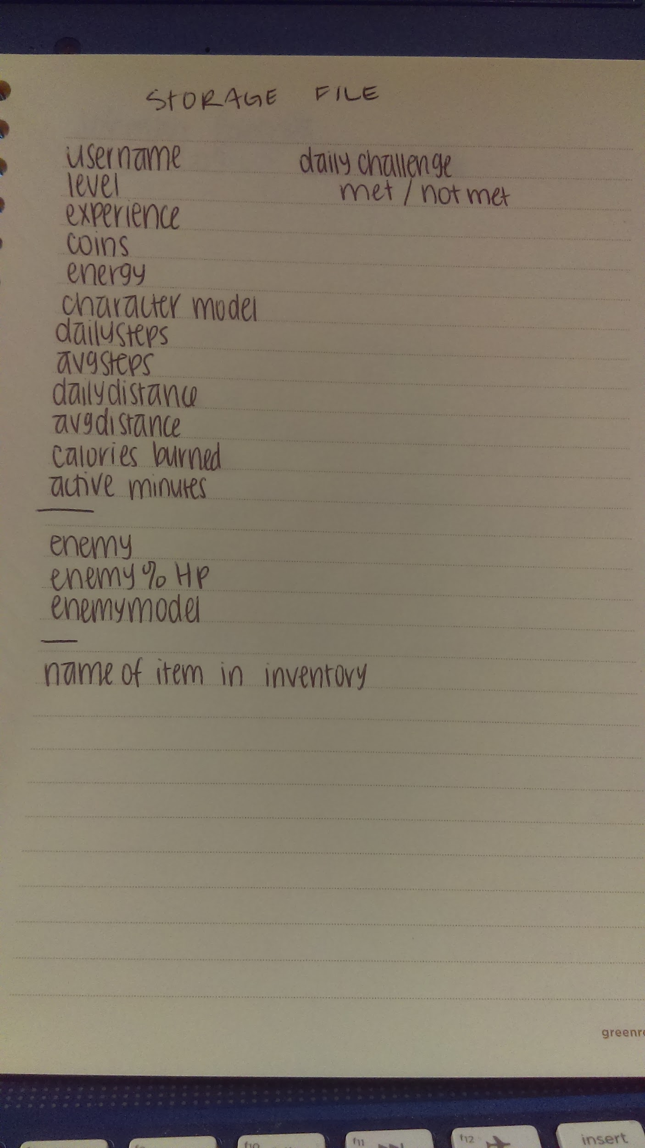
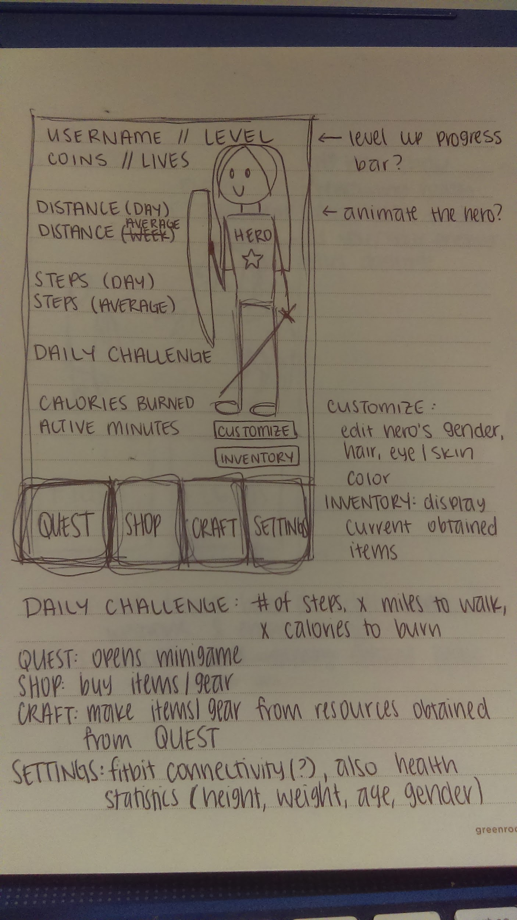
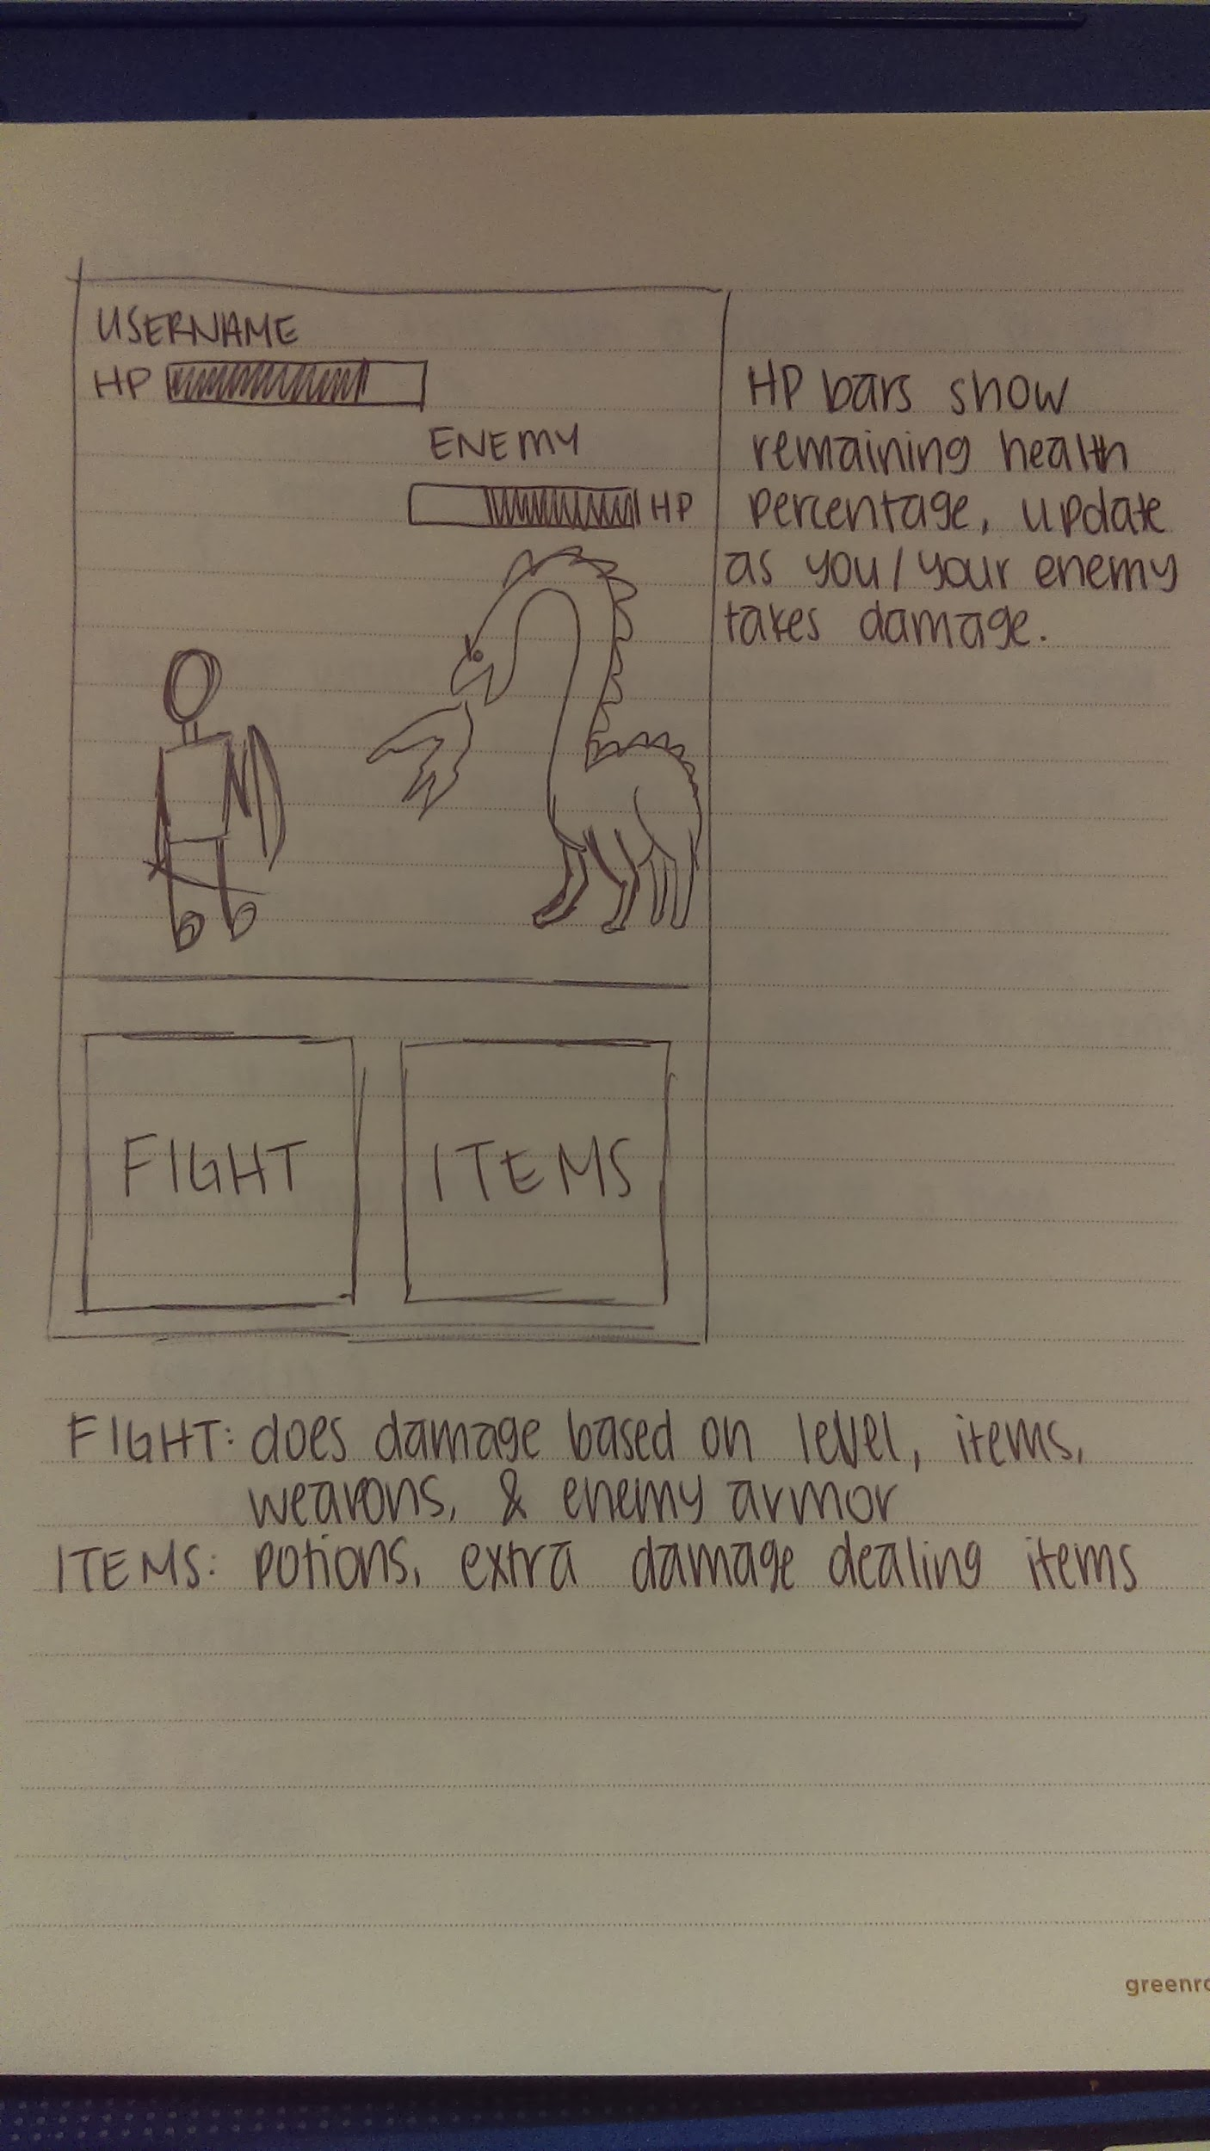
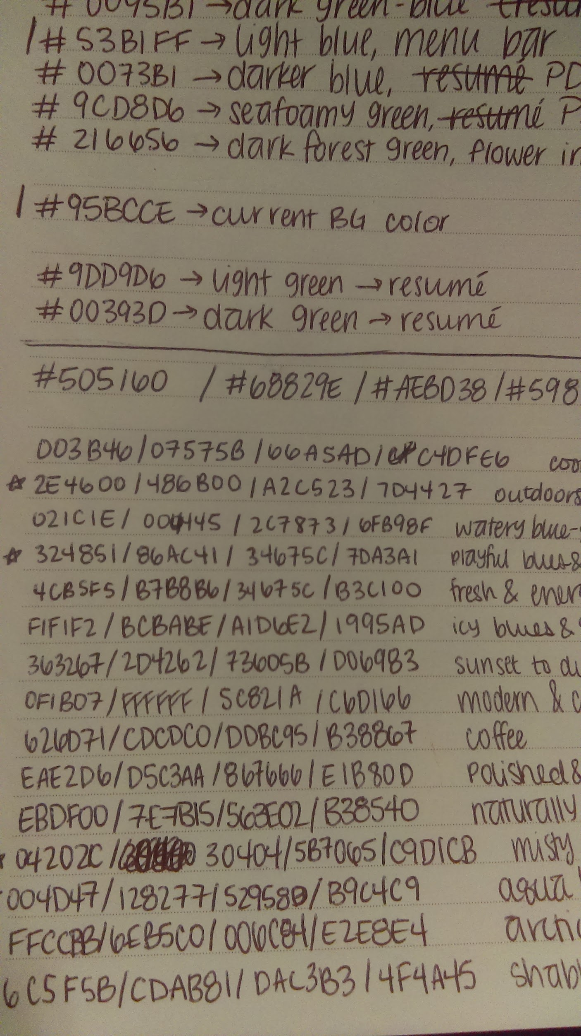
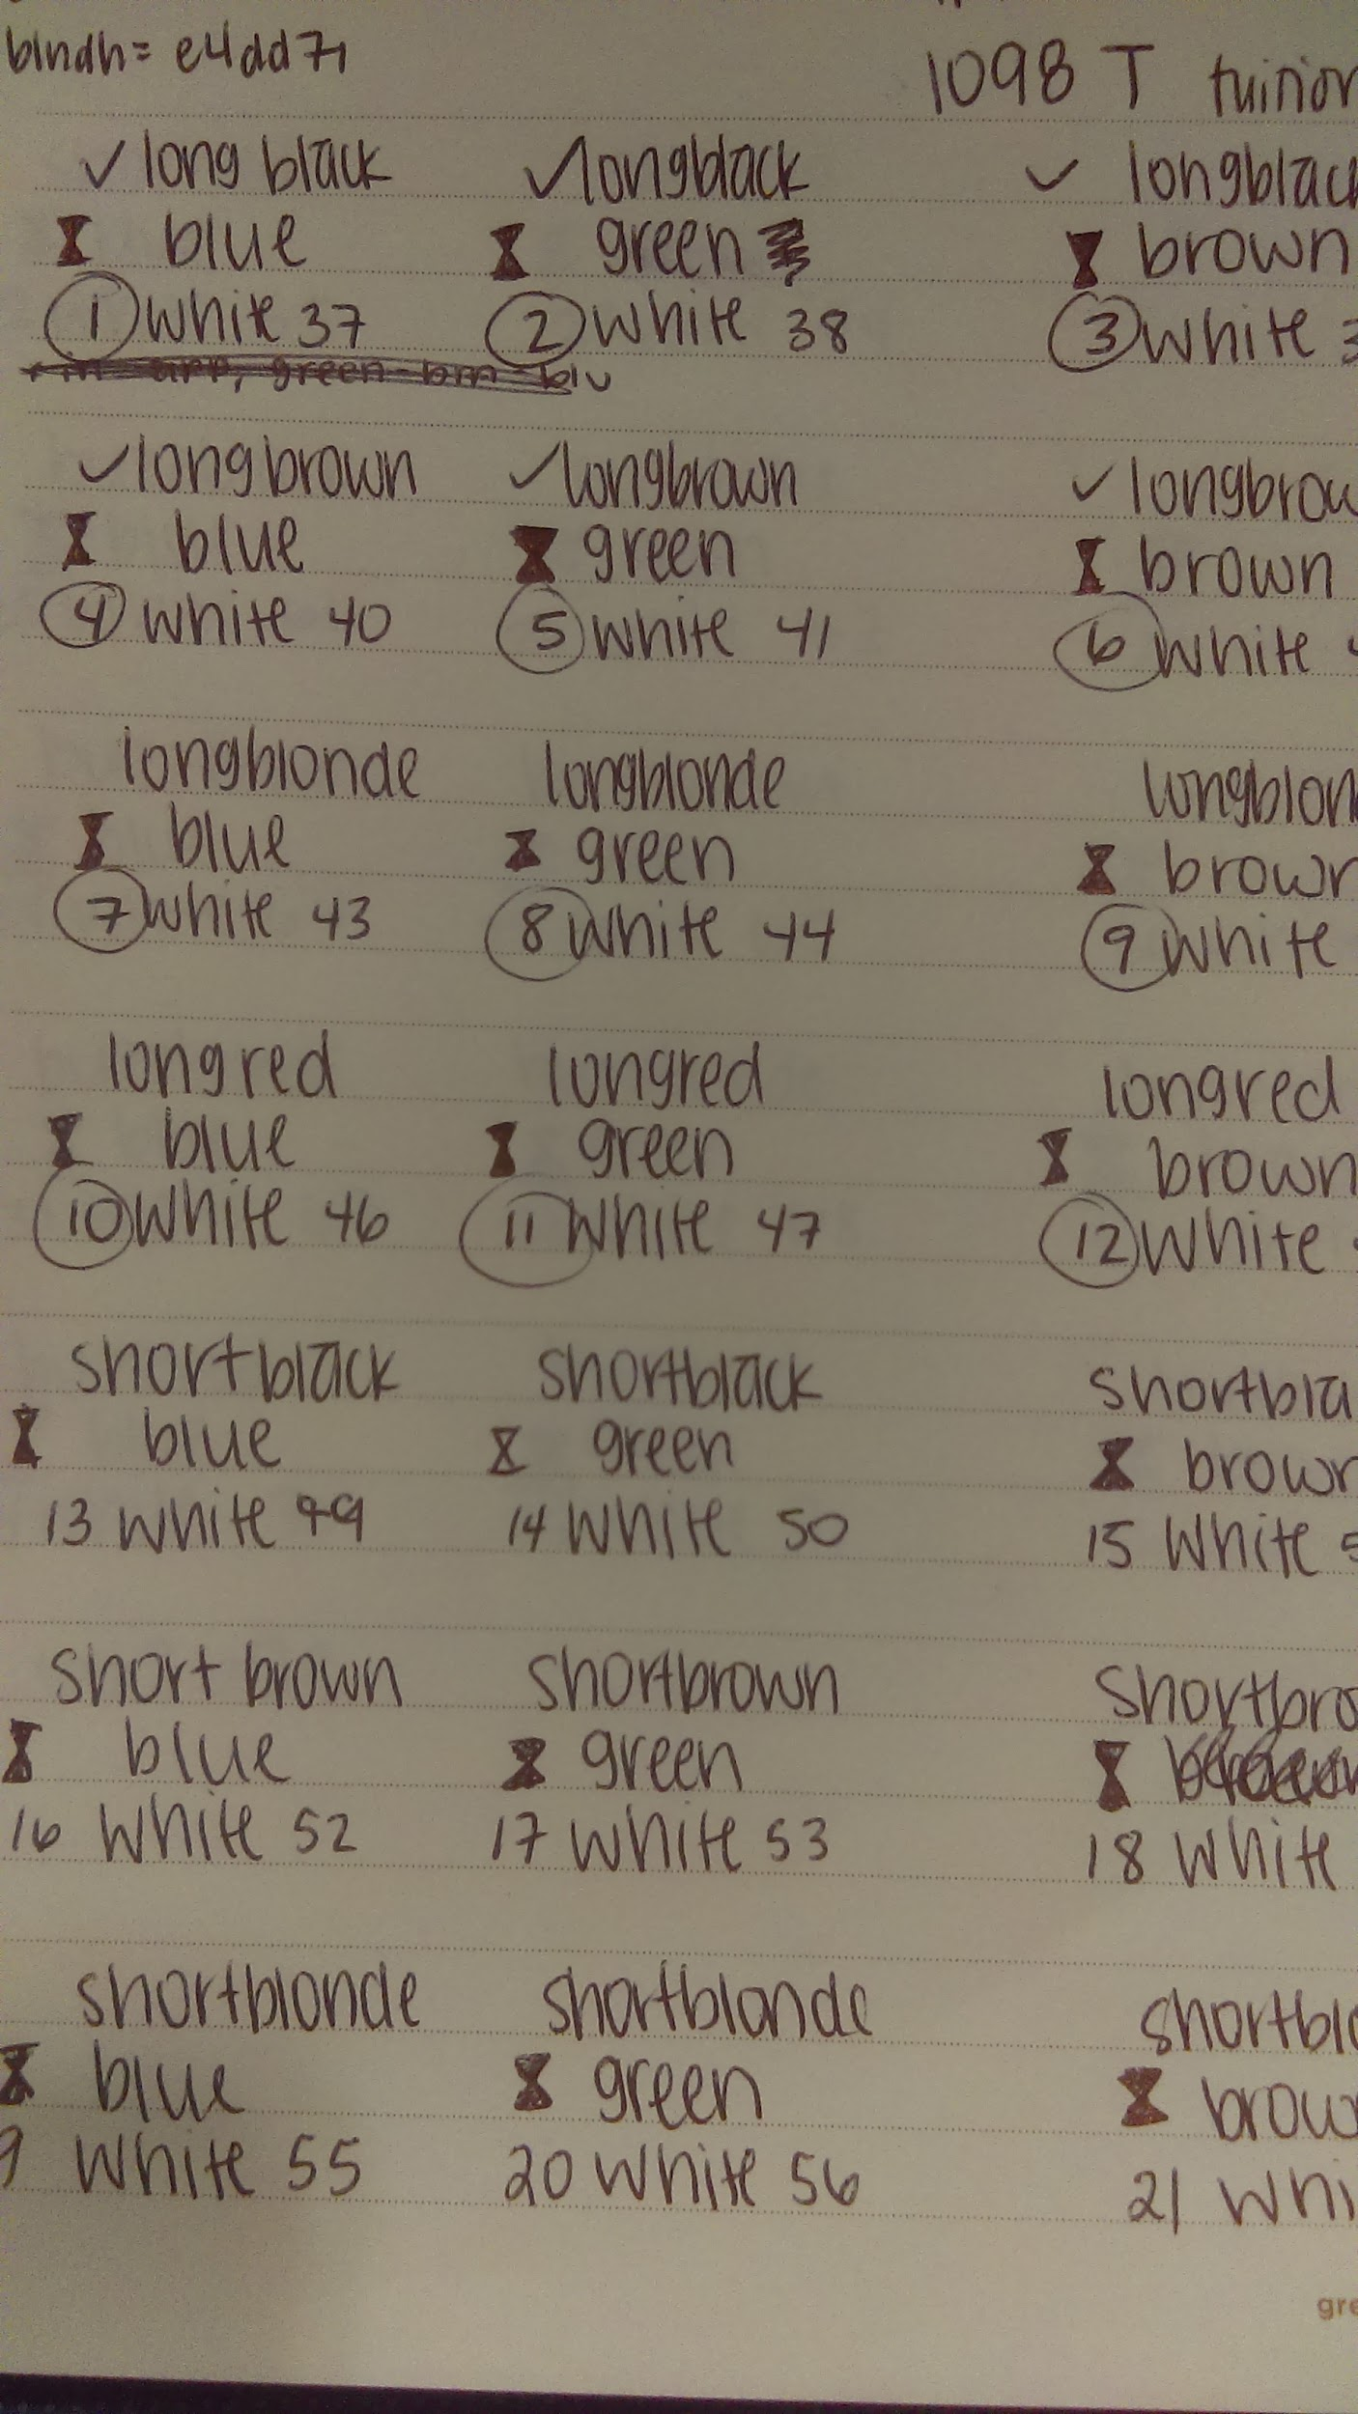
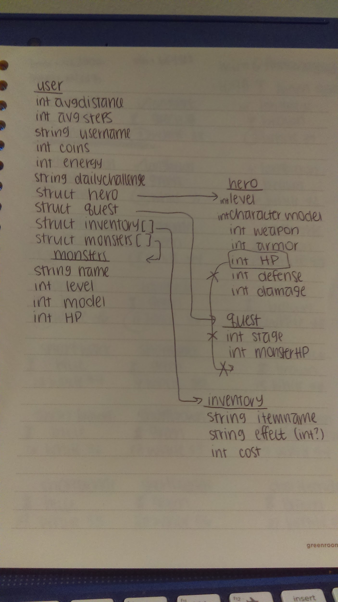
Requirement #1: Design the game

Slide 5
Requirement #2: Determine the type of data and how to obtain them.

Slide 6
Requirement #3: How is a score determined? When?

Slide 7
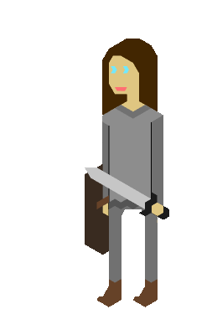
Requirement #4: Develop a “fun” player interface

Slide 8
Requirement #5: The platform should be mobile or mobile-friendly

Slide 9
What didn’t I solve?
daily reset isn’t automatic
doesn’t run in the background
doesn’t automatically update steps
no notifications

Slide 10
Time to show off!

Slide 11
Strategies
Save your backups
Fully understand what you’re putting in

Slide 12
Knowledge
CS 350 - Event Programming
Udemy
stackoverflow

Slide 13
Extensions
In general:
More statistics (calories burned, amount of time spent being active, time spent in the app)
On mine:
PvP?
items crafting system

Slide 14
Advice
Do not be afraid of your project
Set goals

