Slide 1
Animating Climate Trends
By: Danielle Perszyk
April 26, 2017

Slide 2
The Requirements
Research different available climate data sources and file formats.
Prepare data for illustration.
Use visual attributes to describe the characteristics of the data such as value and rate of change.
Illustrate the data for a calendar year.
Illustrate the data for the same month (perhaps day) over a period of years.

Slide 3
Organizing the Data
Where I cry because there’s too much data and not enough data, all at the same time.

Slide 4
Where Is the Data From?
First, I tried NOAA (National Oceanic and Atmospheric Administration)
Data was inconsistent – too many stations didn’t report data
Next, I landed on Dark Sky
Gathers the same data that weather channels use

Slide 5
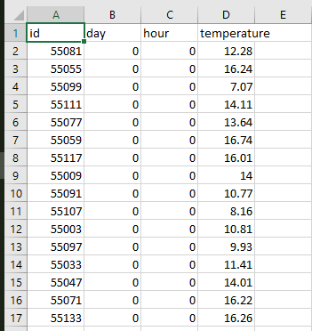
How Did I Use the Data?
Made calls to the Dark Sky API
Used Mongo Database (noSQL)
Each WI county == one collection
Each day/hour combination per county == one document
Using Python, get data from database, write to csv (comma separated) file for each different type of climate data

Slide 6
The Map
The part of this project where I learned my second new language of the semester.

Slide 7
Vega
Vega is a visualization grammar
From Vega’s site: “With Vega, visualizations are described in JSON, and generate interactive views using either HTML5 Canvas or SVG”
TopoJSON data for displaying WI map and county borders
Signals are variables that are updated after being triggered, by, for example, user input
Data is transformed in order to be displayed in the correct color

Slide 8
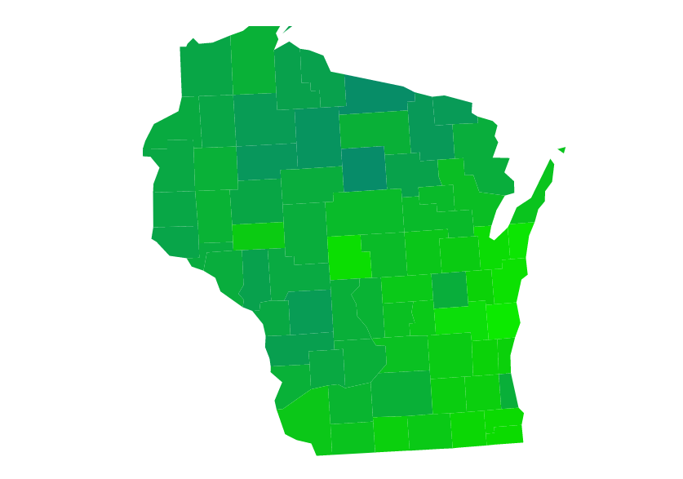
“Prettifying” the Visualization
Initially started with just day changes, wasn’t fluid enough
Went to hour-by-hour data
Added Vega transitions between each visualization update
Adjusted colors to better show changes between
Increased interval speed

Slide 9
And Finally, the Time Dilemma
The most horrible part of this project.

Slide 10
Compression and Splitting
Gzip – compress files (server-side) before they’re sent over the wire
Slight load time decrease
Split into 3 files, one for each climate property type
This significantly sped things up

Slide 11
The Exceptions

Slide 12
What I Did Not Do
Did not implement the ability to compare years
Every Dark Sky API call cost me actual $$$ ☹

Slide 13
Methodology

Slide 14
Start with what you know…

Slide 15
Start with what you know… And then Start Over.

Slide 16
Be Willing to Change
Started With:
Ended With:
Google Maps
NOAA Data
JavaScript front-end
Intended to use Java
Vega
Dark Sky API data
JavaScript front-end
Python for Data Transformations

Slide 17
The Demonstration
Time to show off!

Slide 18
Learning and Development

Slide 19
Techniques
StackOverflow
Vega Documentation
Ask Jordan Henkel

Slide 20
CS Concepts
CS 220, 205
Classes and Structs
Used for storing and manipulating the data
CS 322
Programming Languages – I learned a ton!
JavaScript, JSON-ish stuff, etc.
CS something…
When we learned about files! (So many files…)

Slide 21
Extensions
Allow file uploads
Allow different data “types”
Allow user changes such as color/scale
Decrease initial load time
Show year comparisons side-by-side

Slide 22
Advice
Start week one quickly, every week slow down a little bit
At the end, you won’t have much to do!
Ask others for advice – both CS and Non-CS people!
Show off – Have someone look at your project when you accomplish something, it feels good

Slide 23
Questions?

