Slide 1
Speech To Music
Chance Browning
Spring 2018
Notes:
*Give thanks*

Slide 2
Project description
Build a Songify type application that also allows stretching/shrinking the speed of the song to match a section of a speech
Notes:
Songify is an application that take a voice file and have it match that of a music file – essentially make the users voice go higher and lower in pitch with the music.

Slide 3
Requirements
Visualize both sound files
Implement a pitch detection algorithm
Consider using a phase vocorder to separate out pitch and speed from an audio file
Develop an editor that can make a time snippet in the speech file and another time snippet in the music file. The speed will be adjusted so the speech snippet fits into the music snippet and the pitches adjusted accordingly
Create short cuts and “help” features such as zoom and copy/past for the editor
Implement save, open, ect.
Notes:
Here are the general requirements

Slide 4
Completed Requirements
Visualize both sound files
Implement a pitch detection algorithm
Consider using a phase vocorder to separate out pitch and speed from an audio file
Develop an editor that can make a time snippet in the speech file and another time snippet in the music file. The speed will be adjusted so the speech snippet fits into the music snippet and the pitches adjusted accordingly
Create short cuts and “help” features such as zoom and copy/past for the editor
Implement save, open, ect.
Notes:
*Read requirments completed*
I did get a zoom feature to work which I will show in the demo but didn’t have a great use for it.
First got project from prankratz – didn’t know sound terms
Havent talked about / used this stuff since I was in high school

Slide 5
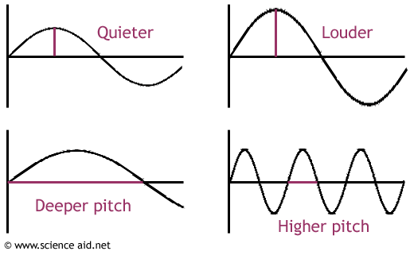
Beginning Research
Sound Wave Terminology:
Frequency: The measure of the number of wave cycles (vibrations) that occur in one second. Measured in Hertz (hz).
Pitch: The quality that makes it possible to judge sounds as “higher” and lower.” The frequency of a sound wave is perceived as pitch.
Amplitude: volume of a sound wave is proportional to the amplitude of the sound wave.
Notes:
Main terms that I will be using
Frequency – the number of times a sound wave “wiggles” per one second
that number signifies the amount of hz
Middle C = 261 hz
Pitch – how we precieve frequency
what makes it possible to judge higher frequency and lower frequency sound wave
higher frequency means it has a higher pitch
talk about pitch when talking about octaves
Amplitude – volume
TRANS So know that I know the terms, their definitions and how they relate to another, now how do I (how does it) translate this stuff to the digital world. Well with sound files, but which sound file type do I use?

Slide 6
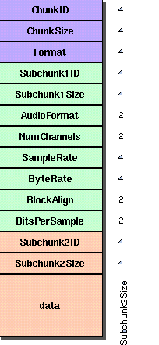
What is a WAV file
Using .wav files instead of mp3
Mp3 is a compressed wav
Wav has raw data
Comprised of two parts
Header
Data
Read data from a wav file into arrays
Byte -> Float -> Complex
Source: http://soundfile.sapp.org/doc/WaveFormat/
Notes:
It wasn’t too hard for me to decide on using WAV files. Wav files are uncompressed “raw” data. Where as Mp3 (the most common sound file) is compressed and thus loses data/cuts data out. I do not want that I want all the data I can get.
Mp3 – about size
Wav – data
So what is a wav file? - Comprised of two parts
*talk about the picture* - describe the wav file
Important things to note are the Sample Rate (44100 samples per second)
Bits per sample - 16
Blue RIFF chunk descriptor
chunk size – sample rate and bitspersample
format – influences the bottom two chunks
Green format sub chunk – describes the format of the sound information in the data sub-chunk
Orange(ish) data sub chunk – indicates the size fo the sound information and contains the raw sound data
TRANS I have decided the type fo file to use how do I visualize the files - first requirement

Slide 7
Seeing the waves
Naudio.WaveViewer
Amplitude and Time axis
Notes:
Visualizing the files is made really really easy with this an open sourced library called Naudio (which I used a lot)
Here you can see some sound waves and this is how they will look in my application
This is an amplitude and time axis – the taller the louder
First one is a file recorded from a microphone
Other is a song prodecued in a studio – altered
TRANS Now that I am able to see these files – how do I get at their data, how do I mess with it?
WARNING: if you are afraid of math just don’t look at this next slide

Slide 8
Detecting Pitch Using Fourier Transform
$$ReX\left[k\right]=\sum_{i=0}^{N−1}{x\left[i\right]\cos\left(\frac{2πki}{N}\right)}$$
$$ImX\left[k\right]=−\sum_{i=0}^{N−1}{x\left[i\right]\sin\left(\frac{2πki}{N}\right)}$$
$x[i]$: signal being possessed, in a time domain
$N$: total number of sample points
$ReX\left[k\right]$ and $ImX\left[k\right]$: frequency domain signals
$0≤i≤N−1$: all of the samples
$0≤k≤\frac{N}{2}$ : first half of samples
Fourier Transforms – What is it?
What does it do?
What are the results?
Notes:
I will be detecting pitch using what is called a Fourier Transform
Essentially what it does is decomposing frequencies from sound
If you were to see the sound wave we would only see the final sound
A DFT will attempts to extract all of the signals that make up the final sound
And all a DFT is a summation of sines and cosines – sinusoidal wave
But first the input data –
When reading in the data of the wav files – a wav file is typically read in in bytes
Again using an Naudio method – I can read in the wav file data as a float
then convert float to a complex (imaginary part being 0)
Then (using MathNet ft) we pass that array though the ft
We take those values and pass them through our Fourier transform(the values are x[i])
We get a complex results (real and imaginary part: real being cos and img being sin)
One thing to note is that for every k we are going through all of the original samples
But, only need our Real and Imaginary parts to be half of the size
This is because of the nature of sine waves and cosine waves (2nd half inverse of the first)
The resulting array is now in the frequency domain where the index of the largest number in the array represents the loudest frequency
TRANS That may sound strange so we are going to go through a less math oriented demonstration of the transform
(IF Someone askes real and imaginary(which is actually a real number): FT provides us with amplitude and phase angle the amplitude is encoded as the magnitude of the complex number (sqrt(x^2+y^2)) while the phase is encoded as the angle (atan2(y,x))
Mainly used in recreateing the singal using the inverse)

Slide 9
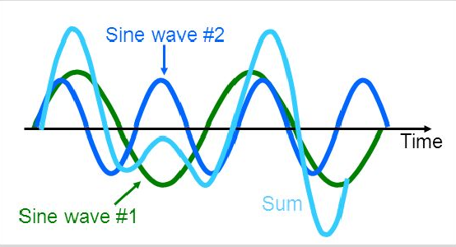
Detecting Pitch Using Fourier Transform
Fourier Transforms – What is it?
What does it do?
What are the results?
Source: http://slideplayer.com/slide/11575479/
Notes:
We have two sine waves green and dark blue
Their sum being the light blue wave – representing our sound wave
Our FT attempts to pull the green and dark blue wave from our sound wave
The green wave and dark blue wave have their own frequency – they are vibrating (wiggling) a certain number of times per second throughout the whole duration of the sound file.
They have their own unique frequencies
TRANS When we extract these waves and display them (theoritcally – I do not display them) in a frequency domain we will get..

Slide 10
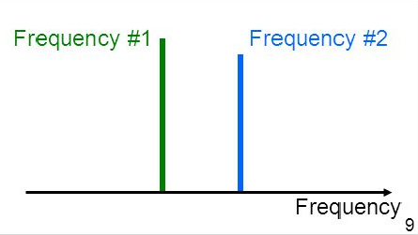
Detecting Pitch Using Fourier Transform
Fourier Transforms – What is it?
What does it do?
What are the results?
Source: http://slideplayer.com/slide/11575479/
Notes:
Something that looks like this
Notice how the x axis is in frequency not time
This is what I mean by the index of the highest value will represent the loudest frequency
(there would actually be a little bit of wiggling around the x axis)
So in my implementation I am taking the index of the largest value and using that as the frequency for that chunk of the wav file

Slide 11
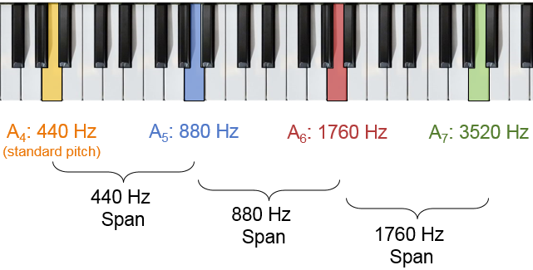
Shifting Pitch
Get the difference using Fourier Transform
Music frequency / speech frequency
Shift on the difference of the two
Pitch Shifting done within octaves
Logic for shifting by their difference
Source: https://community.plm.automation.siemens.com/t5/Testing-Knowledge-Base/Octaves-in-Human-Hearing/ta-p/440025?lightbox-message-images-440025=45687iB07D6A249CC1244A
Notes:
I get the frequency of the speech file and the music file using the FT
Then I will shift on their “difference”
originally I thought subtraction
needs to be division
My algorithm for shifting is done within octaves
Notice how going up an octave is just multiplying its hz by 2
Going down is multiplying its hz by 0.5
The most my alg. Shifts up or down by is an octave – which is why I need to divide the two frequencies
After shifting I write and display the shifted wav file
TRANS At this point, I think it is best just to go through a demonstration of my project

Slide 12
DEMO

Slide 13
Values of Tests
Chunks Per 1 Second
1 Total Chunk
Speech (Hz) | Music(Hz) | Shift Ratio
814 | 440 | 0.54
238 | 440 | 1.848
839 | 440 | 0.524
523 | 440 | 0.841
678 | 440 | .0641
Speech(Hz) | Music(Hz) | Shift Ratio
522 | 440 | 0.841

Slide 14
Strategies
Google
Stack Overflow (other forums about topic)
GitHub
Open Sourced projects
Be open for change of plans – Patient
Professors
Dr. Pankratz, Dr. McVey
Dr. Meyer
Make several test projects
Always end the night with something that works!
(2AM counts as night right?)

Slide 15
CS Concepts
Event Programing
Data Structures
Arrays
Programing Languages
Linear Algebra
Notes:
Event Programming – event handeling
Data structures - soo many arrays
Programing Languages – learning so many different langues and have to use them in labs
Linear Algebra – project about FFT

Slide 16
Extensions
Trim capabilities
Better Utilization of the Fourier Transform
Using more than just the loudest frequency
Inverse Fourier Transform
Utilize a phase vocoder

Slide 17
Questions?

