Slide 1
Paint By Number
Jade Heliin

Slide 2
Definition & Requirements
Definition:
Develop an app that creates a Paint by Number image from a user’s selected picture
Requirements:
Open existing image into application
Save image created to file for later viewing/printing
Specify number of colors to be used
User choose colors to be used in painting
Program choose colors present in the image to be used
Produce image containing only outlines of the regions to paint with the number of the paint to use in each region
Offer “complexity” option that allow experienced and young beginner artists to enjoy the app

Slide 3
SOLUTION
Take pixels one at a time and create cells with similar pixels
Calculate mean color for each cell
Merge cells with small amount of pixels
Merge cells with like mean colors
Merge until less than N cells
Merge until P colors
Processing pixels and their BGRA values

Slide 4
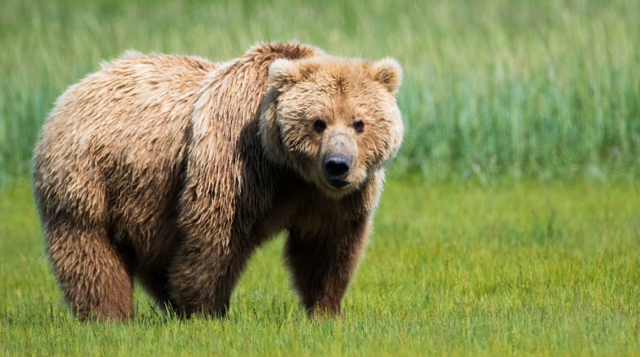
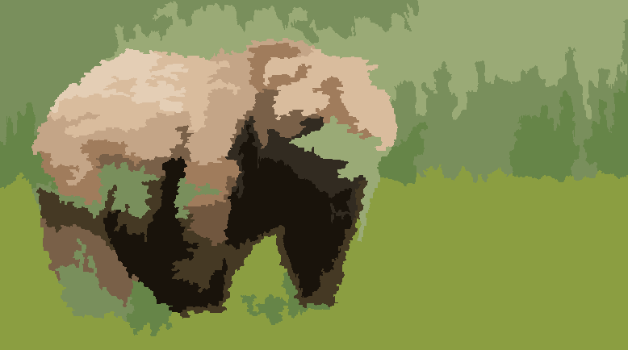
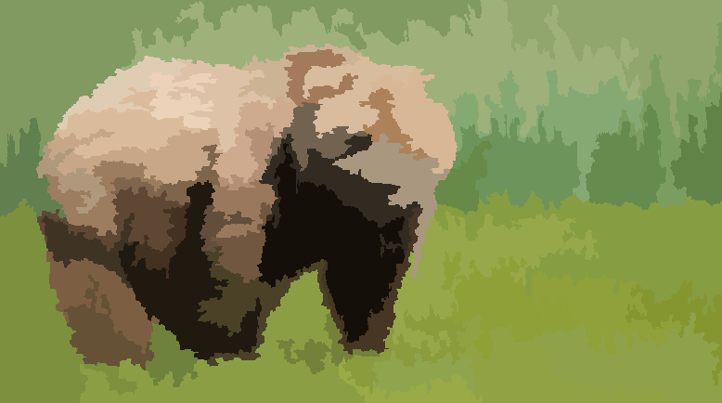
Solution - Processing Pixels and their BGRA values

Slide 5
Solution
Loop through all cells and find pixels on the edge and color
Get label locations for each cell and display over image
Edge detection and labeling cells in image

Slide 6
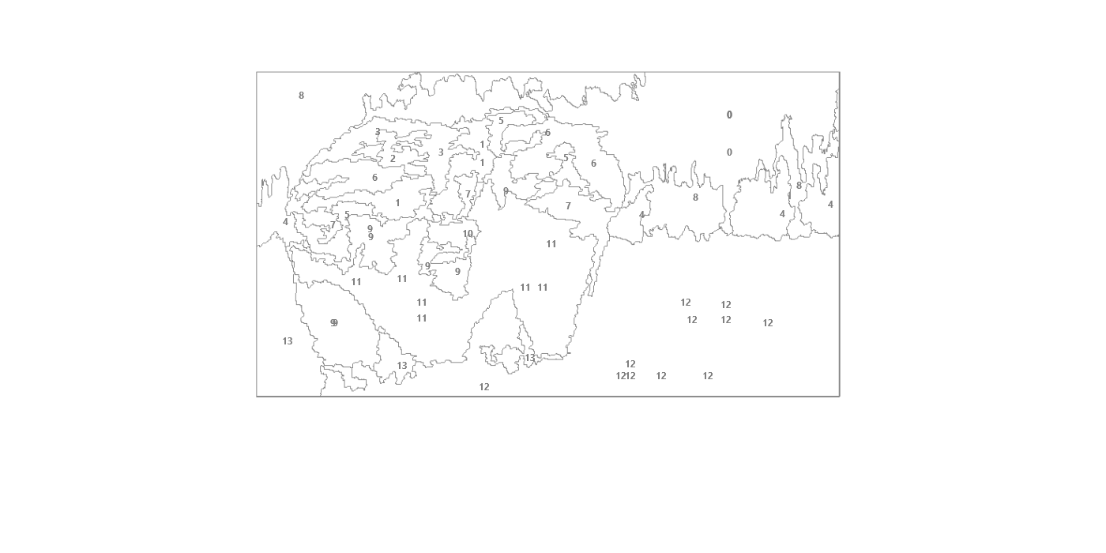
Solution - Edge Detection and Labeling Cells
Cell 0: B - 116 G - 172 R - 149
Cell 1: B - 139 G - 170 R - 202
Cell 2: B - 185 G - 210 R - 235
Cell 3: B - 171 G - 198 R - 222
Cell 4: B - 76 G - 134 R - 100
Cell 5: B - 92 G - 125 R - 162
Cell 6: B - 154 G - 186 R - 216
Cell 7: B - 124 G - 150 R - 172
Cell 8: B - 95 G - 153 R - 123
Cell 9: B - 63 G - 87 R - 110
Cell 10: B - 93 G - 120 R - 154
Cell 11: B - 21 G - 33 R - 41
Cell 12: B - 66 G - 160 R - 141
Cell 13: B - 60 G - 140 R - 121

Slide 7
Solution
Get button number clicked on
Selecting regions mapped to correct buttons
Updating image to include new cell colored
Selecting cell number from buttons and painting cells

Slide 8
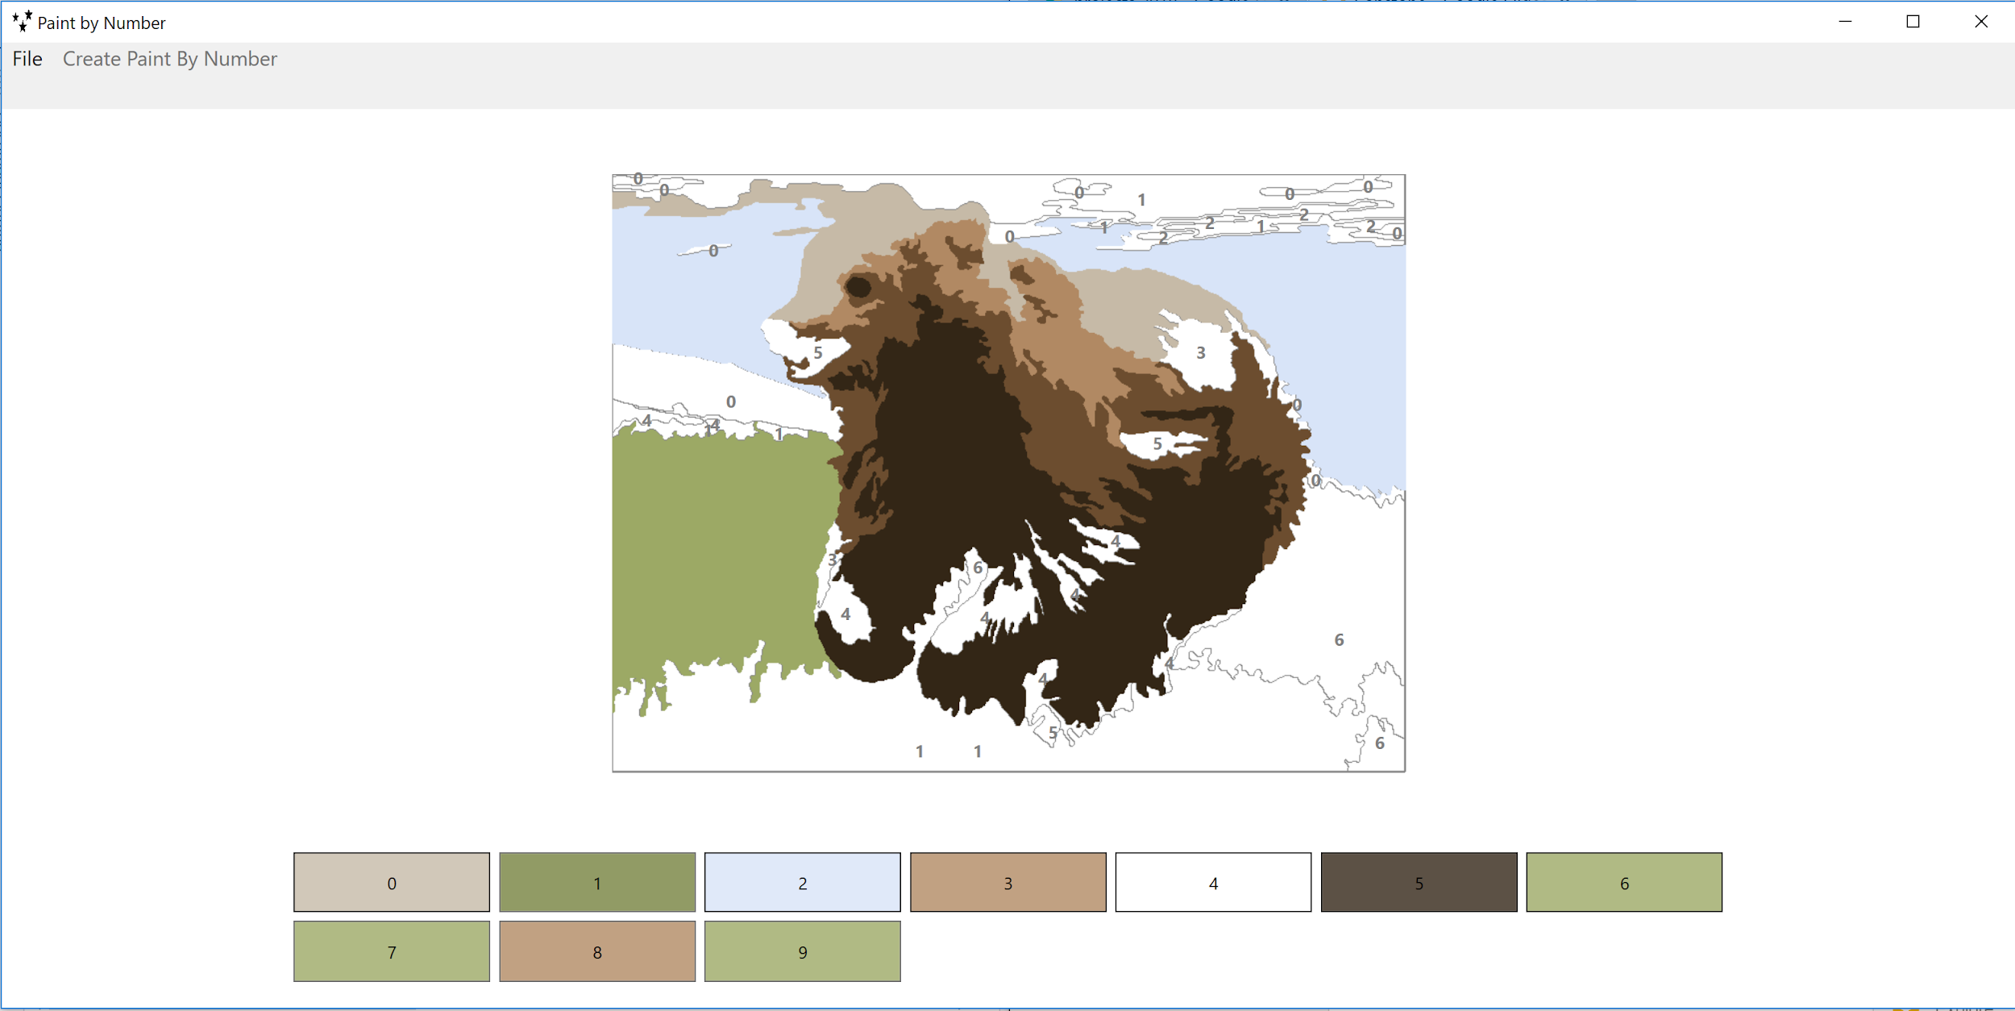
Solution - Selecting Cell Number and Painting Cell

Slide 9
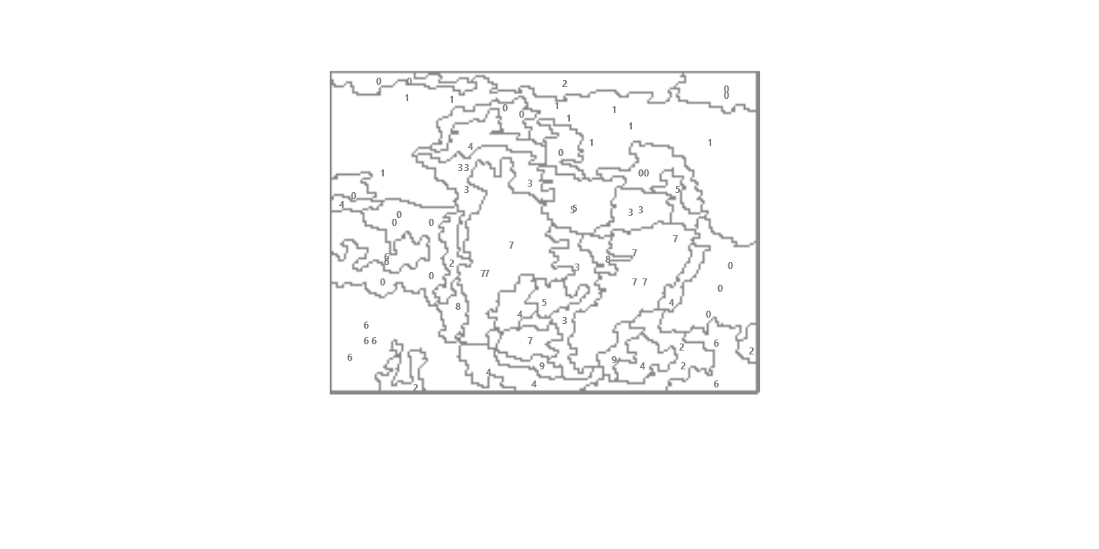
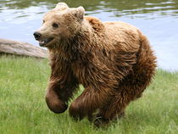
Exceptions
Labeling cells on image with numbers, same numbers for different regions, but they do not differentiate between neighbour cells
User can print and save, but the image is not blown up big enough with smaller cells
Images with lower resolutions make lower quality Paint By Number creations

Slide 10
DEMO

Slide 11
Strategies and Knowledge
The Profs
Stack Exchange - Processing pixels and creating cells
PBNify - Paint By Number web app, displaying color values
One step at a time, have each step working
Writing down algorithms, stepping through & debugging
With large processing, use background thread
Classes:
CSCI 321 - Analysis of Algorithms
CSCI 220 - Advanced Data + File Structures
CSCI 322 - Programming Languages
CSCI 350 - Event Programming
CSCI 350 - Event Programming

Slide 12
Extensions
Allow user to enter previously created Paint By Number and use the cell color file so they don’t have to create a new PBN
Allow the user to click on original image to select the exact colors they want
Have the user decide how many cells and how many colors to be used
Using a different strategy to get the number of colors wanted in image, more efficient, no randomization

Slide 13
Questions

