Slide 1
Image Reconstruction with Polygons Using a Genetic Algorithm
Andrew Burkart
Capstone Presentations – May 1st

Slide 2
Project Description

Slide 3
Overview
Genetic algorithms can be used to generate computer art.
The idea is to generate samples until the computer rendering closely matches the original image.
In this application, a collection of polygons of various sizes, colors, and transparencies are overlapped to create an image close the original.
Notes:
So, a little overview of my project.

Slide 4
Requirements
Use a collection of polygons to produce an image close to a chosen original image.
Use a genetic algorithm to find the best arrangement of polygons.
Graphically display the state of good fit genomes with appropriate statistics that show progress toward the goal.
The system should allow modification of parameters, operators, and probabilities.
Add your own parameters to the genome.
Explore various measures of best fit.
Save the best from some number of iterations.
Notes:
I pretty sure completed all the requirements except for maybe the last one. The application runs the genetic algorithm until the user tells it to stop. There is no option to have it stop after a certain number of iterations.

Slide 5
Solution

Slide 6
What is a Genetic Algorithm?
A genetic algorithm is a search algorithm inspired by Charles Darwin’s theory of evolution.
It reflects the process of natural selection where fitter individuals are selected for reproduction in order to produce offspring of which make up the next generation.
There is more information on Genetic Algorithms on my compsci04 page if you want to read a little more about them.
http://compsci04.snc.edu/cs460/2021/burkab/index.html
Notes:
**Read bullet points**
You did learn about genetic algorithms in Aldo’s presentation, but I want to talk about my algorithm.

Slide 7
Terminology
Individual – Set of polygons
Generation/Population – Set of Individuals
Notes:
Before I continue, I need to tell you some of the terminology that I use. An individual is a set of polygons, and a generation/population is a set of individuals. Depending on the genetic algorithm, generation and population may not mean the same thing. But for my algorithm, they are interchangeable, so if I say generation or population, I mean the same thing.

Slide 8
Steps of my Genetic Algorithm
A set number of random Individuals are generated, and a set number of polygons for each Individual are generated.
Individuals are selected for crossover.
Individuals are mutated.
After crossover and mutation, we have generation 1.
Steps 2 and 3 are repeated using the previous generation. This loops until the user tells the algorithm to stop.
Notes:
I am going to explain some of the steps in a little more detail in the next couple slides, but here is the general overview of the process. Not all genetic algorithms are created equally so these are the steps of my algorithm.
Step 1: A set number of individuals are generated, and a set number of polygons are randomly generated for each individual. Both of those numbers can be configured by the user before the algorithm begins.
Step 2: Individuals are selected from the current generation to reproduce to create individuals for the next generation. The method I use for selection is called Tournament Selection, and I will explain what that means in a couple slides.
Step 3: We have created individuals for the next generation, but we are not done yet. The individuals that resulted from crossover now need to be mutated.
Step 4: Now we have generation 1, which consists of individuals that were crossed over and mutated from generation 0.
Step 5: Steps 2 and 3 are repeated using the previous generation until the user tells the algorithms to stop. What I mean by the previous generation is that individuals, for example, from generation 3 are crossed over and mutated to create generation 4. They are not always taken from generation 0.

Slide 9
Single-Point Crossover
Mother
p₁
p₂
p₃
p₄
p₅
p₆
p₇
p₈
Father
p₁
p₂
p₃
p₄
p₅
p₆
p₇
p₈
The p_{i}’s represent polygons in the individual.
Notes:
This is how single-point crossover works. The first individual and the second individual are split at the same point.

Slide 10
Single-Point Crossover
Child
p₁
p₂
p₃
p₄
p₅
p₆
p₇
p₈
The first section of individual 1 becomes the first section of the new individual, and the second section of individual 2 becomes the second section of the new individual.
Notes:
The first section of the mother becomes the first section of the child, and the second section of the father becomes the second section of the child. The individuals do not need to be split in half; they can be split anywhere. Where the individuals are split is decided by the user. In the application, the user is prevented from picking a crossover point at the beginning or end of an individual.
**Point at the beginning and end of the individual on the board**

Slide 11
Multiple-Point Crossover
Mother
p₁
p₂
p₃
p₄
p₅
p₆
p₇
p₈
Father
p₁
p₂
p₃
p₄
p₅
p₆
p₇
p₈
Notes:
This is how multiple-point crossover works. Polygons from the mother and father are randomly selected to be added to the child.

Slide 12
Multiple-Point Crossover
Child
p₁
p₂
p₃
p₄
p₅
p₆
p₇
p₈
To determine if a polygon is going to be taken from the mother or father, a random number on the interval [0, 1) is generated.
Notes:
To determine if a polygon is going to be taken from the mother or father, a random number on the interval [0, 1) is generated. If the random number if less than 0.5, then the polygon is taken from the same position from the mother, otherwise it is taken from the father. This means the child is not necessarily going to consist of an equal number of polygons from its mother and father.
The user gets to pick whether the algorithm uses single-point or multiple-point crossover.

Slide 13
Tournament Selection
Tournament selection is how the algorithm chooses parents for crossover.
Individuals are chosen from the current generation to be parents for crossover ”randomly”.
A set of individuals (a tournament) are randomly chosen from the generation. The fittest individual of the tournament wins the tournament and is selected for crossover.
Tournament selection is done twice per crossover event to select two parent individuals for crossover.
Notes:
Tournament selection is how the algorithm chooses parents for crossover. Choosing parents is technically random but fitter individuals have a much higher chance of being of being selected over the lesser fit individuals because they are more likely to win the tournament. Tournament selection is done twice per crossover event to select two parent individuals for crossover.

Slide 14
Mutation
For each polygon in an individual, a random number in [0, 1) is generated. If the random number is less than the mutation chance (which is set by the user), the polygon is mutated. Mutation of a polygon consists of moving each of its points slightly and changing its color.
Notes:
During mutation, for each polygon in an individual, a random number between 0 (inclusive) and 1 (exclusive) is generated. If the random number that is generated is less than the mutation chance, the polygon is mutated. The mutation chance is another parameter that is set by the user before the algorithm begins. Mutation of a polygon consists of moving each of its points slightly and changing its color slightly. Here is an example of mutation. The mutation chance for this example is 0.1 or 10% and r is the random number that is generated for the respective polygon. Generally, 10% is little high for a mutation chance, it is typically around 2-3%.

Slide 15
Mutation
Notes:
Polygon p_2 is mutated to p_new because its r was less than the mutation chance.

Slide 16
Fitness Function
The fitness of an individual is determined by the fitness function.
Pseudocode
fitness = 0
for(i = 0; i < imageWidth; i++) {
for(j = 0; j < imageHeight; j++) {
red = individual.getRed(i,j) – solution.getRed(i,j)
green = individual.getGreen(i,j) – solution.getGreen(i,j)
blue = individual.getBlue(i,j) – solution.getBlue(i,j)
pixelFitness = red² + green² + blue²
fitness += colorError
}
}
Notes:
I keep talking about the fitness of an individual, so I need to explain how the fitness of an individual is calculated. The Individual’s image is compared to the solution image via RGB values. The squares of the RGB values of a pixel are added to get fitness of the pixel, and then each pixel fitness is added to the total fitness. Because the fitness is calculated like this, a lower fitness it better.
This is a little pseudocode on how the algorithm calculates an individual's fitness. individual is the image create by the individual's polygons, and solution is the original image the user imported to the application.

Slide 17
Elitism
Mutation is random.
This often causes the algorithm to lose the fittest individuals.
This is where elitism comes in.
Notes:
Because crossover and mutation are used to generate the next generation, the algorithm risks losing the fittest individuals from the previous generation. This is where the concept of elitism comes in. The fittest individuals from each generation are kept and put into the next generation.
Elitism can be enabled or disabled by the user.

Slide 18
Data Flow

Slide 19
GUI
I wanted this to be a standalone application that users can download from compsci04.
I needed to create a GUI that allows the user to interact with the application.
My application is written in Java, so I used JavaFX, which is Oracle’s latest GUI platform.
Notes:
So that’s all you need to know about my algorithm. So now for the GUI. That’s Graphical User Interface for the people who don’t know what GUI means. You could relate JavaFX to android GUI programming. JavaFX uses FXML, which is pretty much XML, to control the layout of windows. Then a Java class called a controller controls when happens in the view generated by the FXML file.

Slide 20
Exceptions

Slide 21
Exceptions
Algorithm works better on simple images.
Standalone application issues.
Notes:
My algorithm works better on simple images. When I run the algorithm with more complex and detailed images, the algorithm doesn’t produce a super accurate image. It gets the average colors, but some of the details don’t show up in the generated image.
JavaFX did not make it easy to deploy the application. JavaFX is an open-source project from Oracle. Since JDK 11, JavaFX is not included in the Java Virtual Machine, it is a separate runtime needs to be downloaded separately. I think that seems too complicated for a user, so instead I can include a subset of the JVM with contents needed to run the application plus the JavaFX runtime. This way, the user doesn’t even need Java installed on their machine. But this method just created a new issue. I don’t really need to get into the details, but the user can’t just double click on the application, a zip file needs to be downloaded and the application run via the command line. The zip file for macOS and Windows 10 are on my compsci04 page, and there is also an instruction manual showing how you can run the application.

Slide 22
Methods

Slide 23
Methods/Techniques/Designs
I started of with simpler algorithms
Tests of the algorithm did not involve the GUI
Multiple scenes/windows are used
Using relevant/up-to-date libraries
Threads
Notes:
I didn’t want to just jump right into replicating images, as that gets very complicated. Instead, I started off with simpler genetic algorithms. The first algorithm I made that worked started of with a random string of characters and crossover and mutation were used to get the original string that the user entered.
I did not run the application from the GUI the whole time. I just used a command line application that printed out each generation’s fitness. I did start running it from the GUI in the beginning but having to enter parameters each time took too much time, so I hard coded parameters in and let it run on the command line. Obviously, I’ve tested the GUI, but to get the algorithm working in the first placed, I just used the command line.
I tried to use only one window for the application because I was having trouble sending data between windows, but I felt I was cramping too much information into one window, so I decided I needed to use multiple windows and to figure out how to pass data between them.
When I first learned Java GUI programming, I used Java’s swing library. Swing is still used today but it is showing signs of its age. Swing was first released in 1997. Believe or not, 1997 was 24 years ago, and technology has advanced a ton in that time. While Swing is still updated, I felt JavaFX would help me learn a more relevant technology.
Before I implemented threads, the algorithm was very slow.

Slide 24
Demonstration

Slide 25
Demonstration
https://www.youtube.com/watch?v=B3QSm3c6c-k

Slide 26
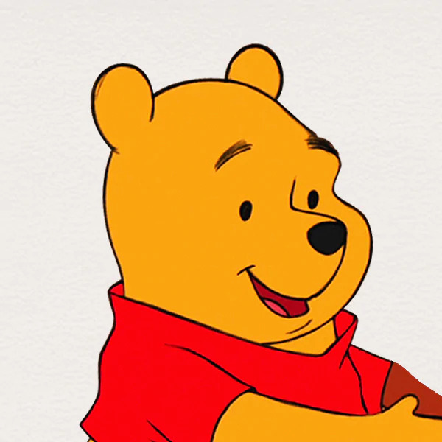
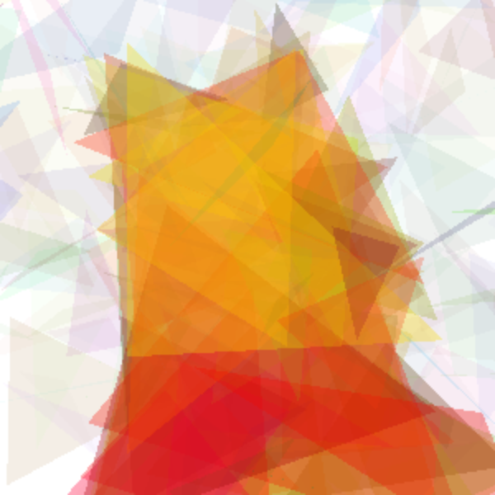

Slide 27
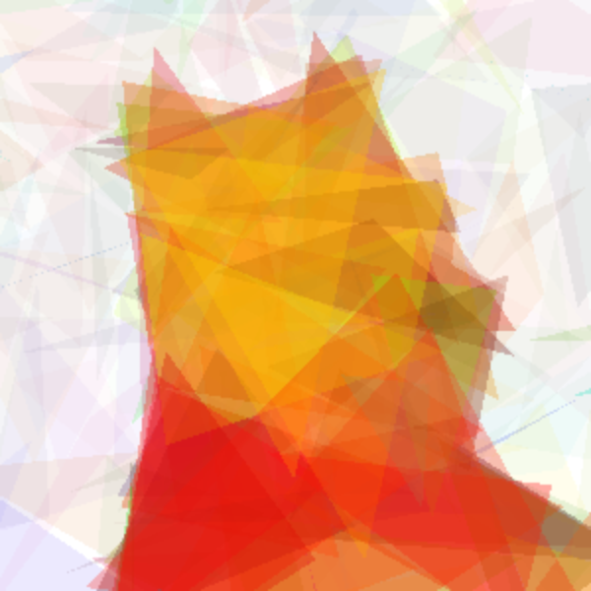

Slide 30
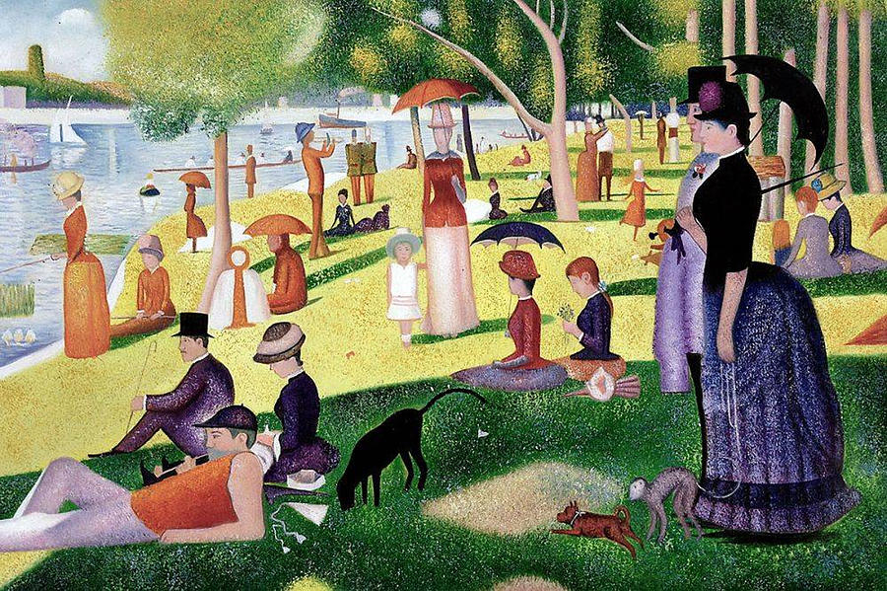
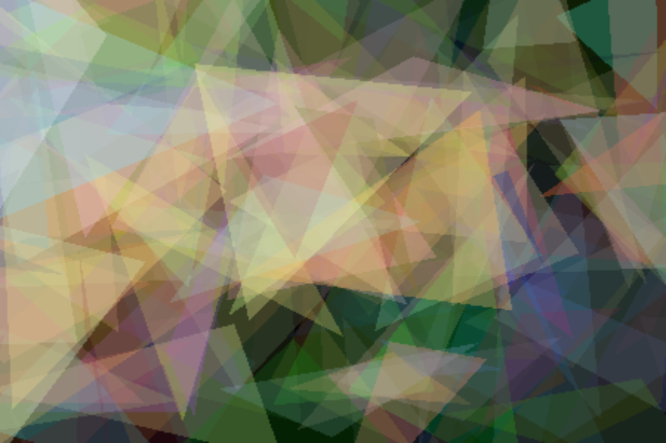

Slide 31
Learning and Development

Slide 32
Strategies

Slide 33
Strategies
Documentation
Previous class notes
Sticking to my schedule
Meeting with professors
Brainstorming with peers
Notes:
Since I have never used JavaFX before, I relied heavily on the documentation on Oracle’s website.
This application accesses arrays almost constantly so I needed to chose a data structure where access time was quick. I relied heavily on my notes from 220, which was only a year ago but feels like it was longer than that. Generations are also sorted by fitness, so I needed a quick sort algorithm. This also led me to my notes from 220.
In the third or fourth week, we needed to have a schedule on our website. Before having a schedule, I pretty much was just kind of winging it. After making the schedule, I realized that I needed to get moving. Having a schedule helped me get the project done on time.
I tried to meet with Dr. McVey at least every other week. While the meetings were primarily with Dr. McVey, Dr. Pankratz and Dr. Deidrich were there occasionally to help brainstorm. I never really had a meeting with Dr. Geisler, but we did brainstorm ideas occasionally after OS.
Aldo’s project and my project were similar, so we did talk a lot

Slide 34
Extensions for Future Students

Slide 35
Extensions for Future Students
Have a clickable app
Run the app on compsci04
Improve the algorithm so that it works better with more detailed images.
Notes:
Have an app that can be opened by double-clicking on an icon.
Maybe a clickable app is not feasible. This application does take a significant amount of CPU resources. Maybe it would be more beneficial for the user if the application could run on compsci04 and not have to use the users CPU.
As I said, the algorithm works best with simpler images. I think it would be beneficial for the user if the algorithm could recreate more detailed images.

Slide 36
Questions?

