Slide 1
Cartoonification Application
Colby Wall

Slide 2
Project Description
Upload a photo and convert it to a cartoon like image
Control the contrast, tint and intensity of the cartoon.
Allow the user to specify the number of colors in the cartoon image.
Allow the user to specify which colors will be in the cartoon image.
Implement save and open functions.
Examine various algorithms and consider designing your own.
Notes:
Read through the Description. I really wanted to focus on creating an application that is simple and easy to use and allows the user to create detailed, general, or even abstract cartoons.

Slide 3
Here’s what I did
Created a class that holds the struct “bucket” and an ArrayList of buckets which holds the HSV ranges to be captured. Buckets are created around the HSV color selected by the user. The algorithm searches pixel by pixel for the HSV ranges.
Notes:
Created a class “colorScheme” that holds the struct bucket an ArrayList of buckets which holds the HSV ranges to be captured. Known as a “bucket”. The buckets are created around the HSV color selected. During computation, any pixel within range to the HSV color selected is set to that color. Don’t worry if that seemed like a lot. I’ll go into some depth now.

Slide 4
Layers
of
Buckets
Segments the an image based on the bucket range for each selected color
From each color bucket a layer is created with only the color in the areas that were found in the original image
Layers are stacked on top of each other to create the cartoon version
Background applied to areas that buckets did not hit
Notes:
The easiest way to think about this is by visualizing each color bucket as a layer and layers are put on top of each other to get all the colors.
The image is searched pixel by pixel and checked to see if that pixel is within the HSV range dictated by the bucket struct.
This is done for each color the user selected.
The layers are added to a result image until we have the finished product.
Later, a KMeans version of the image is applied to fill in any missed pixels. The main issues I faced here was just working with the emguCV library and

Slide 5
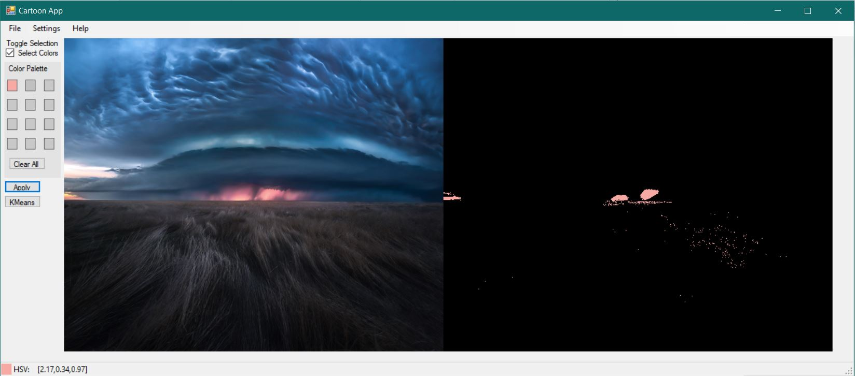
Notes:
Example of a single layer with the red in the middle chosen.

Slide 6
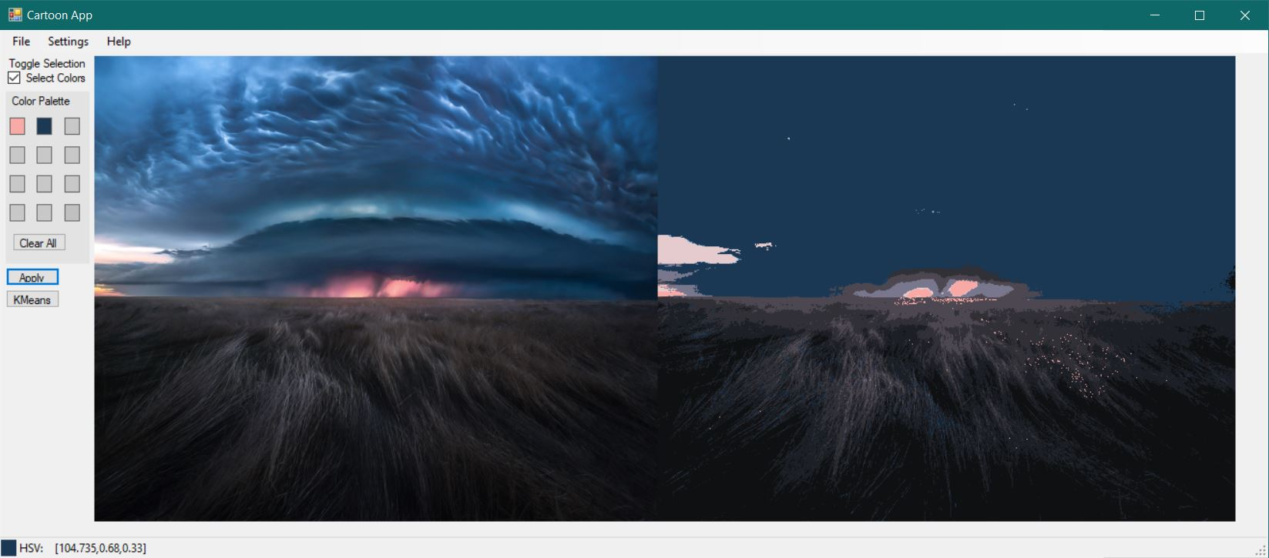
Exception
This could be the part of the presentation where you can introduce yourself, write your email...
Notes:
My one major exception is that the algorithm has trouble with similar hues but different saturations and values. The reason for this is a given hue captures almost all ranges of saturation and value for consistency.

Slide 7
Methods
C# and EmguCV
Professors
Stack Overflow
Lots of EmguCV documentation
Emgu youtube guy
Notes:
I used C# with the help of the EmguCV library - EmguCV is a C# version of OpenCV (image rendering library)
When I got stuck I turned to my professors. Dr.McVey and Dr.Diederich especially helped me with figuring out an object reference issue where an updated bucket did not actually update. And Dr.Pankratz with a good deal of the ideas in this project; getting me going in the right direction.
Lastly, I turned to EmguCV documentation to help with functions, especially with the layering functions

Slide 8
Bucket-algorithm process
V1
V2
BUCKETS
KMEANS
The algorithm only captures the buckets selected and leaves all else black.
Adds up layer masks to lay a Kmeans render or solid color as the background
Examine various algorithms and consider designing your own.
Notes:
V1 - It was during one of the first meetings with Dr.Pankratz that he suggested trying to capture ranges of pixels as a way of segmenting the image. V1 only allowed the user to select colors and spit out the sum of the layers and didn’t fill in the background. At first the app was just going to be a couple filters to smooth out the colors and add edges to get it to pop or some implementation of KMeans, but I dove head first into the last requirement of considering designing my own algorithm.

Slide 9
V1
Notes:
Grabs all the colors selected by the user and leaves everything else black.

Slide 10
Bucket-algorithm process
V1
V2
BUCKETS
KMEANS
The algorithm only captures the buckets selected and leaves all else black.
Adds up layer masks to lay a Kmeans render or solid color as the background
Notes:
V2 - Dr.Pankratz suggested Kmeans as a possible fix to the black area problem
Puts all the masks of each bucket layer together to get the “uncaught” area and fills with Kmeans render or solid color. Also included in this version was the feature to change a color. Allowed for a lot more customization of the images.

Slide 11
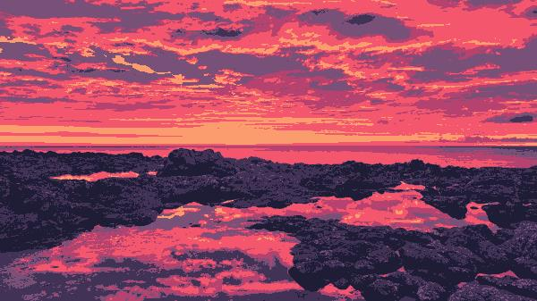
V2
K-value of 6
Notes:
This is the background KMeans render with a kvalue of 6. In V2 it gets layered in wherever the buckets do not hit (the black area)

Slide 12
Bucket-algorithm process
V1
V3
V2
BUCKETS
KMEANS
SATURATION
The algorithm only captures the buckets selected and leaves all else black.
Adds up layer masks to lay a Kmeans render or solid color as the background
The algorithm would split buckets to account for multiple hues/saturations/values
Notes:
V3 - Early bucket algo had only created buckets based on hue and did not take into account the saturation of colors. This was a difficult addition because now I had to account for similar hue colors but different saturation values. The way I wanted to go about fixing this is when a similar hue was selected the existing hue buckets would be updated with a fraction of the saturation range and not overlapping the other color’s range. I could split the buckets fairly easily, but the big issue was I didn’t have a reliable way of reverting a color back to its original bucket once the similar hue was deleted.

Slide 13
Demonstration

Slide 14
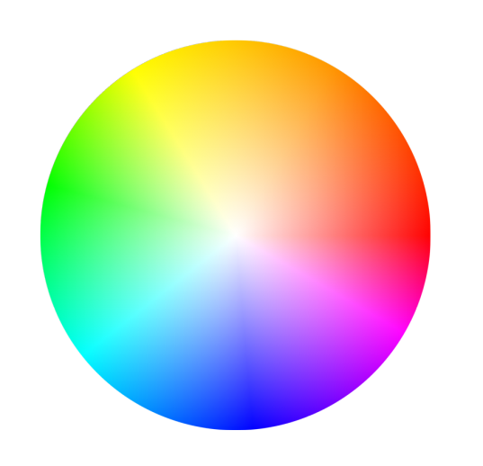
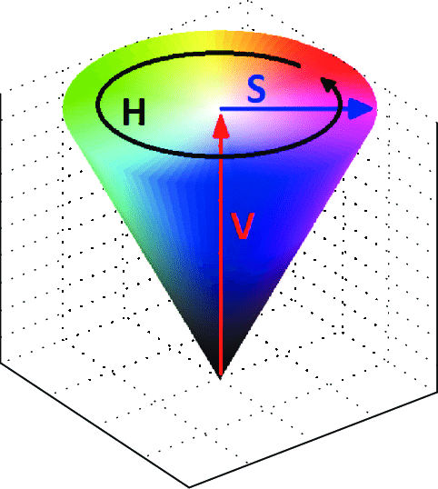
Learning Process
IDEA
Research
Brainstorm
Brainstorm
Bgr vs Hsv
Implement
Refine
Notes:
MY learning process was kind of unorthodox. I would first find an idea and research it to see if that idea is a good fit for what I wanted to do. From there I would brainstorm and just let it sit up there and when I would be doing something unrelated like talking with friends and they might say something that would tickle my brain and then I would start the implementation. Once I got a basic implementation I would refine and expand.

Slide 15
Extensions
Keep the original image dimensions when saving image
Allow for user to change specific colors
Allow user to customize every element of the cartoon algorithm (Blurs, edges, Kvals)
Notes:
One thing that was not required but I noticed, was the original image dimensions were lost after resizing for the GUI.
I did this to satisfy the # and which colors are in the cartoon. But an extension would be to allow the user to change the specific colors.

Slide 16
Do you have any questions, comments?
THANKS

Slide 18
...and our sets of editable icons
You can resize these icons without losing quality.
You can change the stroke and fill color; just select the icon and click on the paint bucket/pen.
In Google Slides, you can also use Flaticon’s extension, allowing you to customize and add even more icons.

Slide 19
Educational Icons
Medical Icons

Slide 20
Business Icons
Teamwork Icons

Slide 21
Help & Support Icons
Avatar Icons

Slide 22
Creative Process Icons
Performing Arts Icons

