Slide 1
Feedback by Location
CSCI 460 - Capstone
Mike Stanaszak

Slide 2
Project Requirements
Original Requirements
Create and build out an application that responds to a client approaching a specified location and displaying some kind of media, image, video, sound etc.
Identify whether the feedback is with the user or with the location.
Identify how it is known that the user is within appropriate proximity of the location.
Address the scale of the physical area in question.
Different feedback should be available at each location.
Can two pieces of feedback be available simultaneously if near two locations? If so, how?
Indicate nearness to a location.
What if two users are near the same location?
The application should check for updates when started so that additional locations and feedback can be added without reinstalling the app.

Slide 3
Project Requirements
Modified Requirements
Create and build out an application that allows the client to be routed through a structured environment
Determine a user’s proximity to the locations.
Consider intersection of locations as well as multiple users per location.
Position “markers” that are used to map the building and guide users.
Consider using an application to map routes within the building.
Choose an appropriate path from the user’s current location to a desired location (and adjusting path if user leaves the suggested path).
Augment the user’s view to indicate direction to take.
The application should check for updates when started so that additional locations and feedback can be added without reinstalling the app.

Slide 4
Solutions
Bluetooth Beacons
Small
Inexpensive
AltBeacon Library
Android Studio
Java

Slide 5
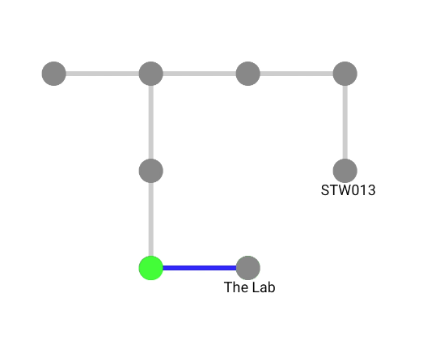
Solutions
Creating the Graph
What I needed to store:
MAC Address
Name of Beacon (Location)
Adjacent Beacons
Direction

Slide 6
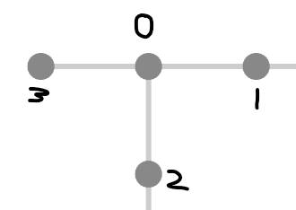
Solutions
Storing Directional Relationships

Slide 7
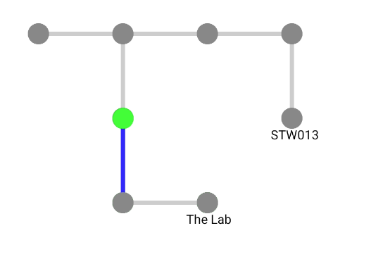
Solutions
Event Based Routing

Slide 8
Exceptions
Difficulties with Bluetooth Beacon Distances
Multi-Client Interactions
Admin Application

Slide 9
Demonstration

Slide 10
Learning / Development Strategies
Sources for Information
Previous class work in CSCI 350
AltBeacon Documentation
Documentation on Bluetooth Beacons
Layering Features
Tasking steps out
Taking one step at a time
Planning features & drawing the designs before beginning development
Saving old versions of app via version control and branches

Slide 11
Extensions
AR Routing
Multi Client usage
Traffic Monitoring
Sending “invites” to other clients to join them at a location
Subgraphs (Larger scale)

Slide 12
Q/A
Thanks for listening!

Slide 13
In case bad

