Slide 1
CCR (COMPUTER CONTROLLED RAILROAD)
A Senior Capstone Project by
Brice Hilgemann

Slide 2
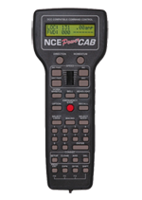
Project Description
Design and implement interfaces for the CCR that campus visitors can use to control trains.
General Requirements: 1. Allow PC control of the railroad 2. Consider multiple interfaces including: a. PC (mouse/keyboard) b. Mobile devices c. Wireless devices 3. Interfaces must be easy to use 4. Provide visual feedback and log states 5. Develop a simplified operating system that handles multiple
trains and prevents collisions

Slide 3
Initial Thoughts/Strategy
Get familiar with hardware
Understanding previous code and methods
Utilize as much previous work as possible
Implement OS principles/strategy from CS370
Asynch sockets over Pipes?
Monitors in C#
Dynamic and multi-user
Powerful and reliable
Time to diagram, document, and theorize

Slide 4
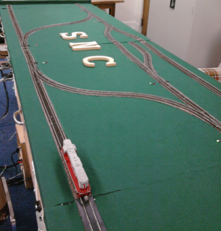
My Implementation
CLIENT
CLIENT
Server/Client Design
Server Functions
Communicate with ‘Blackbox’
Adding Trains
Deleting Trains
Prevent Collisions
Client Functions
Connect to Server
Send requests to Server
Asynch Sockets! (Threading)
CLIENT
Sockets
SERVER
Serial/USB
RAILROAD

Slide 5
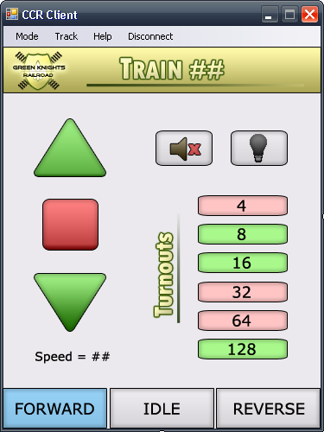
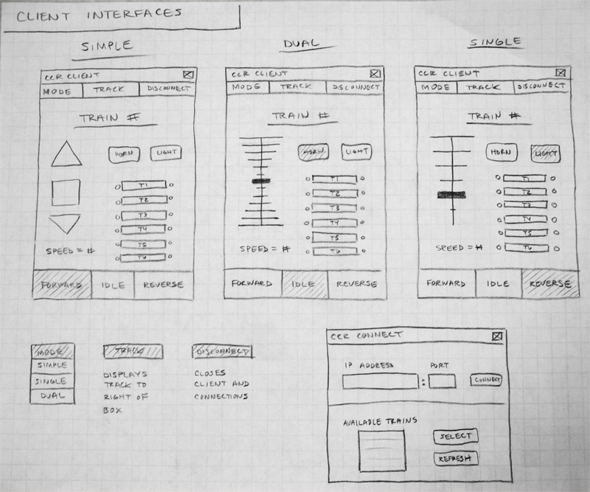
Client Design
Diagram:
In Practice:

Slide 6
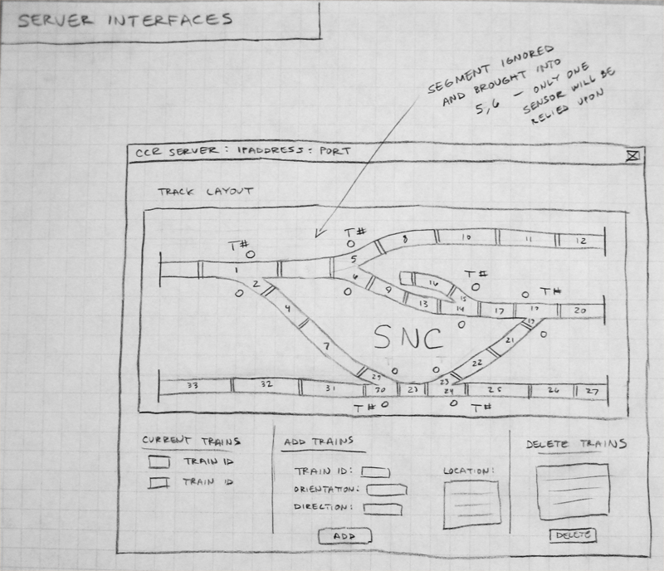
Server Design
Diagram:
In Action:

Slide 7
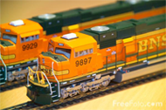
Current Work/Immediate Plan
Repair railroad segments
Perform other maintenance
Test out newer ‘Blackbox’
Rewrite Kratz’s code to work in C# form
Move to newer DCC commands
Finalize acquisition of track and movement
Perfect blocking system
Implement regulation of train additions, deletions
Finalize protocol between Client and Server
Requests and train updates
Potential changes to Client Interface
Document and continue testing

Slide 8
Assistance
Better representation of turnouts on client?
Ability to see full track layout on client?
Mobile device extensions?
More features?
Concerns?
Questions?

