Slide 1
Campus Tour
Travis Vroman
CS460 Capstone

Slide 2
Outline
Project Description
Demonstration
Learning and Development
Q&A

Slide 3
Project Description

Slide 4
Requirements
Build a mobile device application that guides visitors through the SNC campus
Include an interactive map of the campus
The guide describes campus features in an interactive manner
Consider an audio feature
A visitor can request to see a specific feature and the guide will “show” the way

Slide 5
Requirements
Design a predefined walking tour option
Consider features like weather, current events, …
You might use a GPS unit to help the guide determine a visitor’s location
The app must be a free download
Consider using the Android platform

Slide 6
Solution

Slide 7
Research
Hardware
GPS? Wireless? Map features? Data?
IDE? SDK? Workflow?
Environment
Platform
Special considerations?

Slide 8
Prototypes
IDE is working; we have text on the screen
Hello, world!
To-do list
Basic user interaction
Tab host
More advanced layouts

Slide 9
Prototypes
GPS demo
Poll basic GPS information
MapView demo
Interact with MapView
Finished Product
Tie it all together.
Add “live” data

Slide 10
Exceptions
Audio
Difficulty in finding voice actors
Weather, current events
Duplicates standard platform features
Requires data source that must then be maintained
Multithreading
Program size, debugging
Multithreading

Slide 11
Methodology
Isolate specific feature
Prototype
Research

Slide 12
Features

Slide 13
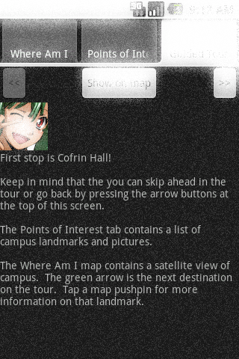
Guided Tour
Mascot will take you on a predefined walking path around campus.
Can skip ahead or back at any time.
Tour advances automatically when you arrive at your destination.

Slide 14
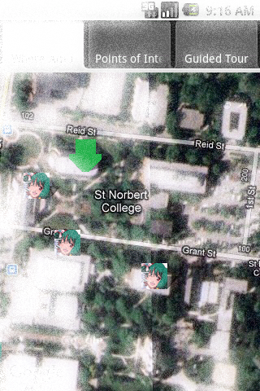
Interactive map
Scrollable satellite view of campus.
Pushpins offer detailed information about a particular landmark.
Green arrow indicates next stop on tour.

Slide 15
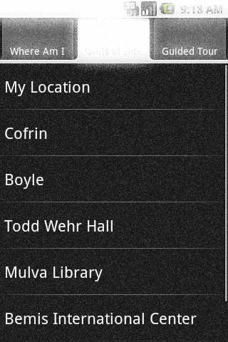
Points of interest
Allows a user to request to see a specific feature. The map will center on that landmark.

Slide 16
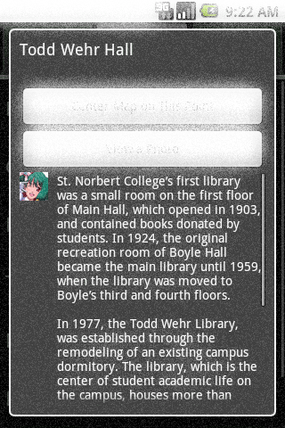
Information
Tapping a pushpin or selecting a point of interest will bring up an informational dialog.
The application can take the user to the landmark’s exact location on the map.

Slide 17
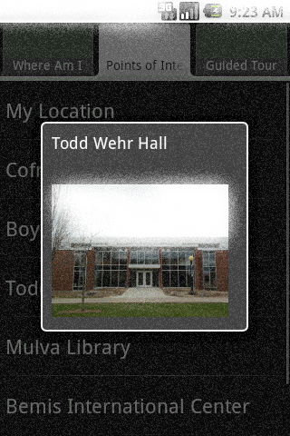
Photography
Tapping a pushpin or selecting a point of interest also gives the option to see a photograph of the landmark to aid in locating it.

Slide 18
Demonstration

Slide 19
Learning and Development

Slide 20
Strategies
Know how to find information
Google, SDK website, forums, dead trees
Know how to debug
Hardware or software?

Slide 21
Knowledge
Object-Oriented Programming
Java is entirely OO
Programming Languages
Special caveats for interpreted languages
Inheritance, scope, virtual functions

Slide 22
Extensions
Live Feeds
Grab data from remote server
Weather, current events, updated landmarks
Widget
Sit on desktop
Share data when near a building
Achievements
Who visited the most landmarks?
Walked the most miles?

Slide 23

Advice
Problems that look approachable OFTEN ARE NOT.
Maintain your website.
“Finish” a month early so you have time to build another prototype.
Use Office 2010 for PowerPoints.

Slide 24

Questions…
…and answers!

