Slide 1
iRobot Create
Sasha Popov
April 27, 2011

Slide 2
Original Project Definition
Develop communication protocol so that two create robots can partner and cooperate activities.

Slide 3
Initial Design
Use GPS to track the robots
Use PC as the “brains” behind the robots
Communicate via Bluetooth to control the robots

Slide 4
Initial Equipment Limitations/ Project Evolution
Failure of the GPS due to lack of accuracy
Project Evolves:
Create a user interface to control the robot via Bluetooth
Use internal Robot’s readings to measure movement distances and directions
Develop an algorithm to keep track of the robot
Backtrack to the starting location

Slide 5
New Focal Points
User Interface
Serial Port/Bluetooth Communication
Multi-processing
Robot
PC
Multi-threading
Modified Stack for movement history

Slide 6
Design Overview
PC
SERIAL PORT
iRobot
Internal Processor
Via Bluetooth
Request Data
Return Data
Threads/Log/Logic
User Interface
Notes:
Give example of Data Request
Talk about “dumb” roomba and the brains of the PC

Slide 7
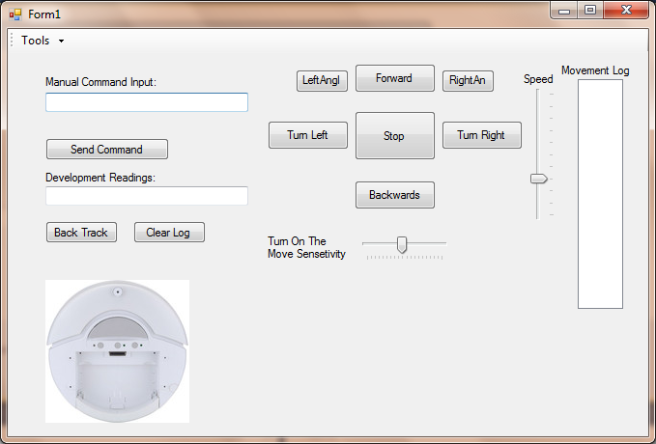
User Interface

Slide 8
Demo
Demo

Slide 9
History Stack
Stack Example:
Drive Forward 67 mm at speed of 3 | 1 | 1
 | 2 | 0
 | 3 | 67
 | 4 | 0
 | 5 | 0
 | 6 | 0
 | 7 | 3
Turn Left 90 Degrees | 1 | 4
 | 2 | 255
 | 3 | 245
 | 4 | 255
 | 5 | 90
 | 6 | 0
 | 7 | 4
1(B,F, R, L)
255
2
0
90
0
3
Direction Key(back/forward/left/right)
Distance Driven
Angle Turned
Bump Sensor
Speed

Slide 10
Extra Features of the Stack Class
Moving?
Last executed Direction?
Last Executed Command Line?
Add another command to the stack?
Command Line == state (Drove x, Turned x, Change Speed, Sensor Bumped)
“Buffer Commands/ Distances”- buffer the current command in progress
Size? Number of Commands
Notes:
Each command line is a state of the robot
Make states smoother I “buffer” the state in progress, add 90 degrees instead of 1 degree at a time

Slide 11
Multi-Processing
2 Asynchronous Processors
PC
iRobot
PC Threading
Serial Port
iRobot<-> PC Communication Time
Sending Data/ Listening for Feedback
User Interface
Issuing Commands(Turning Right/Left)
Lock Variable(on issuing commands to the robot)
Notes:
Go through very quickly and show chart on next page

Slide 12
Main Threads
User Interface/Main Thread
BUMP SENSOR THREAD
Check Sensor
Wait
Loop
Right Turn /
Left Turn
Command Thread
Issue Turn
Wait To Turn x degrees
Submit Data to Log
Backtracking Thread
Execute Backtrack algorithm
Serial Port
Send Command
Spin and Listen for Result

Slide 13
Threading / Lock Variables / Turning Example
iRobot Create
Process Command
Send Feedback
Turn Right 90 Degrees
Turn Right Thread
Lock Out Other Threads
Issue start moving command
Loop:
Ask for degrees turned so far
If 90
Add Deg. To Stack
Stop Robot
Release Thread Lock
Notify Main Thread That Turn Is Completed
Main Thread/
User Interface
Know When Turn Is Done
Allow To Click And Stop Turn
Start The Turn Right Thread
Serial Port
Thread
Send Command
Wait For Response
Start Turning
How far did you it turn since last request?
Notes:
Kill thread with lock variable locked in another thread
Who stops the robot if the thread is killed half way
How far did we go?
Make sure the thread is finished so next one can start.
Reset variables of movement... Etc.

Slide 14
Limitations
Delay between PC <-> iRobot, not accurate angles (accuracy of +- 3,4 degrees/mm)
Errors (3,4 degrees) accumulate over number of commands
If off by 3 degrees on first turn, 2 turn could be off by as much as 6 and so on…
Not Completely Centered Wheels (.5 inches longer in the front).
No third source of data to correct for these errors( GPS )
Threading / Lock Variables
Side-effects of asynchronous processing
Hard to find and accommodate for all possible errors with so many processes happening at the same time
“Racing conditions” on the serial port(don’t want to break up logical segments of code to and from the robot)

Slide 15
Demo
Demo

Slide 16
Accomplishments
Backtracking
Checks and stops on bump
Turning on the move
Multi-threading
User Interface

Slide 17
To Do For Next Year
3rd Reference Point for the Robot
Different GPS?
Use another source to verify robot location/ correct for errors in reading data
Be able to coordinate two robots, even something as simple as, one drive away and the second follow

Slide 18
Advice For Next Year
Often easier to re-write from the beginning than to understand other’s code
Start with my basic functions (Move Forward, Backwards, Left, Right)
At first ignore threading/stack to easily understand the basic functionality
Use the basic commands (+ threading) as building blocks from which to build your own algorithm logic

Slide 19
Learning and Development Process
Finding Answers:
Google and examine sample code
MSDN
Build small programs to test and understand sample code
Write my version of sample and add it to a bigger picture
CS Courses That Were Most Helpful:
Operating Systems
Database Modeling Project in C#
Assembly Language (Low Level Understanding)

