Slide 1
SNC Campus Mobile Tour Guide Walkthrough
Dale Bishop

Slide 2
Project so far
Design
Decided on fixed screen capture of the campus from Google Maps, which is the map that’s on the SNC Mobile website, to be the foundation of the map
Use layers to display important points of interest
Allows the user to remove unnecessary clutter on the map
Allows users to plot only the items they are looking for

Slide 3
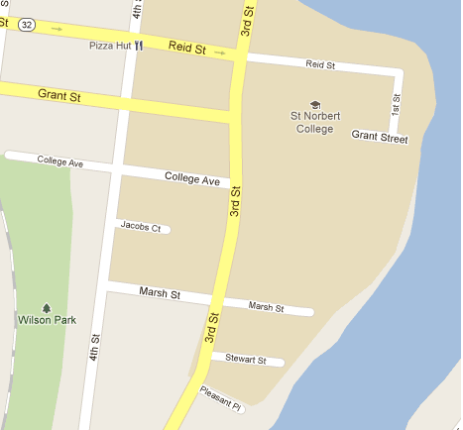
Layer Free

Slide 4
Way to Execute Layers
Store Layers in arrays by Category
Examples
Dorms
Lecture Halls
Office Buildings
Car Parks
Using the coords and dimensions stored in the array I’d draw the layers on the fly upon the user’s request

Slide 5
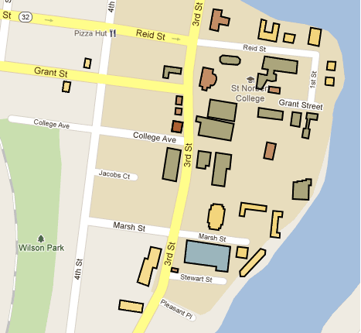
Campus Map w/ Campus Buildings

Slide 6
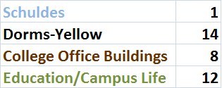
Building Color Code & Population

Slide 7
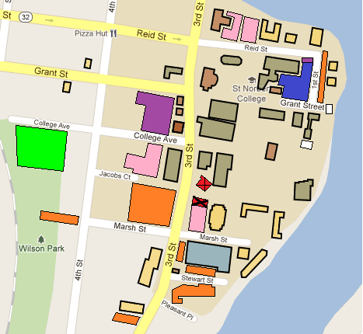
Campus Map w/ Everything

Slide 8
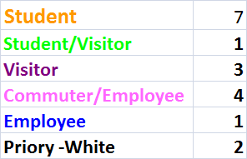
Car Park Color Code & Population

Slide 9
Work That Needs to Be Done
Meet with Scott Crevier(Mobile Campus Map Creator) to cement the design possiblilities.
Map the paths through campus
Animate upon the map using Java
Mine the Android to find how and where the GPS works
Transfer the working desktop tour guide from Eclipse on the PC to the Android

