Slide 1
TEXT RECOGNITION Senior capstone 2012
--Caesar Cai

Slide 2
Definition and requirement
Write an optical character recognition application that identifies and recognizes printed text within an image
Investigate existing algorithms and libraries. Use the Carleton College Computer Science Comps Project 2010 as a starting point.
Initially, try black text on a white background.
Design a uniform API so that you can plug in alternative OCR functions.
Evaluate the effectiveness of your OCR compared to existing algorithms.
Develop an application that employs augmented reality for text within an image (e.g geo-tag state park signs, license plates, campus building signs, ..)

Slide 3
What I did
An C# application using an open source OCR engine to identify printed text within an image.

Slide 5
What I did not do
The OCR function
Some good ideas that I cannot achieve. (For example, Use a dictionary to correct words).

Slide 6
Start with …
2010 Carleton College Computer Science Comps Project
A lot internet researches
Hello World with couple different OCR engines

Slide 7
OCR Engines
Microsoft MODI
Free
Need to Install with Office 2003
Tesseract by Google
Open Source
AspriseOCR
Good, but expensive

Slide 8
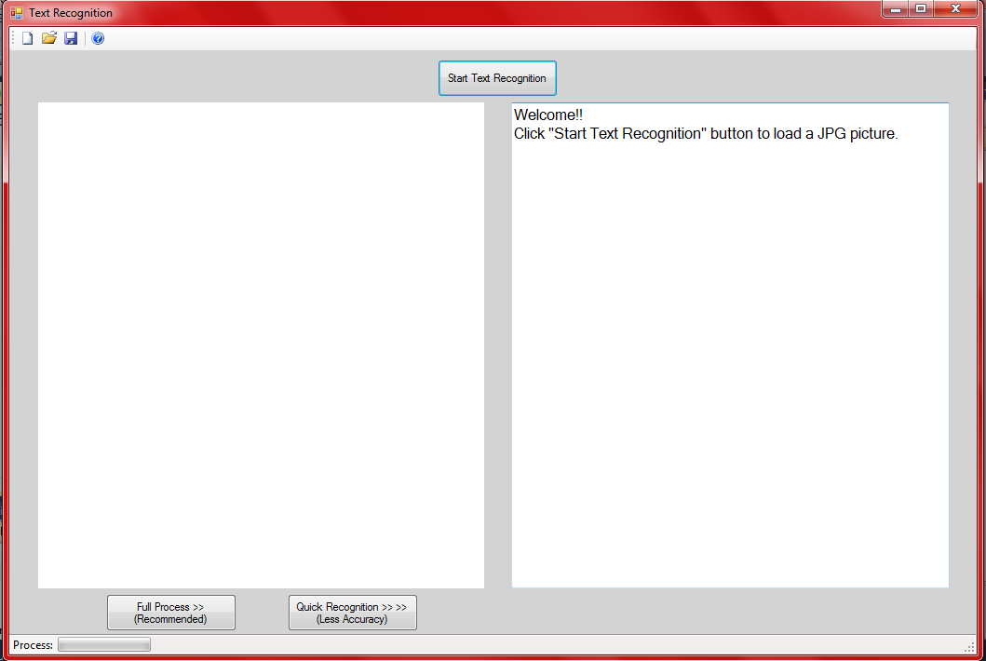
Simple Interface

Slide 9
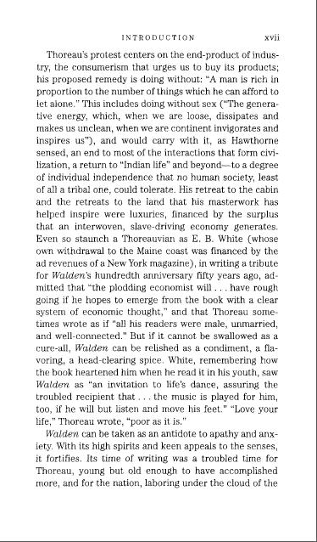
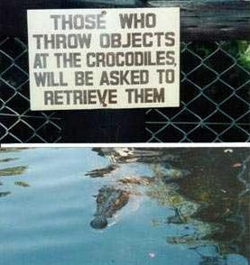
Fast or Full
Fast
OR
Full

Slide 10
Steps for a fast RECOGNITION
Cut Lines
Cut Words
Send Char to OCR Engine
Using Returned Chars to Produce the Text.

Slide 11
Cut Lines
If a line of pixel has more than 98% of white pixels, it is a empty line.
If there are three empty lines together, this is a gap between two lines of text.
For efficiency, check one line out of three when it is not empty line. If find an empty line, the check whether its neighbors are empty lines, too.

Slide 12
Cut Lines

Slide 13
Cut Words
<20%
>20%
100%
Not White Space
White Space

Slide 14
Cut Words

Slide 15
Steps of Identifying Text w/ Picture
Range the Text Area
Pick the Text Color
Denoising

Slide 16
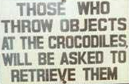
Range the Text Area

Slide 17
Pick the Text Color

Slide 18
Some Issues (well, a lot of issues)

Slide 19
Some Issues (well, a lot of issues)
iiiiiiiiiiiiiiiiiiiiiiiiiiiiiiiiiiiiiiiiiiiiiiiiiiiiiiiiiiiiiiiiiiiiiiiiiiiii

Slide 20
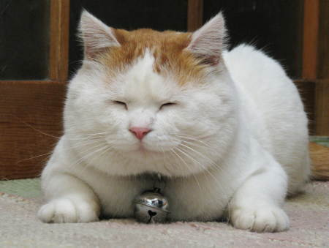
Watch a demo

Slide 21
Best Learning techniques
Internet – Online tutorial website, Google
Professors
Textbooks

Slide 22
Most helpful CS classes
Event Programming (C#)
Theory of Computation (Algorithm)

Slide 23
Advice for next year’s seniors
Talk with your Professors and classmates
Work on regular schedule
Don’t afraid to ask questions

Slide 24
Any questions

