Slide 1
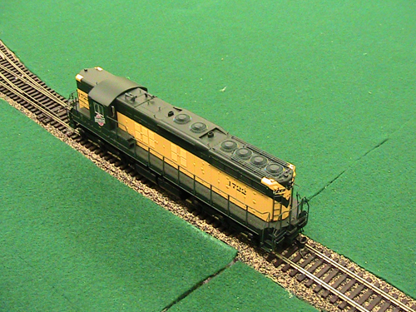
CCR – COMPUTER CONTROLLED railroad
Gwynn Fewell

Slide 2
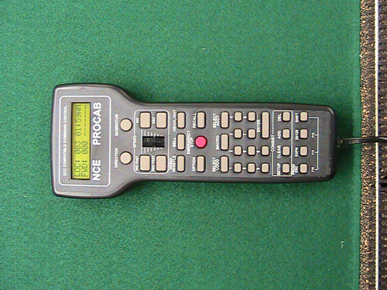
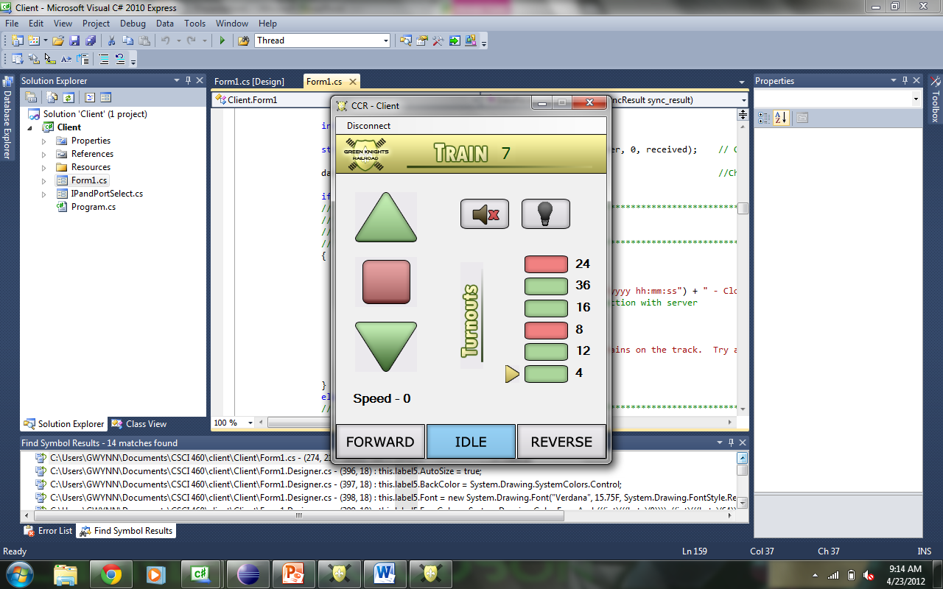
Project Definition
Use Mobile Devices to run trains on the CCR (Computer Controlled Railroad)
  Build on Brice Higlemann’s 2010 Project
  Create a mobile application to create a CAB for the trains
  Show the state of each train
  Consider using the accelerometer
  Make it for the young and the young at heart
Notes:
Make a mobile app to control trains
- CAB for trains is hard to use and lots of buttons to change turnouts
Brice made client more simple using C# to make client and server
Make more mobile and future friendly by allowing control with android

Slide 3
Previous project
Strenghts
  Much simpler than original CAB
  Adaptable
Weakness
  Only used on computer
  Lags between server and trains
  Shorts in track lead to server freeze
Notes:
Allowed easier interface for controlling trains
Server simulates train on track
Client open ended just match commands with server
Shortages make server lose train on track (no longer match)
Server freezes in 112 when train shorts
Names of object in UI not named--- BAD for following

Slide 4
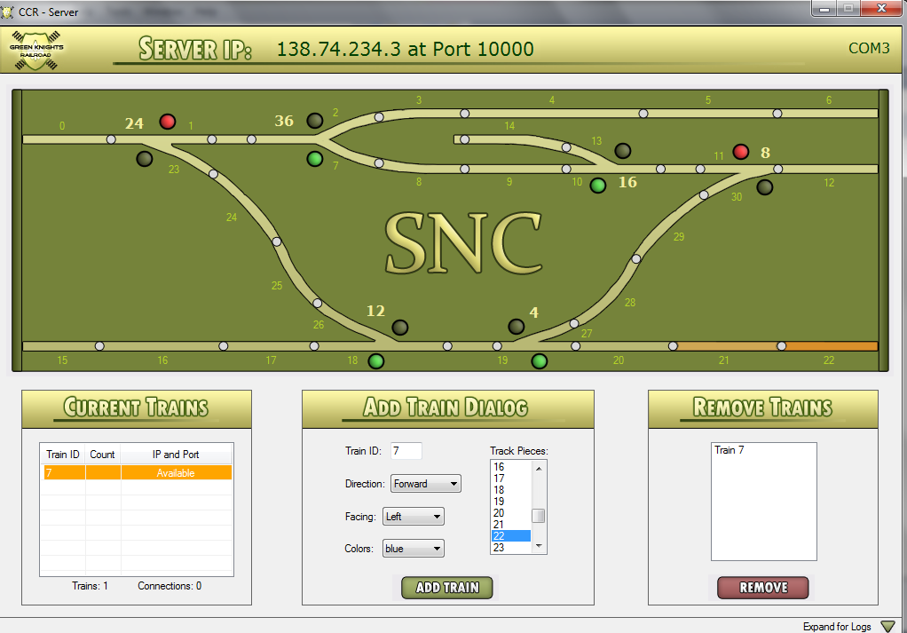
Brice’s Server
Notes:
Brices Server
Simulates the trains
Keeps track of the trains on the track and the connections
Choose COM port to start
Handles crashes and turnout problems
Implements speed limits
Has some problems when the track shorts
Work off this server, don’t change

Slide 5
What I Did
Created a TCP Socket to connect to a C# Server
Implemented Brice’s Client in Java
Tried Implementation with Accelerometer
Notes:
Sockets connect client to server
Followed Brice’s design for implementation
Worked with getting x, y, z coordinates with accelerometer and use y

Slide 6
Problems
Android would crash when reading from Socket
AsyncCallback in C# doesn’t have an implementation in Java
SNC firewall doesn’t like outsiders
Notes:
Android doesn’t wait for C# to respond so main thread killed – crashed
AsyncCallback allows function to run once another task completes
SNC firewall wouldn’t let non-SNC computers to connect to a server on campus

Slide 7
Solutions
Put Read code inside thread
Find a different way to handle data
  Create connection upon creation
  Kill on disconnect or error
  Read in thread
  Pass information back to handle the user interface
Talk to IT to create a hole for a specific IP address
Notes:
Thread read separate from UI and write to allow while loop to run to continuously read
maintained connection
Passed data using a handle to pass info from thread to UI to handle data and UI based off server
IT created a hole in the firewall for a specific IP address and physical address – 1 computer with same connection

Slide 8
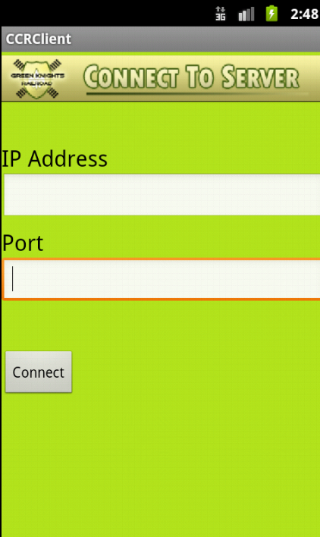
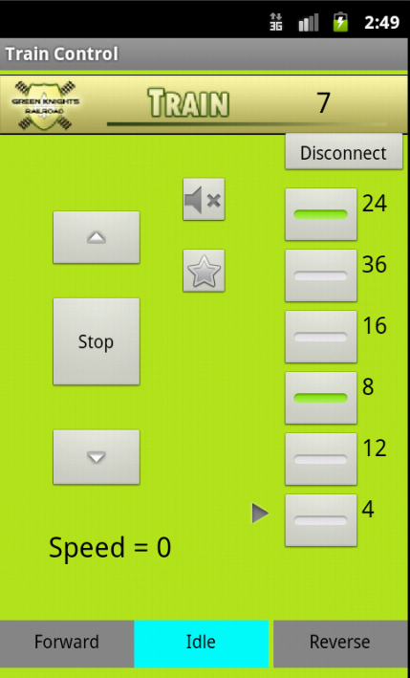
Solution
Notes:
Solution
Enter ip address and port of server
Arrow to indicate next turnout will reach in track
Numbered turnouts
Buttons to switch turnouts
Green makes turn toward bottom (not necessarily straight)
Red makes turn toward top
Train number
Direction highlighted in blue
Forward and reverse arrows to increase and decrease speed
Disconnect button to end
Sound for horn… don’t know if it works
Star for light on train
Speed negative for reverse, 0 stop, positive forward
Home button doesn’t kill application… Android doesn’t recomment it
Not the “Android way”

Slide 9
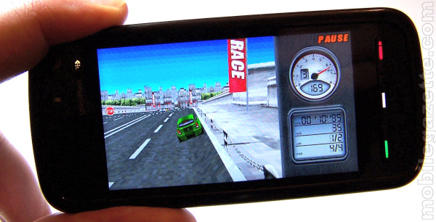
Still needs work
Didn’t get the accelerometer working properly
Notes:
Got it to move forward but not in reverse… not sure why
Ran out of time for full testing and fixing

Slide 10
Methods
Thread read separate from write and user interface
Same commands as Brice’s Client to match server
Get coordinates on accelerometer (x, y, z)

Slide 11



Strategies
Great use of developer.android.com resources
  Class descriptions and sample code
Stackoverflow.com question and answers
MSDN C# Reference
Professors and other students
  Special Thanks to:
    Dr. McVey, Dr. Pankratz, Joel Rodriguez, Chris Gusman, and Rob Downard
Brice’s Project from 2010
Trial and Error

Slide 12
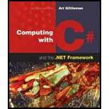

CS Concepts
Sockets extremely important (TCP Connection to server)
  Help from professors and some concepts from CS 350
C# language and concepts (CS 350)
Threads (CS 350)
Classes (CS 350 and CS 205)

Slide 13
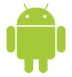


What More Can be done?
Accelerometer – working but not completely
Graphics between tablet and phones
Handling screen twists
Cellular service possiblility?
Better Client
Different OS
Notes:
Could create graphics that left or right option pops up when reach turnout
More complex implementation with simpler design
Screen twists wouldn’t work with my accelerometer implementation
tablet oriented sideways(y) phone portrait (y)
Only works with wifi not cellular service
Different Operating systems for mobile devices

Slide 14
Advise
Get right into your project
  Don’t Procrastinate
Start small and work your way up
Meet with the professors and other students
Keep up documentation and blog throughout
Have fun!!
GOOD LUCK!!

Slide 15

Questions??

