Slide 1
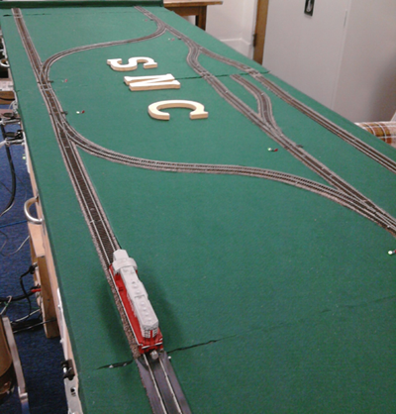
CCR – Mobile CAB
Gwynn Fewell

Slide 2
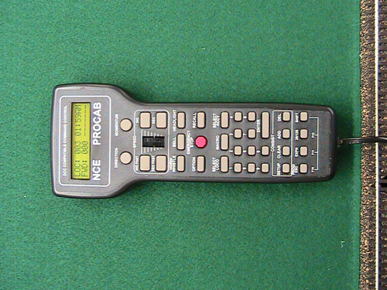
Project Description
Build off of Brice Higlemann’s work from 2010
Mobile app becomes the CAB to control one train at a time
App can switch between trains
CAB shows state of each train
Consider controlling trains using accelerometer
Investigate racing conditions on CABs and track
Design the app for the young and young at heart

Slide 3
What’s done so far
Hello World app created to become familiar with Java, Android, and Eclipse
Played with the trains
Created a socket using Java and tested it with Java server and C# server
Downloaded application to an Android device

Slide 4
Hello World
Linear Layout
Relative Layout

Slide 5
Plans for future
Get a connection working to the C# server that sends and receives messages
Get Brice’s project running again with the track
Test small commands from the application based on commands Brice used
Connect the commands to the interface of the application
Set limits and control potential crashes

Slide 6
Socket Example
Connects to Brice’s Asynchronous Sockets but app will crash & force close
Connects and communicates with Java sample

Slide 7
Problem
Application crashes when connecting to C# and I don’t want to change Brice’s server just connect to it
Suggestions?

Slide 8
