Slide 1
Mobile To Mobile
By: Joel Rodriguez

Slide 2
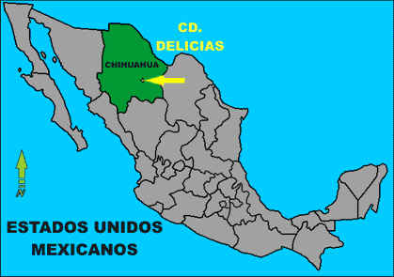
About Me
International student from Mexico
Delicias, Chihuahua Mexico
Spanish
Sports and Music

Slide 3
Project
Develop a walkie-talkie protocol and interface
Extend to pre-emptive bidirectional connections.
Consider many to many and client-server applications

Slide 4
Brain Storming
Decided to go with the Client Server Approach
Ideas 1, 2 and 3
Decided to use TCP to communicate with the server and UDP to communicate between devices.

Slide 5
Getting Started
C# server and client communication TCP
C# clients communication using UDP
Android client and C# server communication TCP
Android client and C# client communication using UDP

Slide 6
TCP Sockets
Create a Socket
Bind IP Address
Starts listening on one on the ports.
Accept connections, reads and writes to client side with a stream.
Sends and receives byte[] which interpretation depends on Protocol used by designer.
Close socket
Transmission Control Protocol
Must be connected to communicate

Slide 7
UDP Sockets
Open the socket
Bind IP Address
Sends and receives byte[] which interpretation depends on Protocol used by designer.
Close socket
User Datagram Protocol
No need to be connected to communicate
Thread Listener

Slide 8
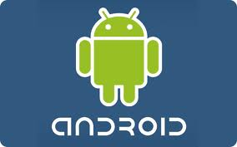
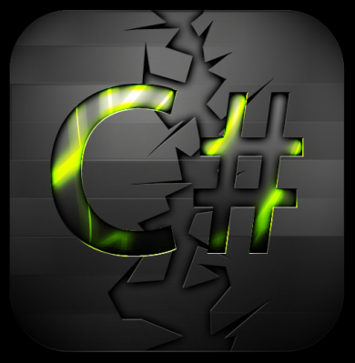
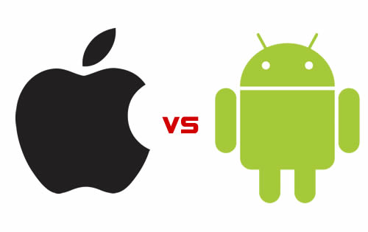
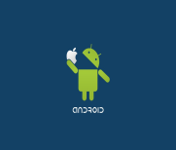
Programming Languages Used
Server C#
Client C#
Android Application
XML for users graphics
Java for background work
I have more familiarity and access to android technologies.
Due to not having experience developing in these technologies before this project, android represented having a better starting point.

Slide 9
Server Structure

Slide 10
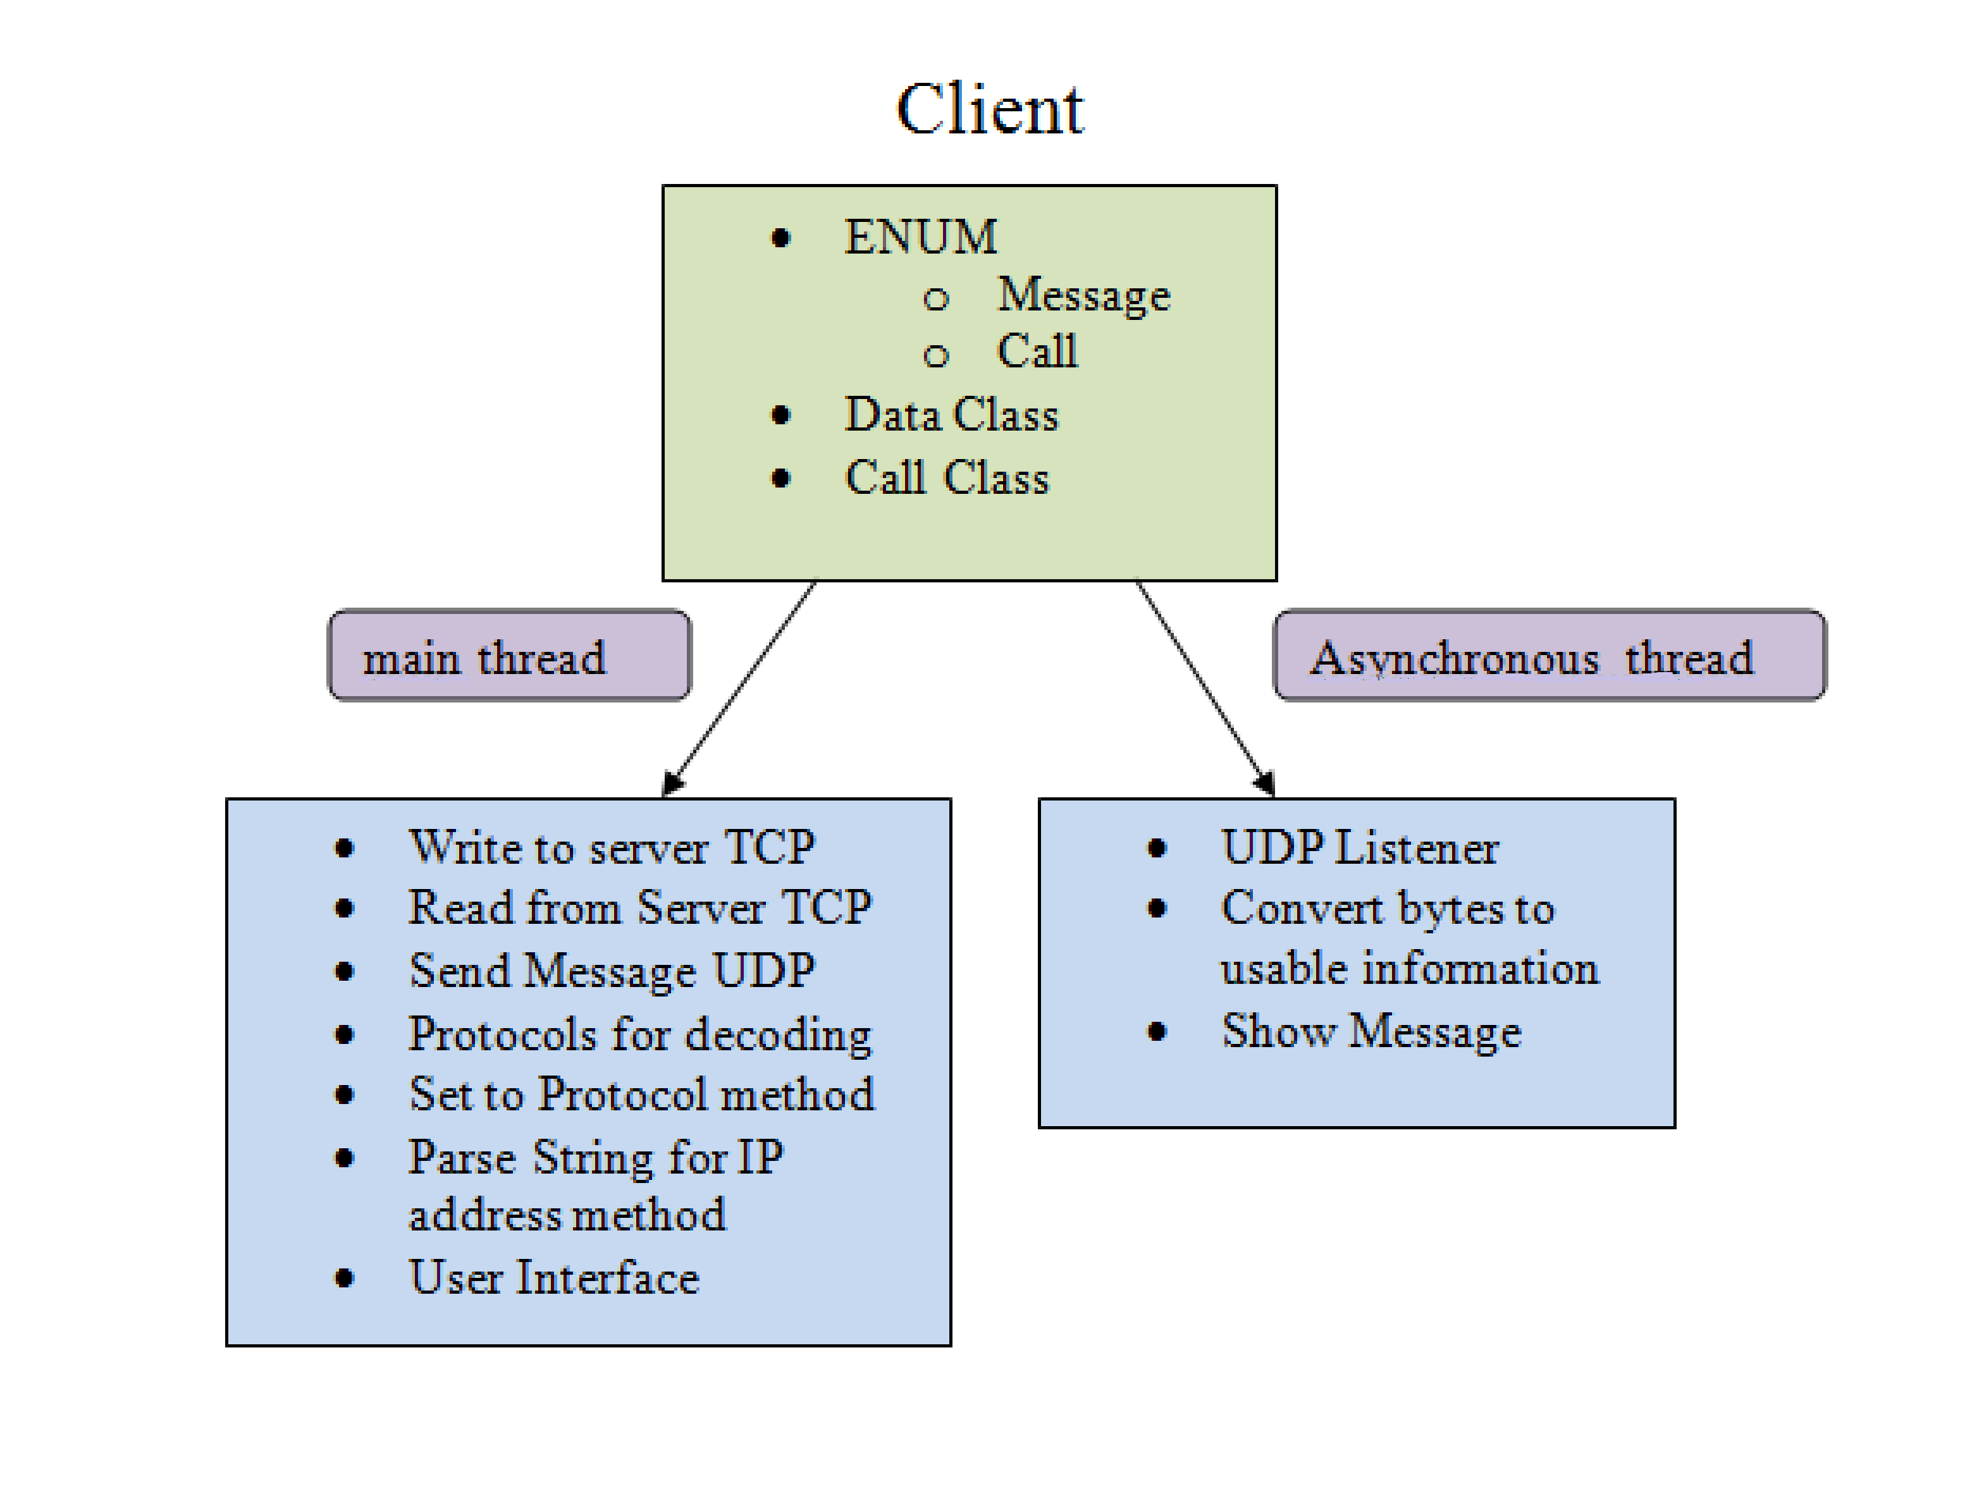
Client Structure

Slide 11
First Step
Server
Client
1.Server Accepts connection
2.Creates a new Client Object and binds the stream to it.
3.Adds the new object to the Clients linked list.
4.Adds the IP Address to the IP Array.
User Attempts Connection with the server
1.Sends Request
2.Once accepted enables all the functionalities on the form for the user.
3.Starts listener thread
Sends acknowledgement of connection back to server

Slide 12
OnClick_Send
Server
Client A sends a request to the server asking for the IP of the users currently connected.
Server gets all the IP addresses from the Array, puts them on a string and sends the String to the client.
The client gets the String containing the IP addresses of the users currently connected, parse it and start sending data to each individual device using UDP sockets.
The client B listener receives the encoded data, decodes it and sends the information back to the main tread to be displayed by on the user Interface.
Client B
Client A
Request
IP Addresses
Decoded Data
Encoded Data
Client B Listener

Slide 13
Voice
Call Class A
Client B
Client A
Opens form
Sends Request to the listener
1.Opens the form class.
2.Sends UDP sockets
1.Sets Parameters for recording
-Sample info
-Gets handle for hardware devices
-Sets the wave format to for capture
-Sets buffer with description for storage
-Sets the playback buffer description
2.Makes a request for IP Addresses
3.Seds a Call request for Listeners to get ready to receive the bytes.
4.Starts sending the bytes using UDP Sockets
1.Opens the form class.
2.Sends UDP sockets
3.Calls Play function
Starts sending the bytes
Request IP addresses
Requests IP addresses
Calls Play Function
Sends IP addresses
1.Plays Voice
Server
Call Class B
Used DirectX.DirectSound dll

Slide 14
Complications
Network security on campus
Phone settings
Bytes manipulation
Did not solve:
Sending Voice
Pictures

Slide 15
Strategies
CS concepts
Take my time before coding
Draw many diagrams
Try to picture the problem in something I like, for me it was music.
When something stops my progress research it but if it takes to long ask somebody.
CS350
Data structure
Socket programing
Assembly language
Senior who take over my project
Handling Bytes
Voice

Slide 16
Sources
Special Thanks to:
Dr. Pankratz
Dr. McVey
Dr. Agarwal
Chris Gusman
Gwynn Fewell
460 Classmates

