Slide 1
Alumni Tracking System
Micah Wheeler

Slide 2
Overview and Requirements
Design and implement an alumni tracking system for the computer science discipline.
Requirements
Perspective students will use the system to investigate typical employment opportunities for computer science majors. 2. The computer science faculty will use the system to search for specific alumni information and to generate reports 3. Alumni can submit new information for the system 5. Primary contacts are the computer science faculty and computer science seniors.

Slide 3
What I’ve done
Research
mySQL
Similarities between mySQL and PL/SQL Developer
Met with Scott Crevier
Kind of a mess
PHP
Similarities to other web based languages
“New Pearl”
Met with Alumni and CS discipline
Gathered in-depth requirements

Slide 4
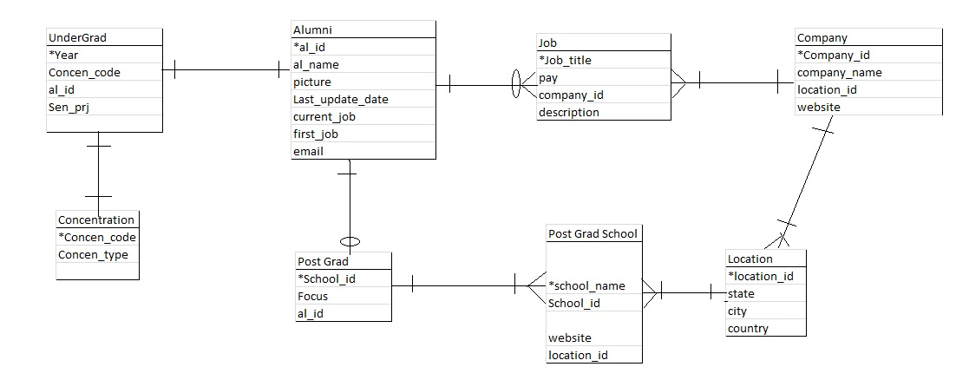
What I’ve Done Cont.
Design
E-R Diagram. Below are some Entity Relationship Diagrams I have created.

Slide 5
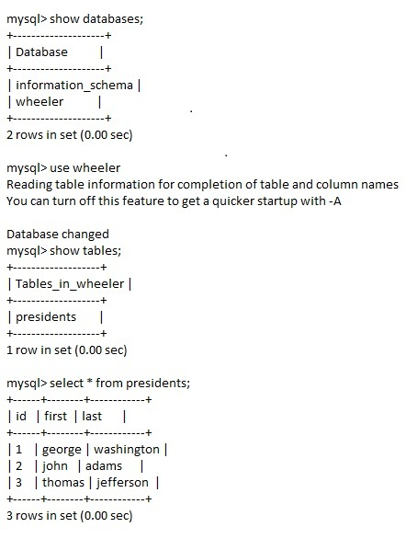
Hello World-ish
mySQL table creation

Slide 6
Hello World-ish
PHP creation
http://compsci02.snc.edu/~wheemj/testmysql.php

Slide 7
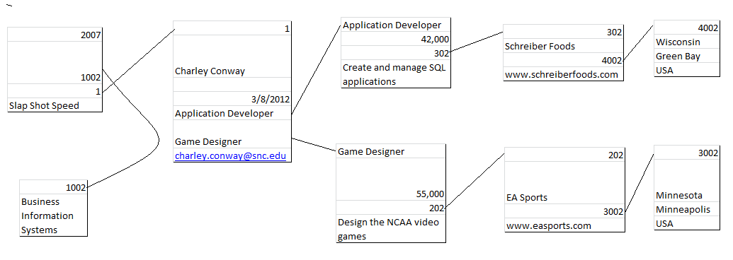
Sample Data
Fake data drawn up of what Queries and tables should look like populated.
Real data: Please fill out hand out

Slide 8
Where I’m going
Turn drawn up data into mySQL tables within my database and use real people(You guys)
Some type of protection and view only options
Design PHP interface
Link the mySQL database to PHP interface

Slide 9
Suggestions?

