Slide 1
Destination Tracking System
By: Matt Johnston

Slide 2
The Project
Design a system that will track the locations of travelers as they head towards a central destination.
Travelers notify their location
Updating visual display
Provide visual and text directions
Travelers based destinations

Slide 3
Accomplished
Visual location rendering
Text directions to destination
Easy user interface

Slide 4
Problems
Adding user defined stops
Creating traveler designed routes

Slide 5
Methodology
Prototyping
Code and Fix

Slide 6
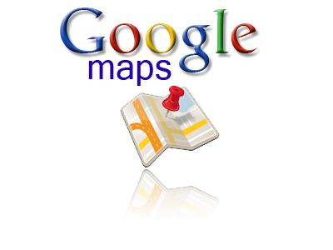
HELP?!
Trial and error
Intensive Reading
Google API developers guide
Dr. Pankratz & Dr. McVey

Slide 7
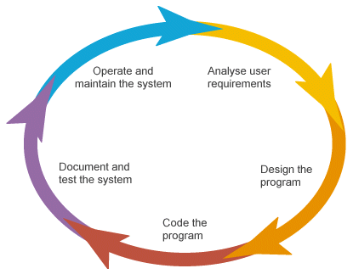
What Helped
Data structures (esp. arrays)
Development life cycle
Adaptability to languages

Slide 8
What Next
Add GPS tracking ability
Allow for more custom routes

Slide 9
Advice
Do not procrastinate
Do in small pieces
Use the people around you

Slide 10
Q&A

