Slide 1
Computer Science Kiosk
Mary Spies

Slide 2
Project Description Definition and Requirements
Definition: Develop an interactive application that showcases the computer science major!
Requirements:
1. Include multi-media and live demos of projects and data
2. Develop interactive and creative apps that describe and promote computer science at SNC
3. Activate hardware demos such as a robot
4. Display a slideshow
5. Run programs designed by students
6. Link to web sites/pages
7. Develop a "game" that quizzes and informs about CS at SNC
8. A screen in the kiosk displays options and results
9. The kiosk is accessed using your mobile device
Notes:
Explain what is meant by the kiosk – the kiosk is behind glass and the user approaches it and is able to play on it using only their mobile device.

Slide 3
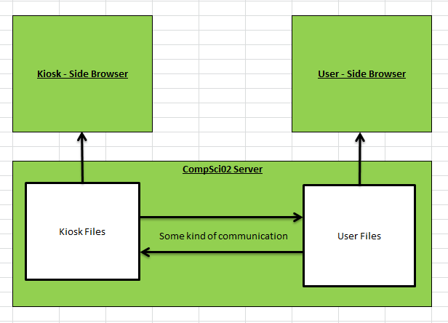
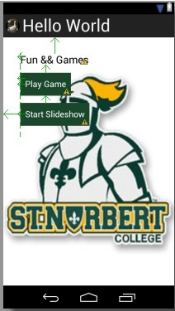
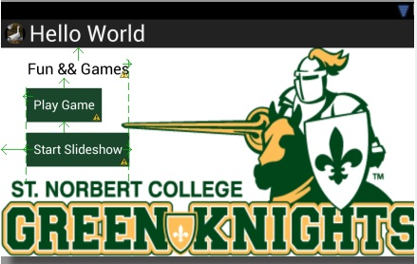
Project Description My Solutions
Finalized game
Started with Android
Two-way browsers
Notes:
I focused on the game portion of the requirements.
I started originally with an Android app. I worked for a few weeks on a Hello, World, never having written one before. Pankratz and I met a few days after I got stuck on a problem, and decided that an Android app might not be the best idea; we want something that is quickly accessible for a passing potential student, say, on a tour. We also wanted something that wouldn’t stay on a student’s phone, like a downloaded app would.
So, we decided to switch to two browser, somehow being able to talk to each other. I had never really heard of anything like it, so it was a novelty for me. It took some thinking about in order to get some ideas. I’ll talk a more about this later.

Slide 4
Project Description My Exceptions
Delay
Phone browsers
Multiple users
Off – campus user
CSS issues
Notes:
- There is a time lag after the user presses a button – sometimes the browser hangs on reading from the text files
- Phone browsers might not have the power to run the program. I’ve tried using it on a smartphone, and when running the browser off the internet provided by the provider, and the power wasn’t enough to handle the two-way handshaking. When I connected the phone to a server through WiFi, though, it worked. This means that in order to work, a player would have to connect to the SNC network, which they can’t do without registering the phone.
- No way of handling more than one player at once, and there is no way of making sure only one player is playing at a time. The kiosk browser is waiting for a change in a text file. The text file is changed by the user browser. If multiple user browsers are active, it still changes the same text file, and can really mess with what the kiosk is expecting to read
No way of preventing a student not in front of the browser to access it. The student wouldn’t have the question in front of them, but someone might just decide to press buttons for the fun of it. Because there is no way of locking a single user, someone might be playing and someone off campus with the web address for the user browser could mess around with it
Even though they all use the same CSS page, some things react differently than others. It’s purely for visual attractiveness, but that’s kinda my thing.

Slide 5
Project Description Methodology
Creating and using a socket: Socket Test
Isolating IP addresses: IP Address Test
Notes:
Looked into a few ideas to create the connection:
The first idea was to create a socket from one browser to the server to connect to the second browser. I was able to create a simple socket to the CompSci server that just gets a bunch of header information. As I found out more about sockets, though, I figured out there were probably simpler ways of doing it, so I kept it on the backburner and then looked into other ideas.
The second idea was to isolate the user IP address and then only allow input from that specific IP address. This would then solve the issue of multiple users playing at once. The problem I had with this was that in order to isolate an IP address, the browser already needed to be running. Essentially, a second user might not be able to get into the house, but would make it onto the porch. There would have to be a secondary catch in order to work, and the IP address would need to stored somewhere besides in the browser.
This got me looking into text files. I wanted something that could be easily accessed and changed by an administrator, in case they wanted to change or add questions. It worked out and was easily accessed from the browser, so I went with it, since I wanted to start work on the actual game. The socket idea was probably the most secure, but I wanted something that worked and that I could work with.

Slide 6
Project Description Methodology
Reading to and Writing from Text Files
Notes:
Explain what each color means: Black arrows mean the browser is redirected, a blue arrow means the file writes to a text file, a red arrow means the file reads from a text file. The blue boxes are files that are used in the handshaking between the two browsers.
The kiosk browser waits and listens for a change in the user_input file.
When a user starts playing, the press play and the file writes to the user_input file. The user_title page redirects to the user – side browser to start playing.
The kiosk recognizes the changes, and moves onto game play, choosing a questions randomly from game_questions.txt and displaying the question and answers to the screen. It also writes the answers into user_answers.txt
The user side browser waits for a change in user_answers.txt, and then reads the potential answers. She displays the buttons to the screen and starts counting down 10 seconds for the user to answer. After 10 seconds, the kiosk checks for an answer, regardless if the user pressed one. This takes care of the user quitting the game unexpectedly.
The kiosk reads the input, either the button pressed, a -1 if the user didn’t answer but the browser is still open, or a blank if the user closed the browser and uses the input to display a message to the screen, and uses the input to either continue the game or stop it.

Slide 7
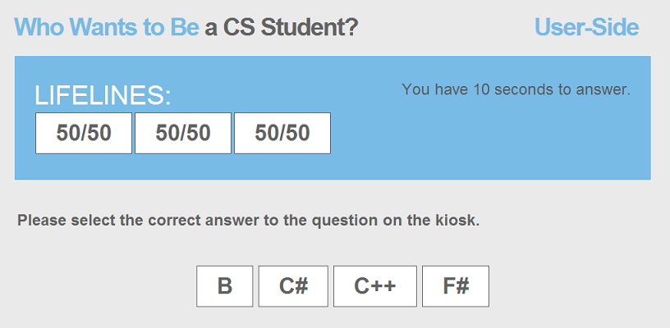
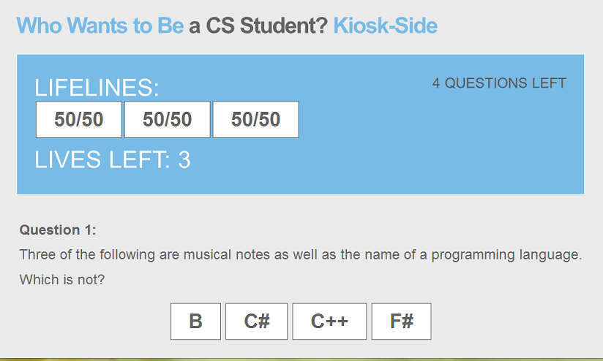
Demonstration Who Wants to be a CS Student?
Kiosk Browser
Notes:
Explain the game:
Each user gets three lives and three 50/50 (explain what a 50/50 is)
Explain the five questions, and how each question is randomly chosen from three
Explain how the answers are parsed and then written to a text file for the user-side to read and display
Once the user chooses an answer, the kiosk compares it to the stored correct answer, displays correct or incorrect, and then an explanation of why that specific answer was the best one.
Explain the timer and how it handles a user closing the browser
Play the game

Slide 8
Demonstration Back-Up Video
Opening Pages
Playing the Game
Winning the Game
Losing the Game
Quitting the Game

Slide 9
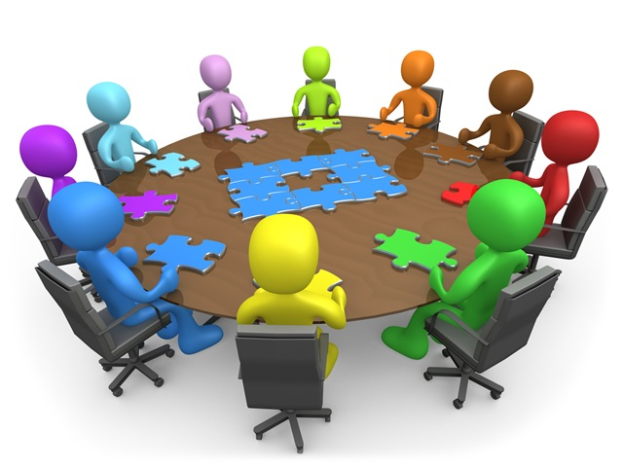
Learning and Development Process Strategies
Fresh pairs of eyes
Google / w3schools.com
Drs. Pankratz and McVey
Being stubborn
Notes:
Fresh pairs of eyes. Through our group walkthroughs, working in small groups, and even just bouncing ideas off others gave me new perspective and new approaches. When I got stuck, also, being able to had over my code to a friend to look through meant that they might be able to find errors that I had missed because I’d looked at it for so long
Google / w3schools.com. I actually found the solution for the JavaScript Ajax loop on w3schools.com, and even just Googling problems I’ve had took me to a lot of tutorials and question/answer sites that were very helpful.
Drs. Pankratz and McVey – came up with a few solutions that no one else could figure out. They came up with the idea of the timer which also solved my issue of the user closing the browser unexpectedly.
Being stubborn. I had to tell myself, and sometimes have other people tell me that my program, despite it’s many issues, is something I’ve worked hard on, and something I’m proud of. In order to actually be able to continue working a semester long project, you have to actually like it. Sometimes I didn’t, but I fought through those moments.

Slide 10
Learning and Development Process Knowledge
Programming Languages
Theory of Computation
Reading from and writing to files using “fopen”, “fwrite”, “fgets”, “fclose”
Notes:
Programming Languages: absolutely necessary to the program working. Having Programming Languages and the Concert Reservation project was very helpful in just getting started with HTML, PHP, JavaScript, and Client-Server Validation. It meant I didn’t have to start with a Hello, World, like I did the Android app. It was another positive reason for switching from Android to browsers.
Theory of Compuation: helpful in catching every possibility and
fopen, fwrite, fgets, fclose – honestly, this one is just for any 110 students that haven’t understand a word of my presentation and are trying to get some extra credit. I’m pretty sure we learned how to use fopen in 110, right?

Slide 11
Learning and Development Process Extensions
Use the title page to finish some of the other requirements
Make the game playable for multiple users
Increase the efficiency of the game
Notes:
Use the title page to finish some of the other requirements. I needed a title page to let the kiosk know that a user was playing, but it also means that there can be multiple buttons. The same process will apply, though. The kiosk will be waiting for a change in the text file, and each button would write something different. This would be an easy way to link to web pages, or display a slideshow. It might be more difficult to activate hardware demos like the robot, but the same idea can be the same: some sort of handshaking between the browser and the robot.
Make the game playable for multiple users: it would be nice to have a setup where each player would be pitted against one another and scores would be kept for each.
Increase the efficiency of the program, decrease the lag, possibly find a better solution than text files as the method of passing information. The idea of sockets might be a good start

Slide 12
Learning and Development Process Advice
Don’t stop when it doesn’t work
Keep the professors updated
Use your blog to brag!
Document as you go
Set accomplishable goals each week
Talk to the other seniors!
Notes:
Don’t stop when it doesn’t work. It means you’ll be less excited about it, and less likely to want to work on it. You’ll never remember what the error was the next time you start again, either. If you want to take a break, that’s fine, but either undo what you did to create a crash, or work through it
Keep the professors updated. They’re here to help, but they can’t if they don’t know what’s going on. And don’t just go to them with problems, either – they’ll be excited at your progress!
Use your blog to brag. (CLICK) You can be humble in real life – and sometimes you can’t contain yourself. You should be proud of your accomplishments and be able to share that pride
Document as you go. The code will work in the end, but that doesn’t mean you’ll be able to explain why and you’ll never think the exact same as you did when you were originally writing it. It only takes a few seconds!
Set accomplishable goals each week – even if it’s something as easy as “write on my blog” or “make it look pretty”, being able to check something off your list will make you feel like you’re making progress, and with a project like this, sometimes you need that boost of self confidence
Talk to the other seniors. Sometimes you just need to hear that someone else is struggling, too, to make you feel a lot calmer

Slide 13
Q & A Any questions for me?

