Slide 1
Door To Door
Ryan Abendroth

Slide 2
Definition and Requirements
Drivers, passengers, and destinations are presented visually on a map.
The map is updated after an event: request, pickup, drop off…
Pickups can be requested and cancelled at any time.
Handle multiple taxis.
Give drivers “what if” capabilities so they can make efficient decisions.
Save the sequence of events and play back.
Distances between objects are computed and displayed.
Each taxi has a maximum number of riders.
Some riders have specific scheduled appointments.

Slide 3
Solutions
Passengers and locations are presented on a map.
The map is updated with selection of route and arrival at destinations (pickups and drop-offs).
Drivers are given “what if” capabilities with ability to select route.
Distances between destinations is calculated and displayed.

Slide 4
Exceptions
Pickups can be requested and cancelled at any time.
Handle multiple taxis.
Save the sequence of events and play back.
Some riders have specific scheduled appointments.

Slide 5
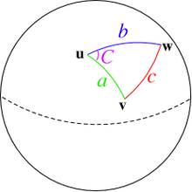
Methodology
Utilized GMap references to display a map to navigate with
Incorporated Geocoding references to retrieve the latitude and longitude of a location and place a marker at that point
To find distances between two points I used the haversine formula to calculate the distance

Slide 6
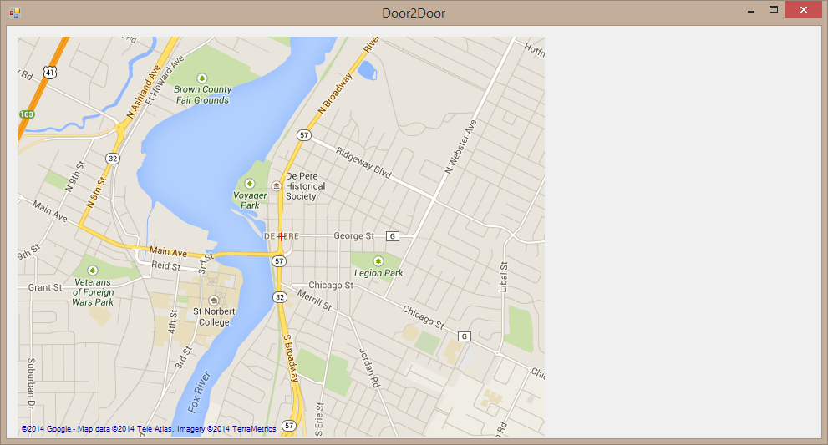
Problems
Getting the map and marks to display
Google queries
Google API can’t find some addresses

Slide 7
Demo

Slide 8
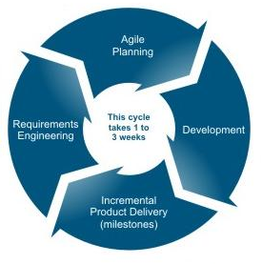
Learning Techniques
Agile Method
Ask professors
Ask classmates
Start with something work and end with something working

Slide 9
Past Knowledge
Intro to Computer Programming (CSCI 110)
Database Modeling and Techniques (CSCI 330)
Event Programming (CSCI 350)

Slide 10
Extensions
Get and store driver location via mobile “driver responsibility” of the application.
Get distance to destinations along actual route taken (with directions from Google).
Multiple taxis and passenger limitations.

Slide 11
Advice
Start right away
Manage your time in a way where you allow yourself to always spend time on the project regularly
Stay aligned with project requirements and scope
Don’t hesitate to ask for help and/or direction
Don’t stay stuck on a single issue

Slide 12
Questions?

