Slide 1
Senior Capstone: Voice Editor
Nathan Heppe

Slide 2
Requirements
The user can easily mark a voice snippet
Save snippets to an appropriate data structure
Design a snippet search/retrieval option
The editor supports functions like play, seek, mark, fast forward, rewind…
Design a compose function that allows the user to create and play a sequence of voice snippets

Slide 3
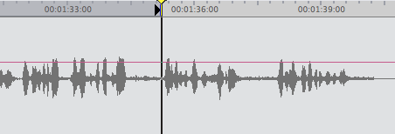
Step 1: Decide on Audio Library and Waveform Timeline
Decided on Naudio for the library
Made it easier to work with sound files
Waveform Timeline
Left this out for the time being
Notes:
Naudio a great decision. It was used to handle audio playback.
Helped with the concatenation and trimming of wav files.
Waveform timeline was very hard to get working and eventually decided that it was more trouble than it was currently worth.

Slide 4
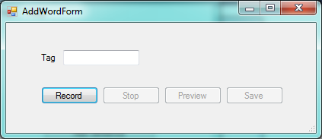
Step 2: Data structure design and saving snippets
Decided that an access database would be easiest
Created a table for my initial needs
Was able to get a proof of concept for saving snippets
Added entry into the access database
Copied file into a specific location
Notes:
Talk about what columns were added to the initial database.
There were probably more than were actually needed
Initial just recorded and saved words just so I could get a proof of concept.

Slide 5
Step 3: Played speech recognition
Added to the save word screen
What I used
How well it worked
Notes:
I thought that speech recognition would have been cool but it was very unreliable.
Say test get the tree

Slide 6
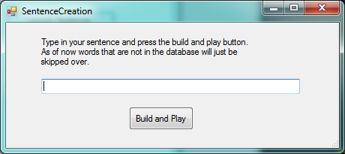
Step 4: Initial Sentence Creation
Initial design of the screen
How the building worked
Flaw
User needed to know what snippets were in the database
Notes:
You essentially just typed out the sentence that you wanted and hoped that the words were in the database.
Talk about the concatenation of wav files
Essentially just a dump of each file after each other. Giant copy and paste
Flaw was that the user would need to know all possible snippets
This is another stepping stone part of the program

Slide 7
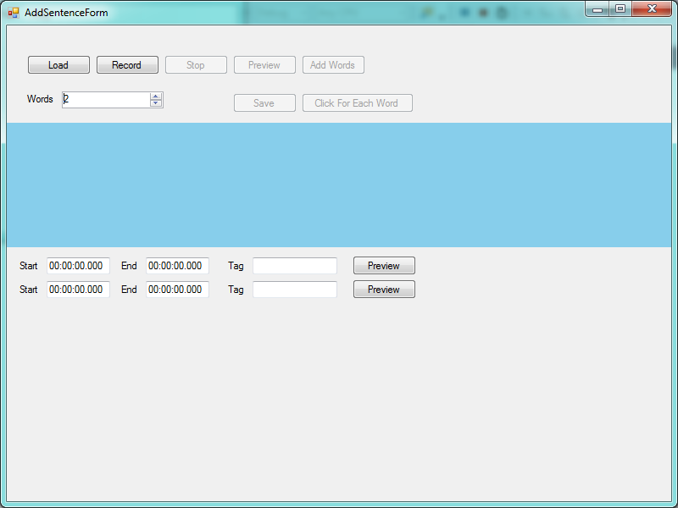
Step 5: Initial Snippet Editor
Taking multiple snippets from a sentence
Initial design very hard to use
Continual struggles with waveform timeline
Helpful
Was able to learn how to start a wav file from the middle of the file
Figured out how to “trim” wav file
Notes:
Initially was thinking that just words would be saved
Talk about the words
Add words button and click for each word
Decided that it was too complicated of a screen to be using, numbers wouldn’t mean anything to the average user.
Talk about the helpful things
Trimming sound files
To get the start and the end I used functions I found online which essentially find the number of bytes per millisecond and then trim out the bytes that the user marks out.
Can try to go into more detail later.
Have start time and end time in milliseconds
Find bytes per millisecond = WaveFormat.AverageBytesPerSecond / 1000
start = milliseconds from start * bytesPerMilliSecond
end = milliseconds from start * bytesPerMilliSecond
moved position to start
while position < end write data to the new file

Slide 8
Step 6: Final Snippet Editor
Finally looks like an editor
Decided on track bar rather than waveform timeline
Much more intuitive than the last design
Can now save to a specific person
Notes:
Was going to try and make a custom wave form time line but the drawing on it was not very good
Decided on the track bar which actually moves pretty smoothly

Slide 9
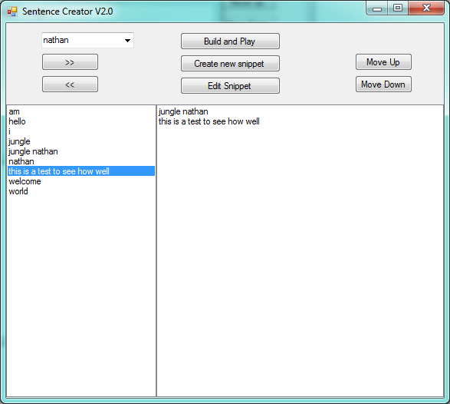
Step 7: Final Sentence Creator
User no longer needs knowledge of what snippets are available
Can now create on specific people
Notes:
Talk about why the layout ended up being what it is

Slide 10
Step 8: Final Data Structure and saving files
Database design
Decided to create new file for snippet
Hash | Word | File | Start | End | Duration
Hash | Word | File | person
Notes:
Explain why each snippet is saved as its own file
There is no primary index because there could be a hash collision

Slide 11
Things I would like to add
Drag and drop on the sentence creation form
Embed the database rather than use access
Access requires office to be installed on the computer
Add a snippet manager
Delete
Rename
Preview
Make an installer for the program
Handle Naudio dll

Slide 12
Methodology
Took small steps and built up
Savings words to saving snippets
Building sentence from typing to using a list box
Recorded before loading in files
Created a CustomSound Class
Handled the trimming and concatenation
Include audio playback and file loading

Slide 13
Demonstration
Notes:
http://www.voiptroubleshooter.com/open_speech/index.html
The Open Speech Repository

Slide 14
Strategies
Technical questions
Primarily searched the internet for answers
Concatenate and trim functions
Asked Dr. McVey for input
Track bar instead of custom waveform timeline
Design questions
Asked Dr. Pankratz for input
Notes:
Stack overflow – put links to functions in my code
For Dr. McVey talk about paint issues I was having and her help
Dr. Pankratz all design questions went through him

Slide 15
Knowledge
Event Programming
Used access databases
Data structures
Used queues
Notes:
Since this was a C# program Event Programming helped
access database
events and form programming
Data structures
used queues

Slide 16
Extensions
Try and get a waveform timeline working
Include speech recognition
Somehow map words to specific locations in the file
Allow for any audio file to be used

Slide 17
Advice
Use Naudio
Very powerful in what it lets you do
Can use more than just WAV files
If you have to make a work around for the time being do it
Notes:
At first I was not sure how I was going to handle new wav files so I recorded myself and used that.

Slide 18
Wrap up & Questions

