Slide 1
Finding Fido
Linsey Zwiefelhofer

Slide 2
Requirements
Description:
Build a system that assists in visually recognizing lost dogs.
Requirements:
Select a platform or platforms.
Find a good face detection algorithm or build your own.
Decide on other possible attributes that identifies a dog.
The app might narrow the possibilities rather than looking for an exact match.
Could the owner be notified WHEN a match is found?
Perhaps doggie (Amber type) alerts are generated.
Decide how/when pictures are removed from the site.
Notes:
General premise: use facial recognition to find lost dogs.
Here’s a scenario: <>
When I got the assignment, I was pretty intimidated.
Facial Recognition is hard enough with humans, let alone a dog. Don’t they all kind of look the same?
I thought they had way too much faith in me.
BUT, 15 weeks later…

Slide 3
Solutions & Exceptions
Notes:
Android: slightly familiar with it and easy for pictures
Firebase: cool web-based tool to store all of my data, BONUS: user authentication
Meat of the app: Reqs said find an algorithm or write your own.
After spending probably too much time on research, turns out said algorithms for animals aren’t widely available, so I wrote my own. Touch on it in a sec
Didn’t get to alerts. Two-fold. Notified on match and “Amber Alerts“
Have ideas and some framework implemented, cover it at end

Slide 4
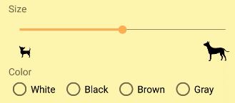
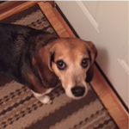
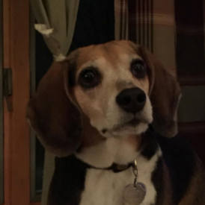
The Facial Recognition
Notes:
Backing up, I want to explain my facial recognition algorithm a bit.
I iterated on it quite a bit, because I had some grand ideas at the beginning, but they weren’t realistic as I moved forward.
Essentially I perform a ton of calculations with the help of some user input.
<explain calcs and boxes>
I realized a few things after running some tests.
1-the dog needed to be head on to the camera.
2-the tilt of the dog’s head makes a difference
3-an exact match would be hard, instead narrow it down

Slide 5
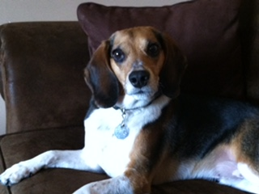
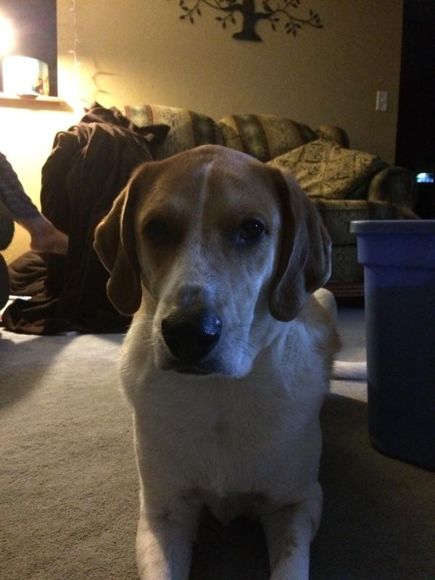
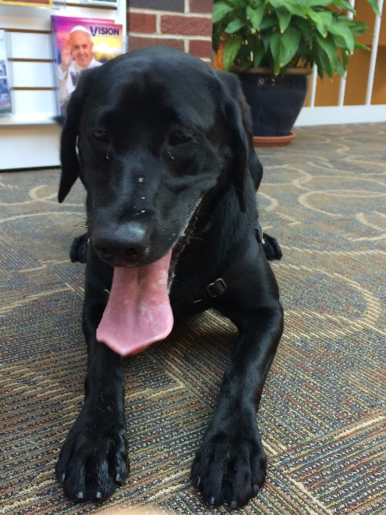
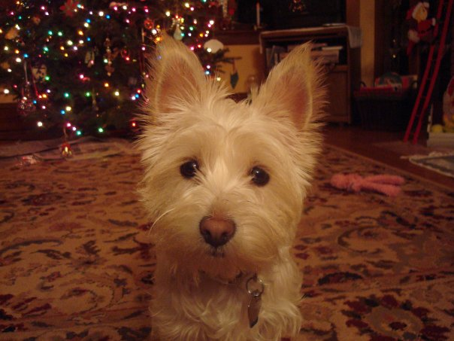
Demo!
Notes:
All that in mind, let’s put it to the test.
<Set the scene and walkthrough>
So that’s the app! But how did I get there?

Slide 6
Created Design Mockups
Bookmarked helpful websites
Methodology
Used mini apps to test features
Performed calculations tests

Slide 7
Strategies
Firebase Documentation
GitHub
Android Documentation
Stack Overflow
Error Logs
Notes:
When I started, I didn’t know how to do a lot of what I was wanting to do, so I did a lot of research.
Here are the gears that kept me chugging along.

Slide 8
CS Concepts
Classes
Building Blocks of Java
Data Structures
Specialized cases
Comments
What did this do again?
205, 350
110, 205, 220
110 - 460
Notes:
However, not everything was totally new.
My CS courses gave me a pretty solid foundation to build off of.

Slide 9
For next time…
Notifications
Location
Contact Mechanism
Error Checking
Browse Page Features
Notes:
So, I’m graduating in 10 days, which means my work ends here.
What can the next student expect to look forward to?

Slide 10
Bits of Wisdom
Take a leap of faith
Make lists with deadlines
Don’t underestimate documentation
Ask people outside of CS
Know when to walk away
Notes:
Finally, a bit of advice for all future seniors:
Take a leap of faith - eventually you have to stop researching and just try it
Make lists with deadlines - I had two capstones and wouldn’t have made it without my to-do lists. Didn’t necessarily meet all my deadlines, but it’s also helpful to have something to aim for.
Know when to walk away - don’t spend 3 hours on one issue, chances are you’ll come back and fix it within 30 seconds, also at the end of the project
Ask for help outside of CS– sometimes you need a non-technical perspective to simplify things
Don’t underestimate the power of documentation – trust me, you’ll be glad you left yourself little notes later.

Slide 11
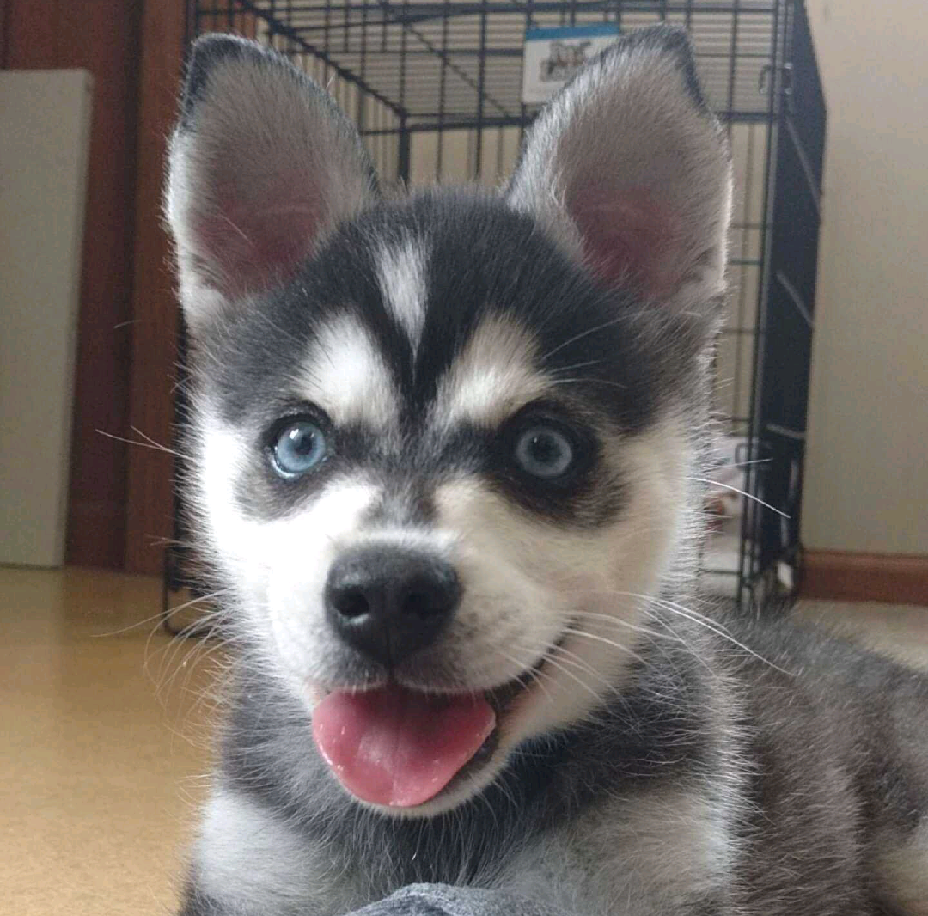
Questions?

