Slide 1
Data Illustrated by Tag Clouds
By Gavin Kijkul (Dino)

Slide 2
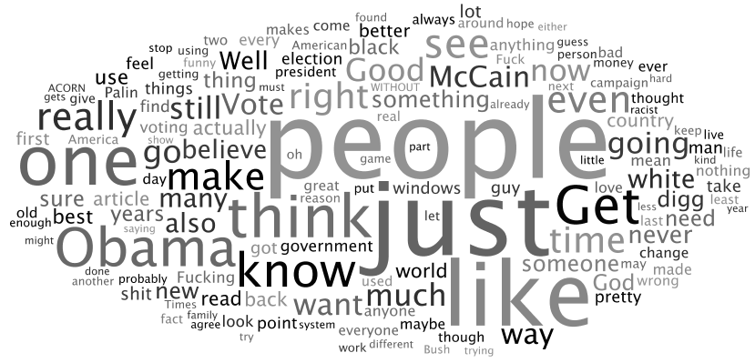
Overview
This project collects data from an online source, processes and stores the data (words and their frequency), then constructs a tag cloud that represents the data.

Slide 3
General Requirements
Describe the most frequent words in the cloud
Input number of tags in the cloud
Use visual attributes to describe the tags
Use a genetic algorithm to determine the best fit by trying to minimize white space
Consider orientation and other parameters
No overlapping words
Should be general enough to handle more than one set of data
Clicking on a visual might provide more information

Slide 4
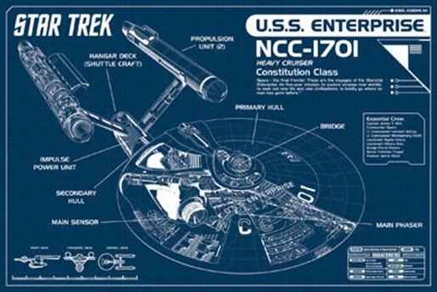
The Plan
Collect Data
Process and Store Data
Genetic Algorithm
UI
Prepare Presentation

Slide 5
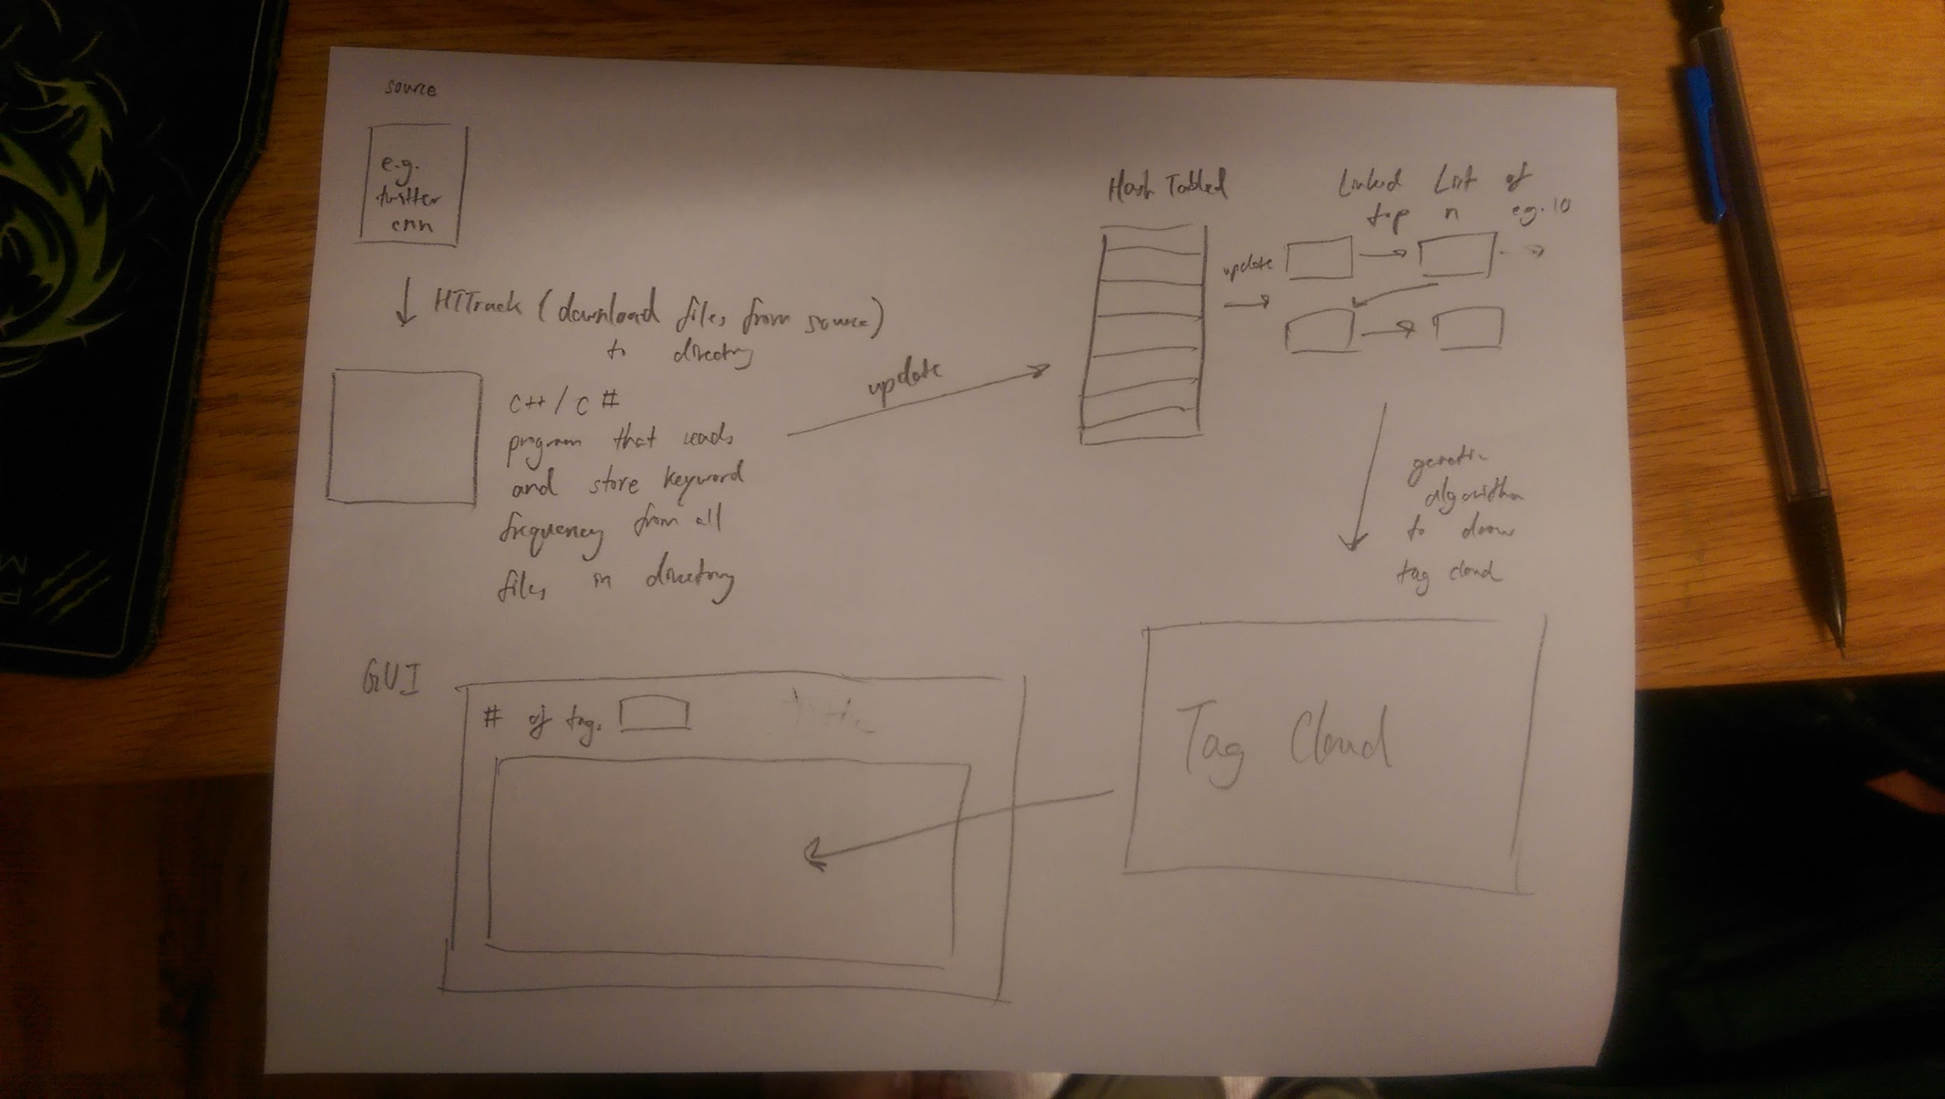

Slide 6
Data Collection
Web Crawlers
HTTrack by Xavier Roche
Retains original relative link structure
There is a command line version, but I used a GUI version

Slide 7
Processing
sfbfb
VAR
CVPID
DOC
CLEARFIX
ISPAUSED
Recursively goes through the files
Filter out and ignore Stop Words and code
THE A BECAUSE THIS HER DOES AND ON OFTEN MY OF LIKELY NEITHER MIGHT RATHER USING VIA ELSE WHY TOO EVERY CAN DO IS

Slide 8
Is a question the same as a question??
I try to look out for letters and symbols used in code.
What I did:
Trim words (whitespace and punctuation)
Make sure uppercase and lowercase does not matter
I made everything uppercase.

Slide 9
Processing: What I did not do well
Given: <area alt="AMC Networks International"
My program ignores “<area” as it should.
My program should not ignore the AMC in “alt="AMC”, but it does (because it finds a " in the middle of the token, not on the outside)
“Networks” and “International"” are properly processed

Slide 10
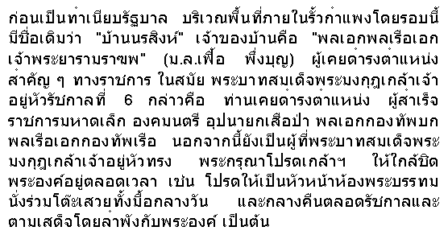
I did not deal with non-English symbols and characters.

Slide 11
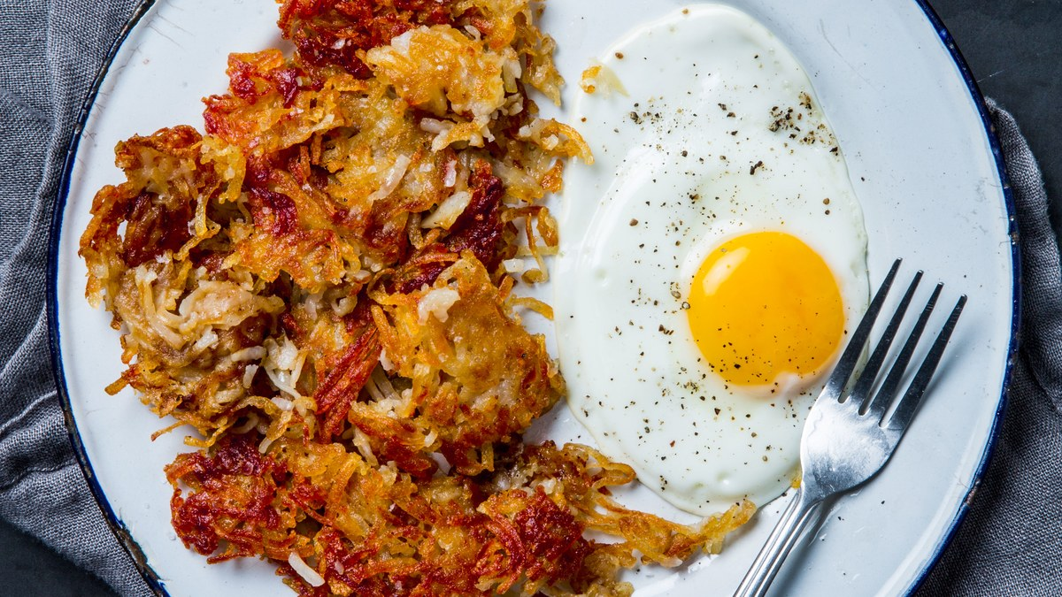
Storing
A hash table is used to keep count of words.
They are fast and words serve as unique keys to easily keep track of their frequency count.
C# provides a hashtable class.
First time it uses a key - set value to 0
Each subsequent time - increment value

Slide 12
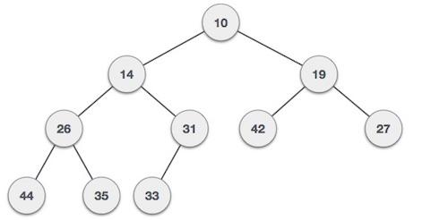
A min-heap is used to keep track of the top 100 words.
Save top 100 words and their count values in a text file.
Store into a text file.

Slide 13
The Genetic Algorithm
Based on natural selection
Solutions as genomes/chromosomes
Fitness
Mutations
Crossovers
A Mechanism that determines what happens to which genome

Slide 14
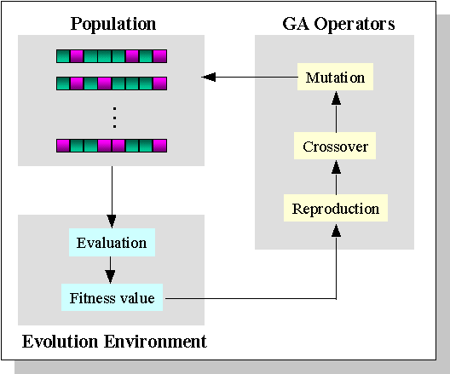
http://www.ewh.ieee.org/soc/es/May2001/14/Begin.htm

Slide 15
My Design
Generating generation zero
Solution population as genome class objects
A genome has all the information to regenerate a particular tag cloud
Randomize array content order to produce different genomes

Slide 16
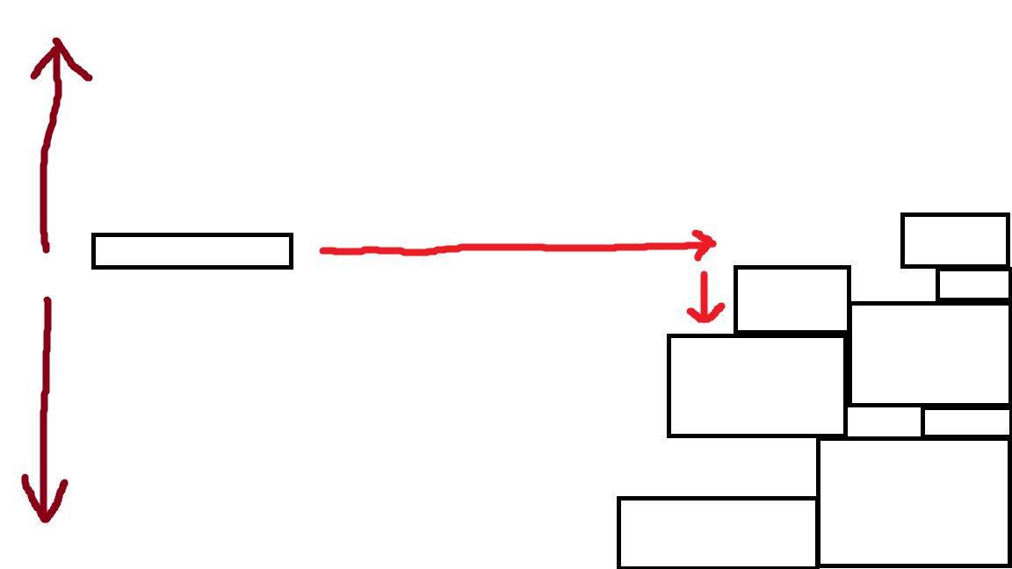
Randomized y-coordinate

Slide 17
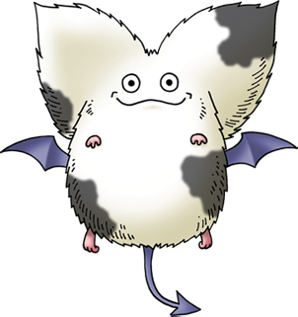
Determining Fitness
Being fit means having the least whitespace.
In order to mutate and do crossovers, the scale has to be standardized.
If all words are scaled down by the same scale throughout the genomes, then given the same “canvas” size, they will all leave the same amount of white space.

Slide 18
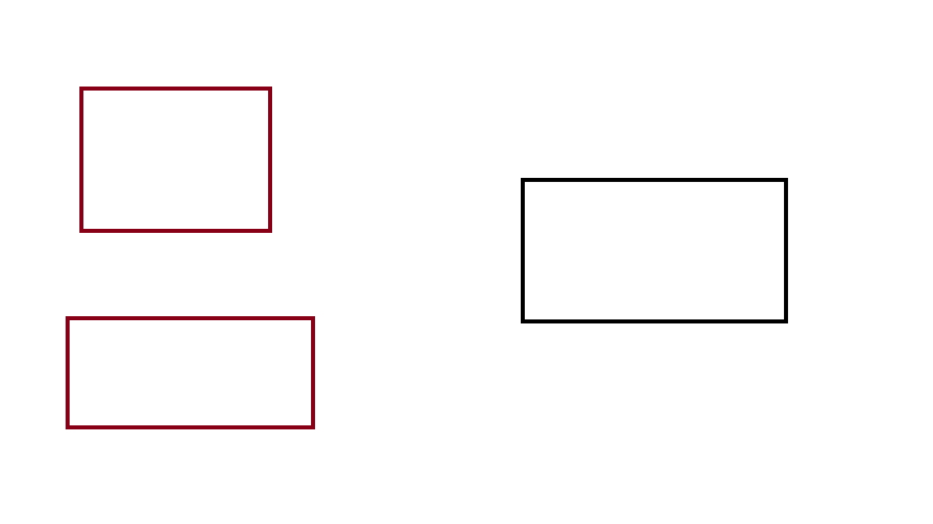
Fitness = genomeArea / totArea;
A small ratio means that there is less white space in that genome.
20
25
20
30
15
30

Slide 19
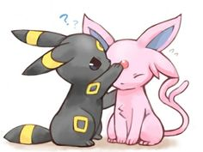
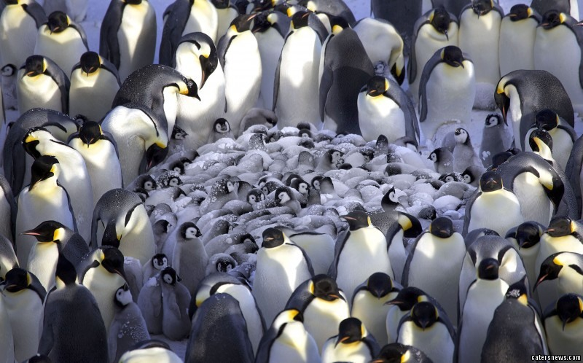
My Mutation Algorithm
Find a clump (Rectangles generally suck)
Regenerate everything else but keep the clump intact

Slide 20
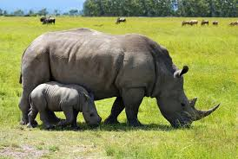
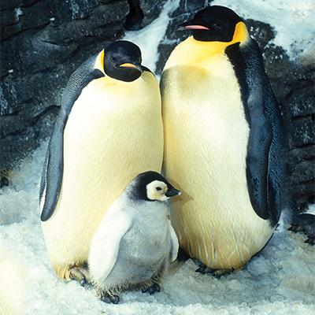
Crossovers
The idea is to create a new genome by combining the data of two different parent genomes.

Slide 21
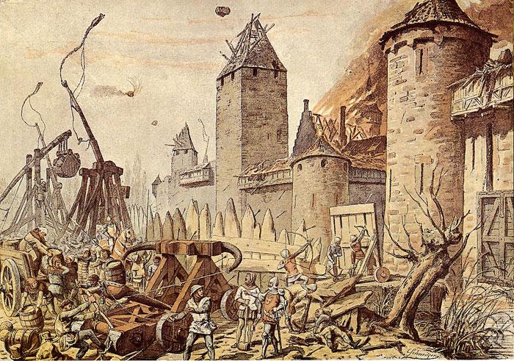
Obstacles
I could not come up with a clean way of making this happen.
Each genome does not have the same clump contents, so exchanging clumps mean I need to get rid of other parts of the genome I might not want to.
Doing so could ruin the genome’s fitness and integrity.

Slide 22
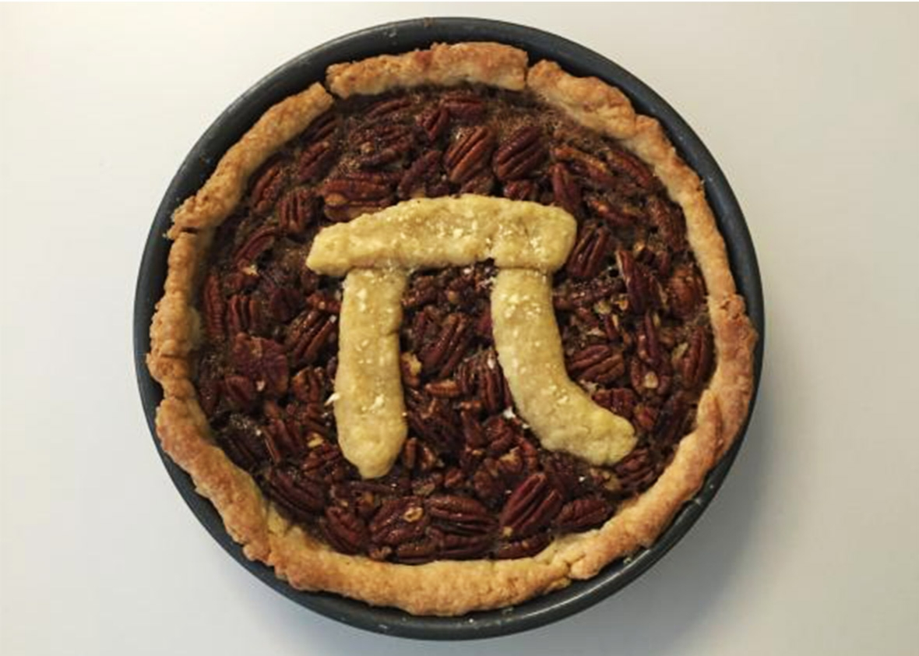
The Roulette
Make it so that the more fit a genome is, the more likely it is to be chosen for crossovers. Healthy parents tend to make healthy children.

Slide 23
Time for the Demonstration

Slide 24
Learning and Development
Concepts that proved very useful during development:
Data structures: hash tables and heaps
Classes and objects
Event programming
Recursion

Slide 25
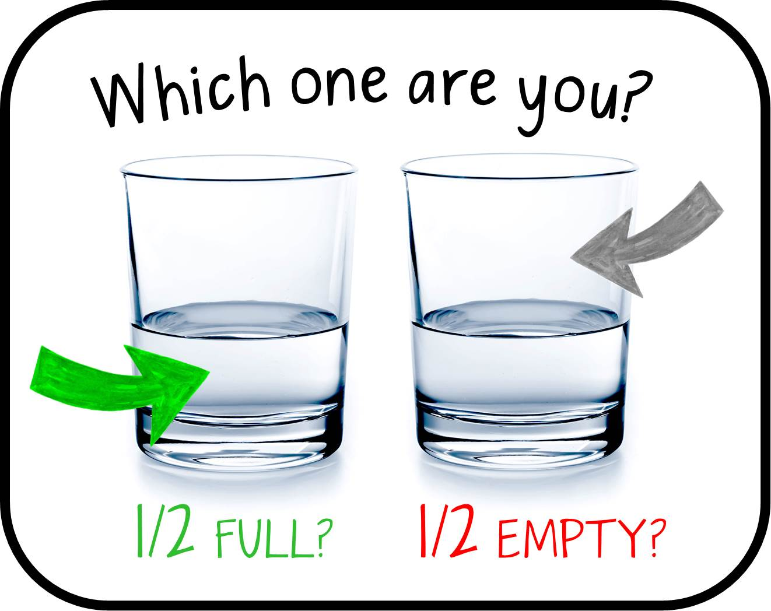
Unfulfilled Requirements
Use visual attributes to describe the tags (I only did size)
Use a genetic algorithm to determine the best fit by trying to minimize white space (no crossover)
Consider orientation and other parameters
Clicking on a visual might provide more information

Slide 26
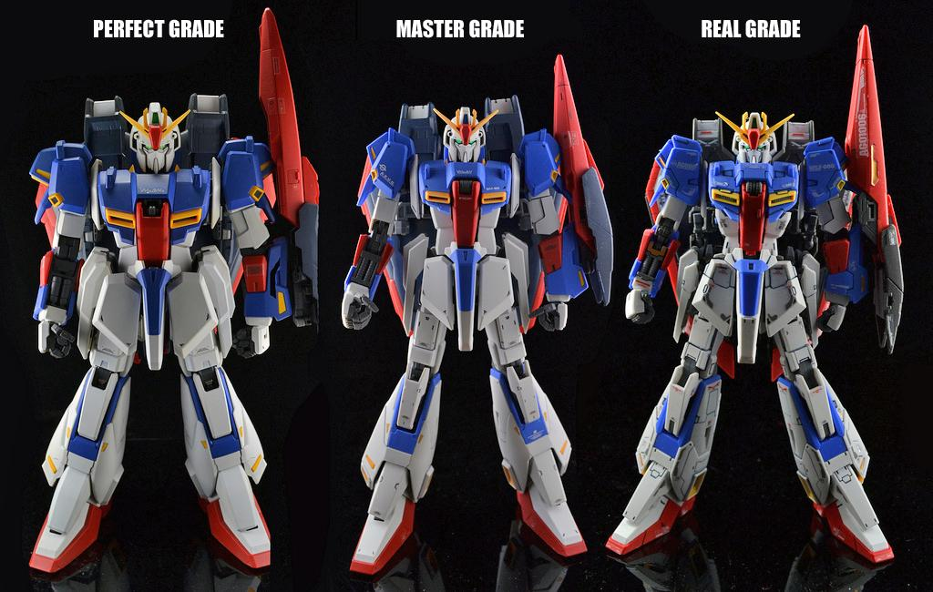
Potential Improvements in the Design
Using other shapes, such as circles, instead of rectangles
For finding clumps, representing words, etc.
Check for jumps instead of set ratio and number when finding clumps
Randomize the text file data order so that smaller numbers don’t tend to shop up first

Slide 27
Possible Extensions
In addition to the unfulfilled requirements, some enhancements might include:
Instead of an open canvas, let a user choose an enclosing image for the tag cloud to be in e.g. heart shape
Being able to combine words from different sources and being able to discern which word is from which set once the tag cloud has been generated
Provide additional information for each word once the tag cloud has been generated

Slide 28
Advice
Certain decisions early on set what I could or could not do later, so try to plan ahead as best you can
Try to work on it everyday
Try not to give in to despair when you realize you’ve been a little too lazy
Don’t compare yourself to others’ progress

Slide 29
