Slide 1
Self Driving Car Robot
By:
Julio Fuentes
Matteo Toffolon

Slide 2
Project Definition
Design a self driving robot that interacts with its environment in real time.

Slide 3
Goals
Research self driving cars.
Investigate/implement sensors.
Design a “road” and smoothly drive it.
React in real time.
Use parallel processing.

Slide 4
Self Driving Cars

Slide 5
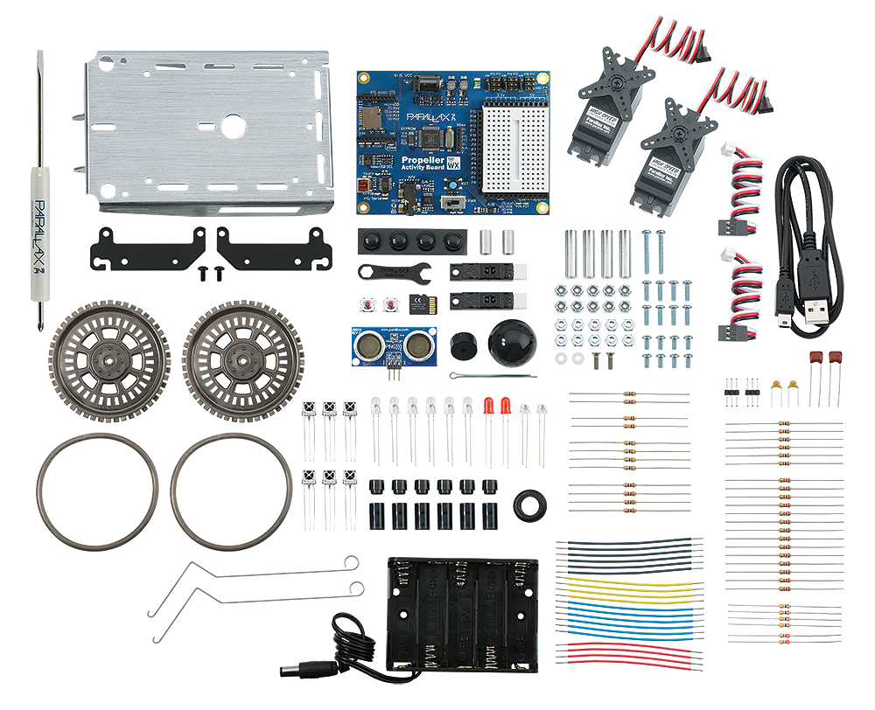
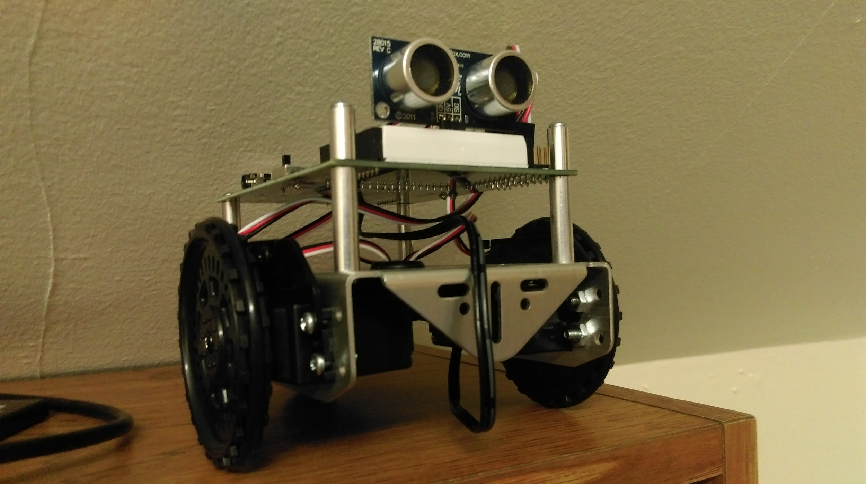
How we started

Slide 6
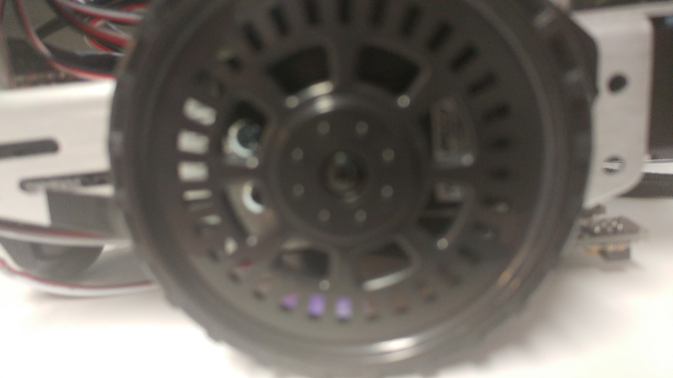
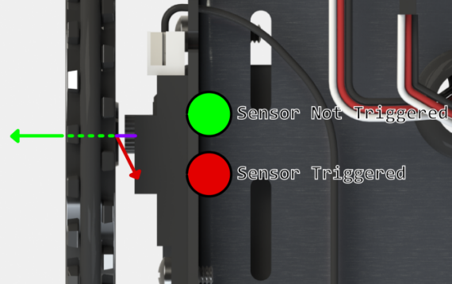
Servos & Encoders

Slide 7
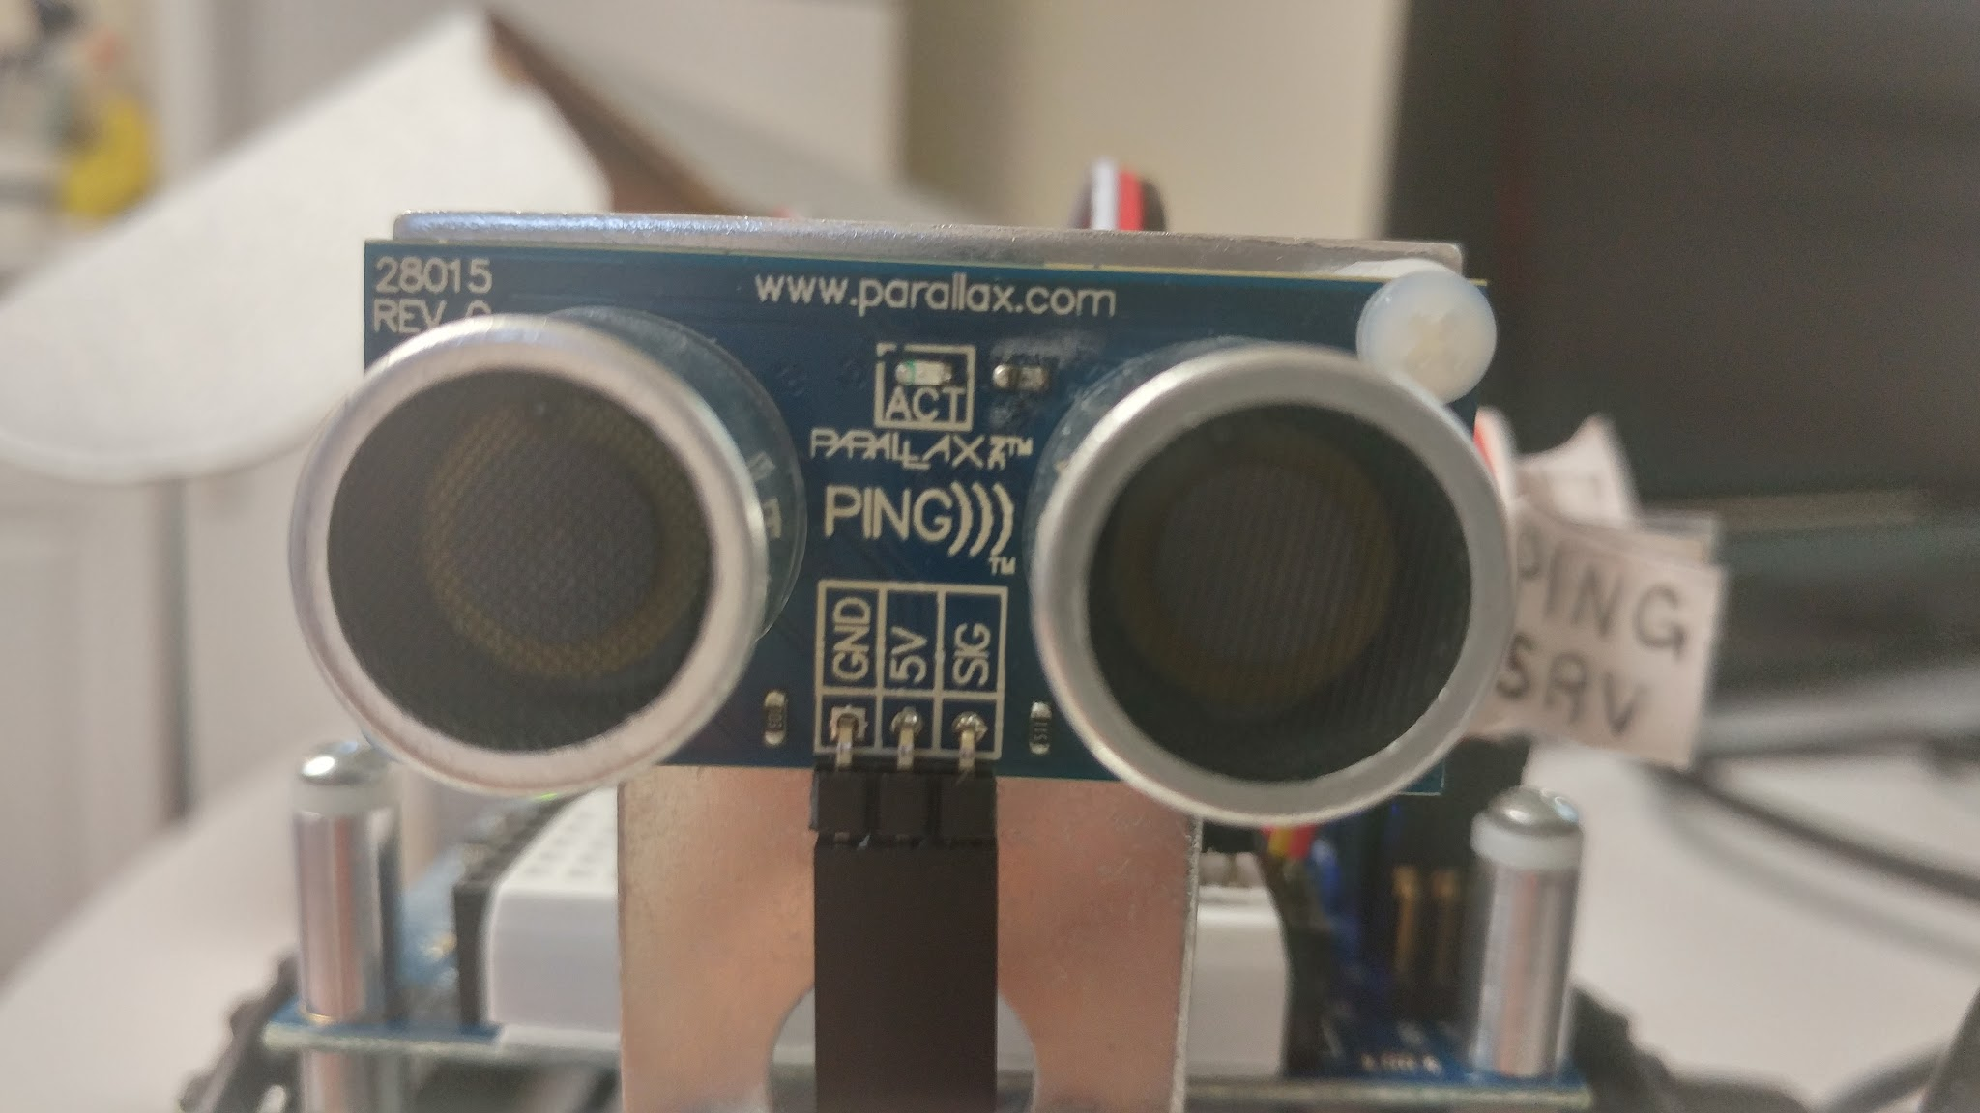
Ping Sensor

Slide 8
Research

Slide 9
Moving Servo

Slide 10
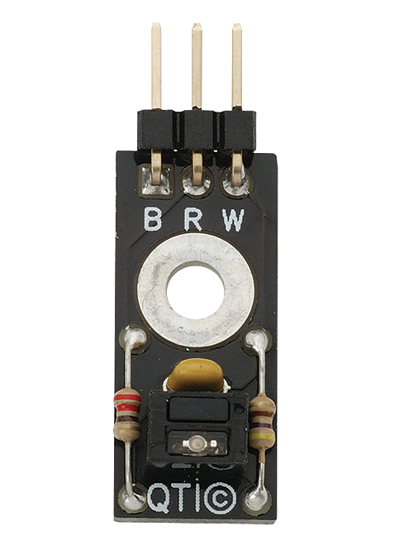
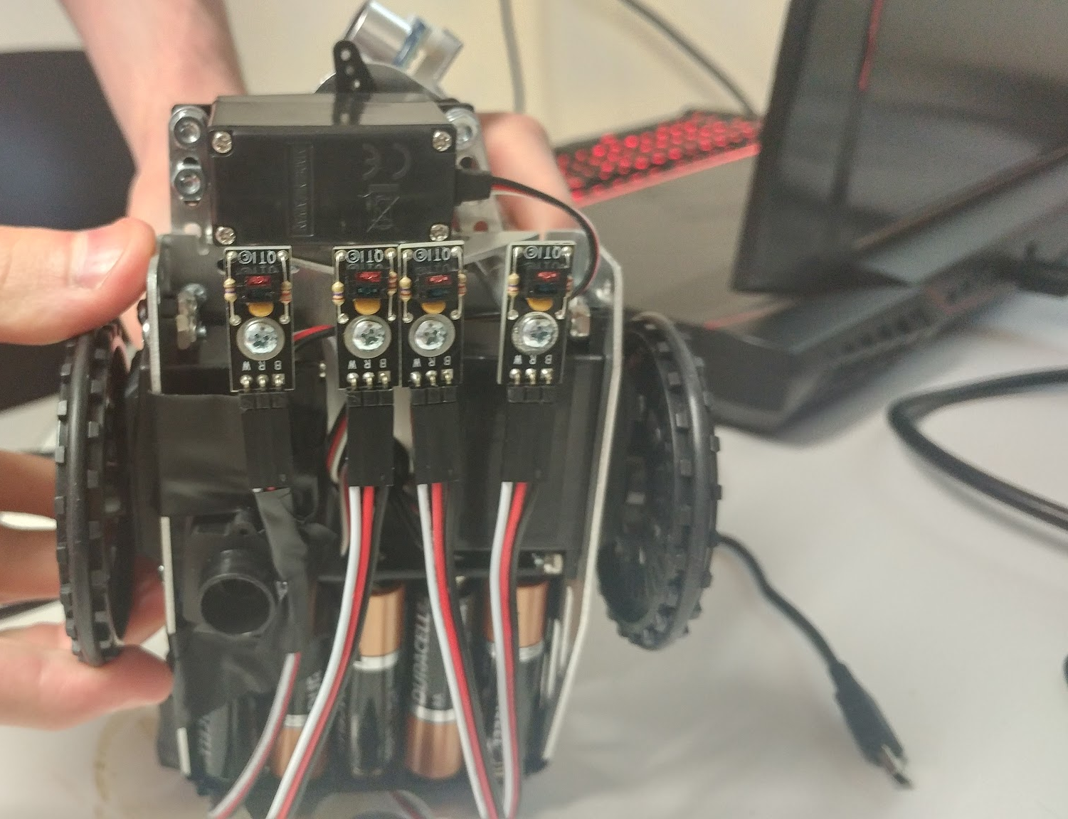
QTIS

Slide 11
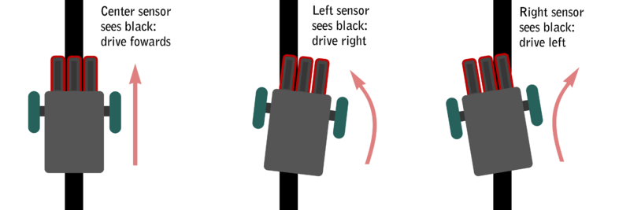

Slide 12
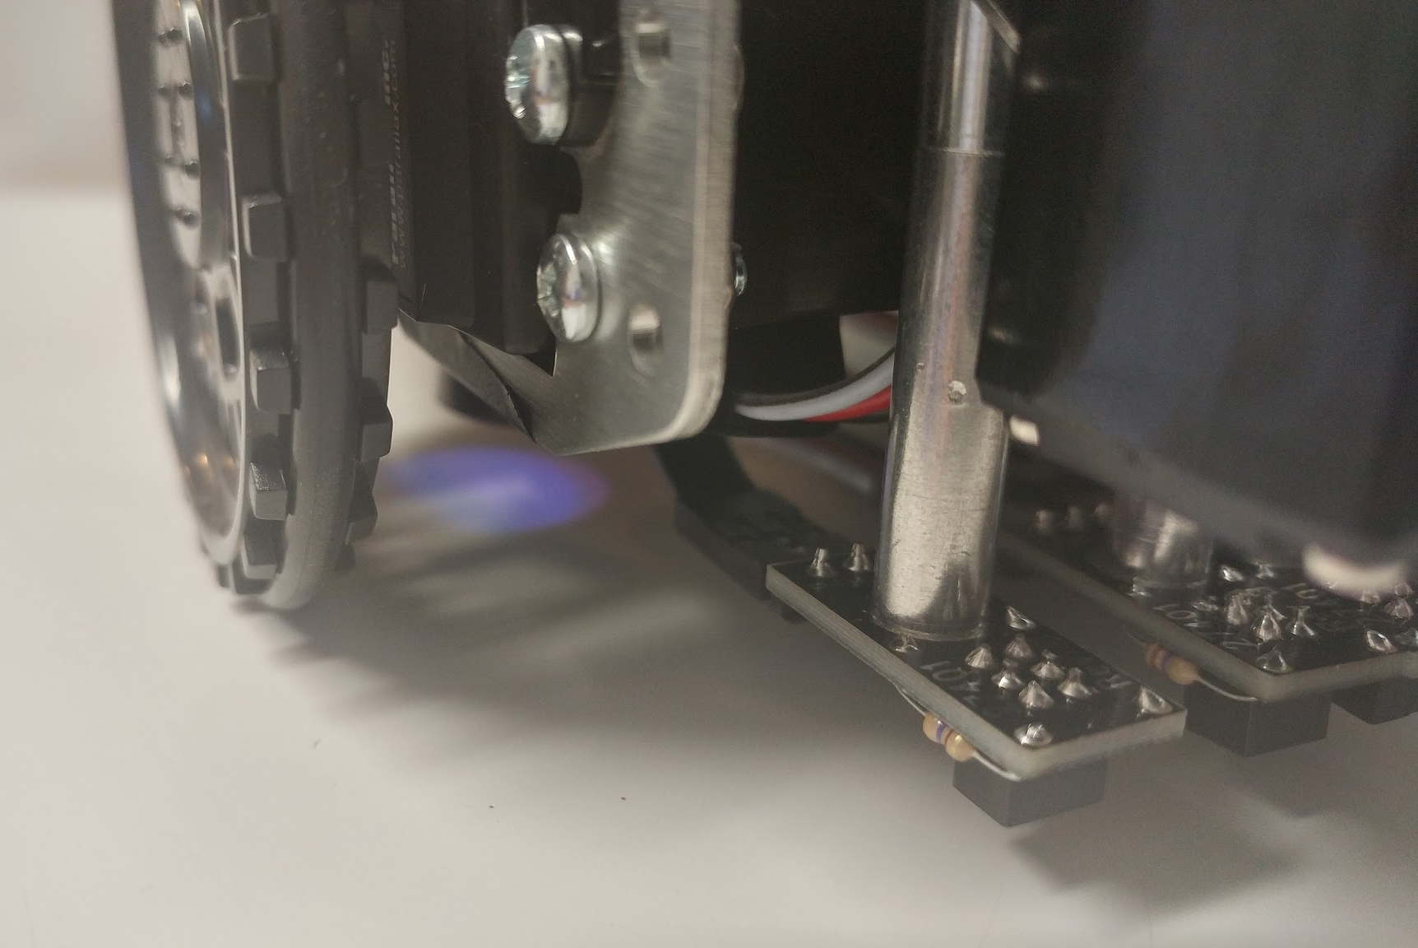
Color Pal

Slide 13
Parallel Processing

Slide 14
The cogs in our machine

Slide 15
Live Demo
Disclaimer: Not 100% fool proof.

Slide 16
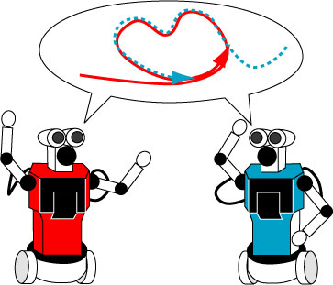
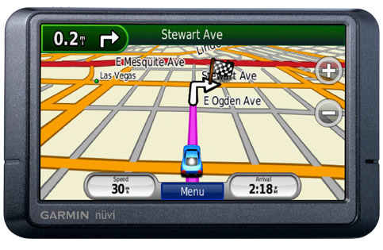
What we didn’t solve

Slide 17
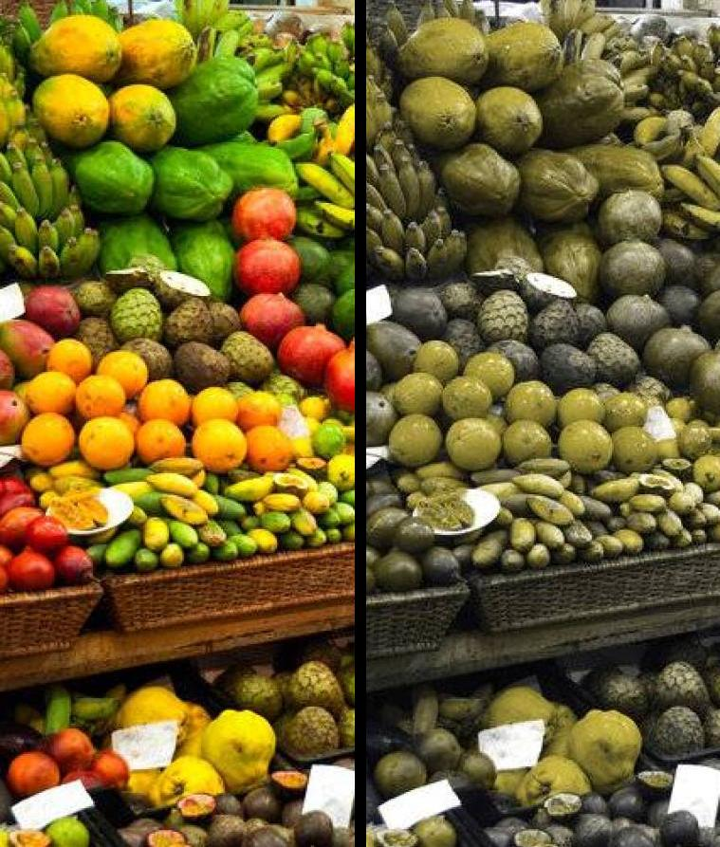
Big Issues
Colors!
Unexpected errors.
Broken encoder.

Slide 18
CS Knowledge

Slide 19
Expanding the Project
Wi-fi
SD card
Pathfinding
Optimization

Slide 20
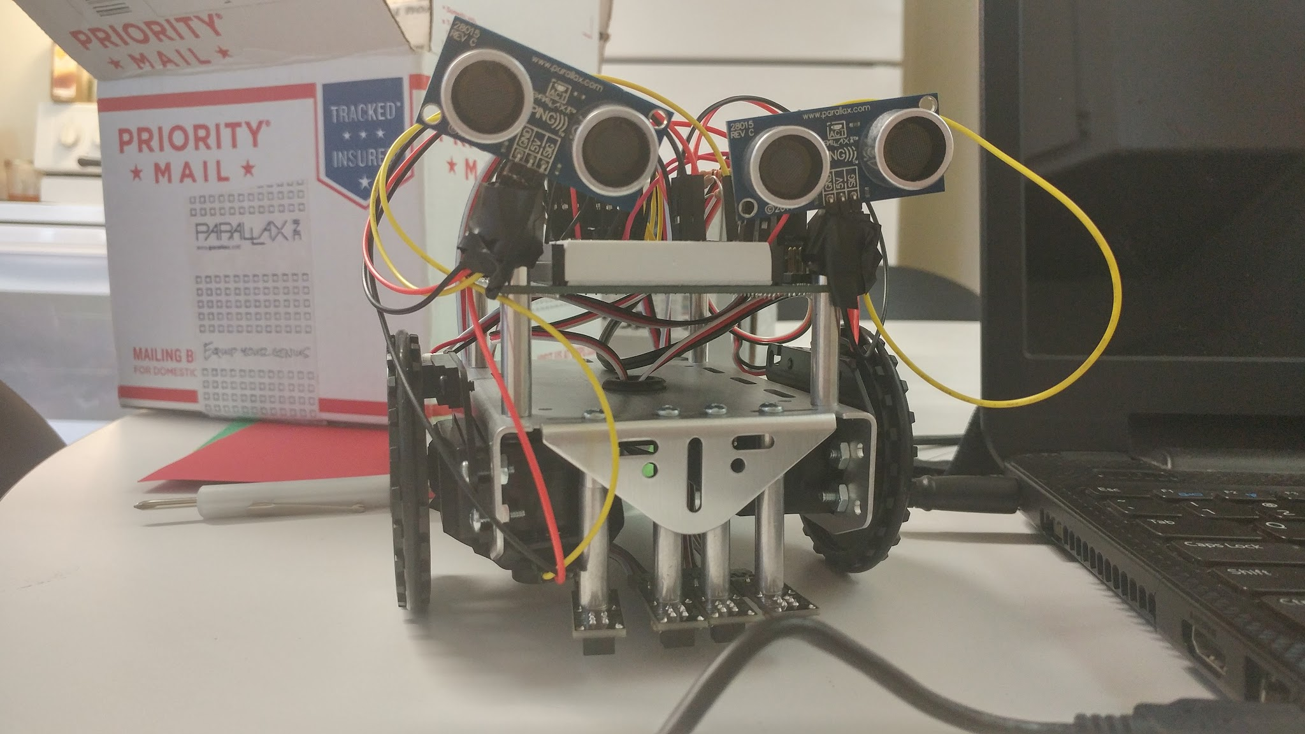
Advice
For Seniors
Plan for the unexpected.
Don’t be afraid to experiment.
Maintain video evidence.

Slide 21
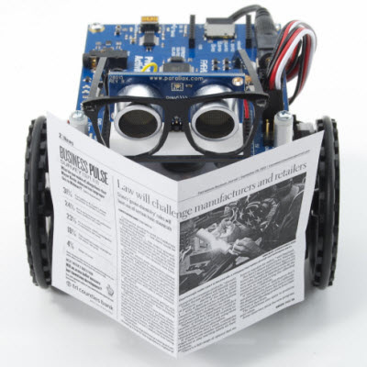
Questions?

