Slide 1
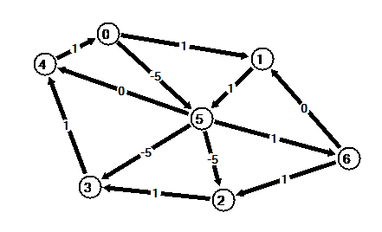
Visualizing Graph Algorithms
Trisha Wilquet

Slide 2
Project Description
“Develop software that enables the user to create graphs, display them visually, and step through the execution of common graph algorithms.”

Slide 3
Requirements – Graph Creation
Add/delete vertices and edges using the mouse or dialog boxes.
Allow directed or non-directed edges, weighted or non-weighted edges.
Number the vertices.
Drag vertices with all adjacent edges moving relatively.
Read/write graphs to disk file.

Slide 4
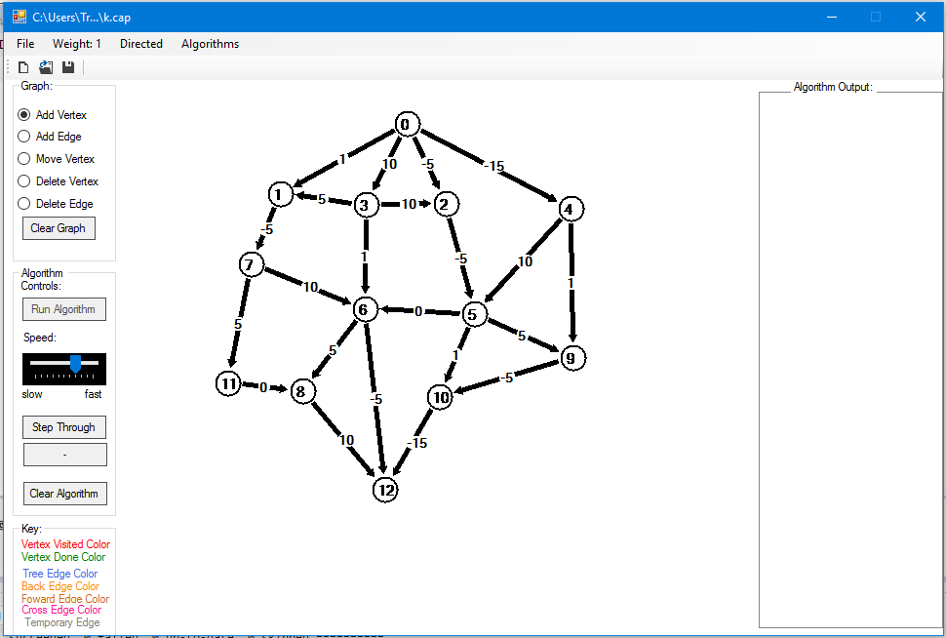

Slide 5
Requirements - Algorithms
Set the speed of the animation. - (timer and trackbar)
Step through an algorithm. - (forward and backwards)
Back up and jump ahead in the algorithm.
Implement and provide visualization of Depth First Search
Implement and provide visualization of Breadth First Search
Implement and provide visualization of a Minimum Spanning Tree Algorithm (Prim or Kruskal)
Implement and provide visualization of a Shortest Path Algorithms (Dijkstra and Warshall) (Bellman-Ford-Moore)
Connected Components
MaxFlow/MinCut Algorithms
Other.
(Not expected to do all algorithms)

Slide 6
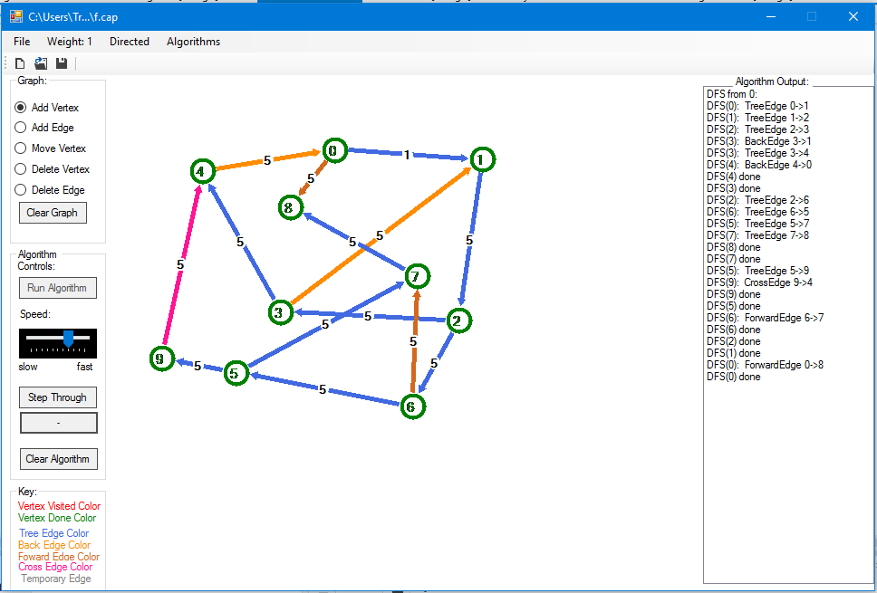

Slide 7
https://image.slidesharecdn.com/maxflowmincut-140407042135-phpapp01/95/max-flow-min-cut-18-638.jpg?cb=1420522395

Slide 8
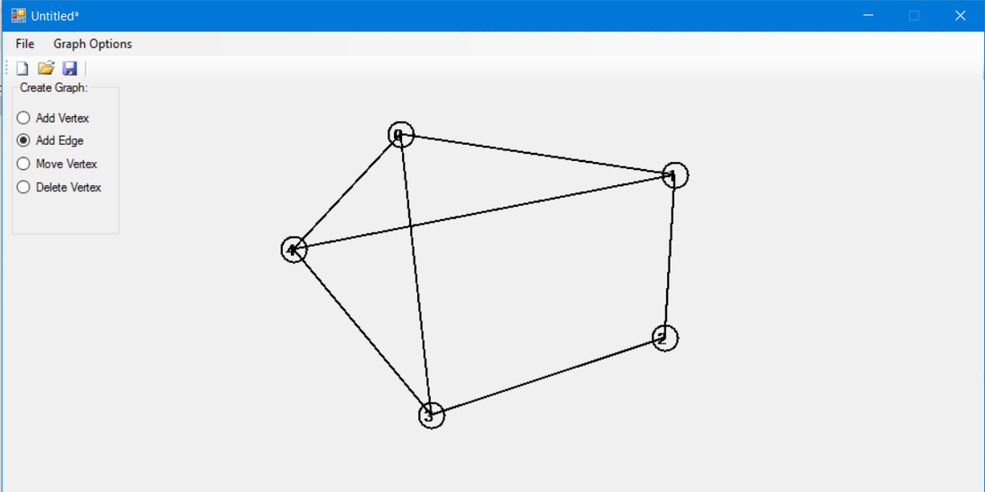
Methodology/Strategies
C#
Started with graph creation
CSCI 350 Lab 6 – connect the dots with mouse - Vertices
Added edges – trig.
Delete edge – find slope and equation of line

Slide 9
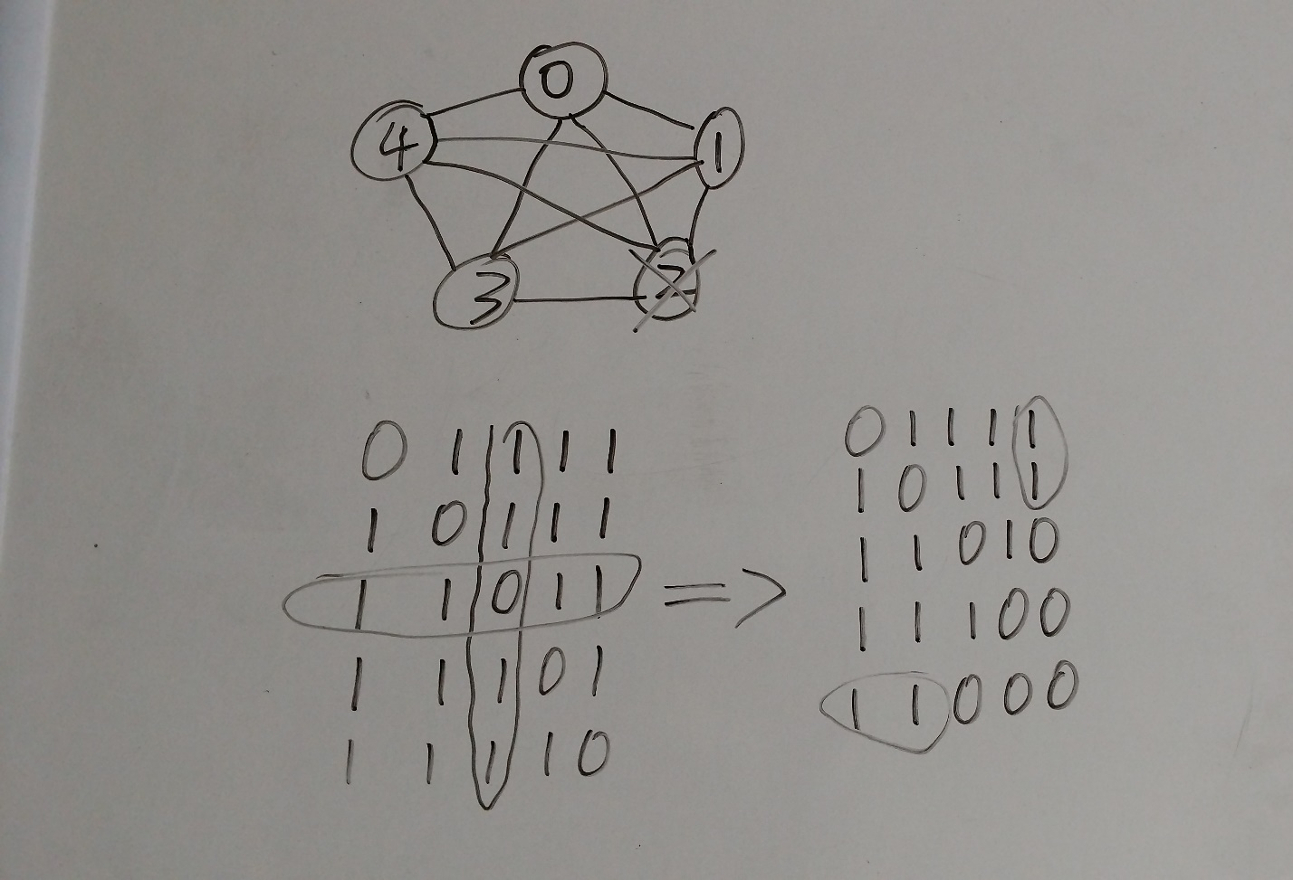
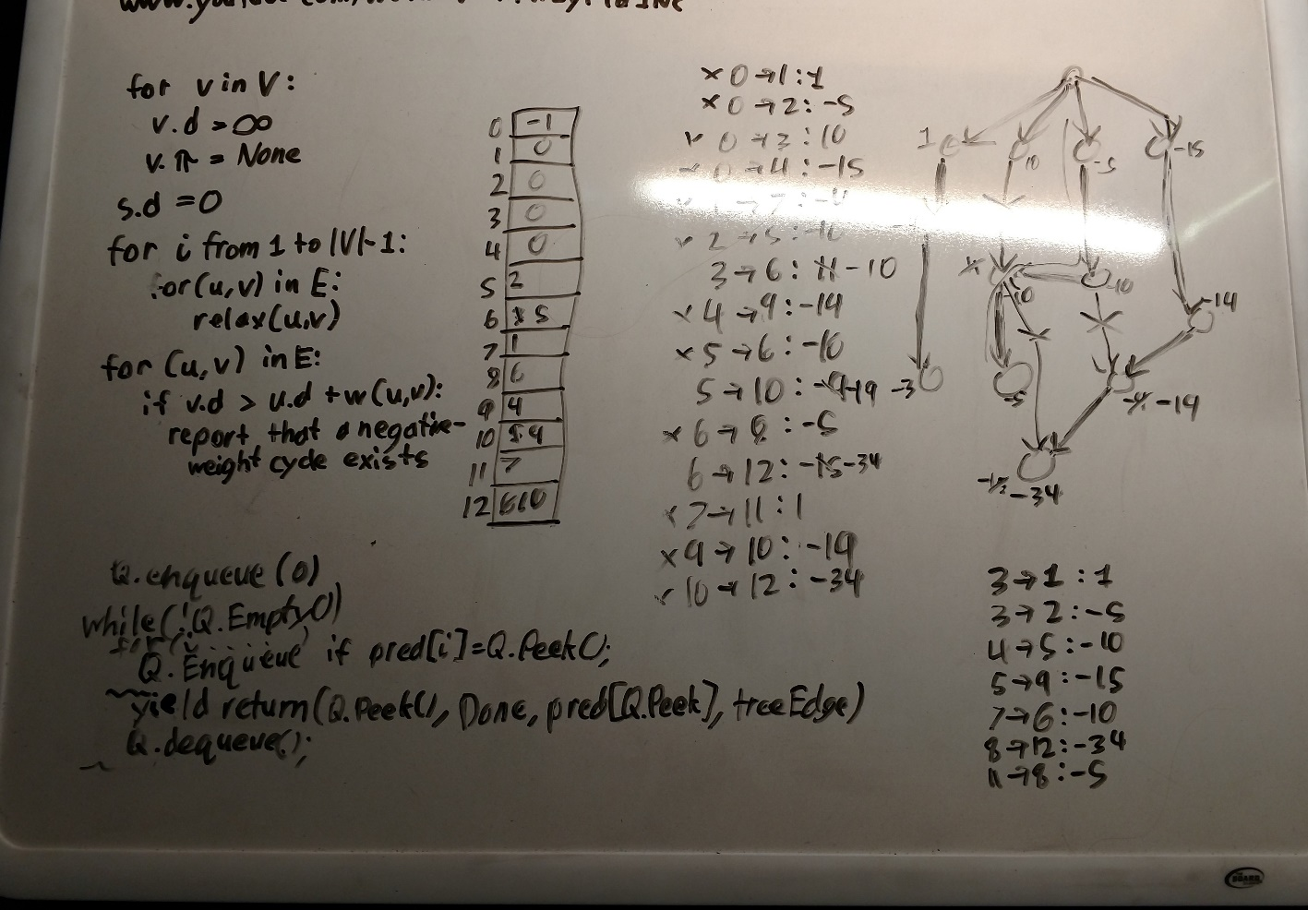

Slide 10
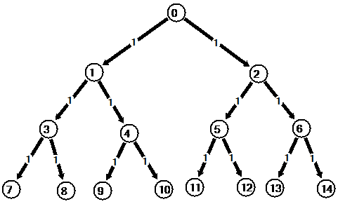
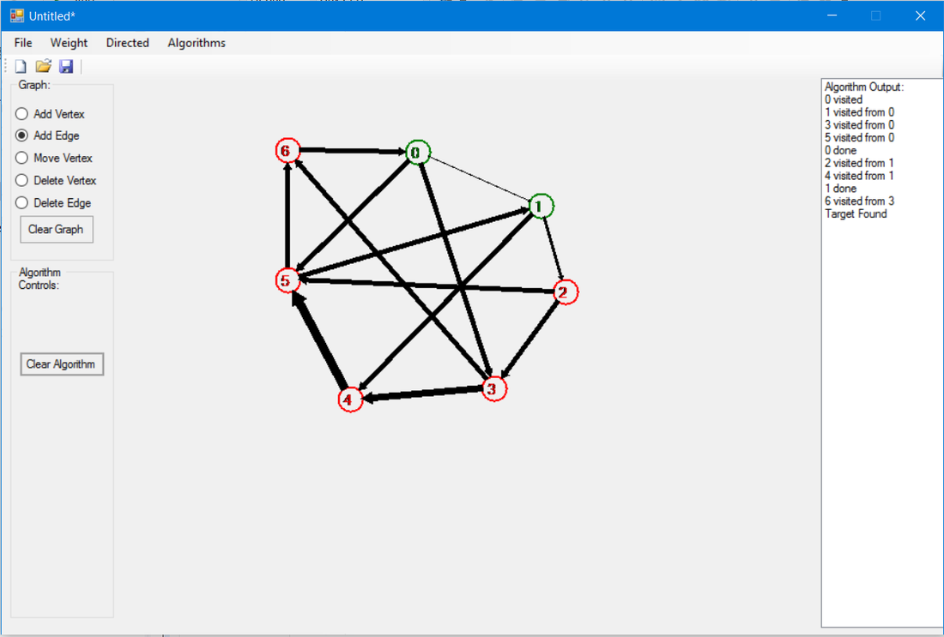
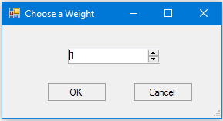
Methodology/Strategies cont.
Algorithms
Started with BFS and DFS
Negative edge weights

Slide 11
Demonstration

Slide 12
Resources
MSDN
Autofill in Visual Studio
YouTube
Dr. McVey
Data Abstraction & Problem Solving with C++ by Carrano and Henry
My brother

Slide 13
Knowledge
CSCI 350 Event Programming
Lab 6
CSCI 220 – algorithms/graphs
Stacks, 2-dimensional arrays (matrices), lists, queues, recursion, timer

Slide 14
Extensions
More Algorithms
An undo button
More structured
Find a better way to animate

Slide 15
Advice
Get ahead early
Back up your project
Talk to people

Slide 16
Questions?

