Slide 1
Illustrating Text with Tag Clouds
Emma E. Alberts

Slide 2
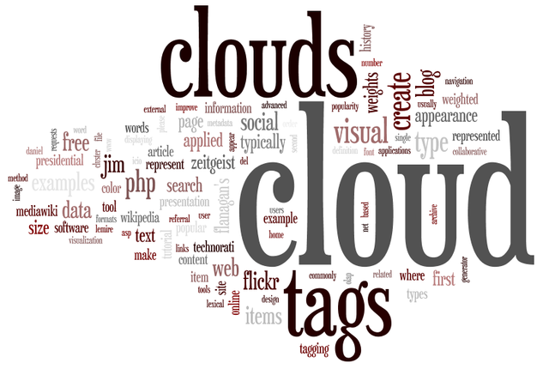
What is a Tag Cloud?

Slide 3
Project Description
Build a software system that collects a large amount of text, processes and stores the data, and then constructs a tag cloud that represents the frequencies of a specified characteristic.

Slide 4
Requirements
Describe the most frequent words in the cloud.
Input number of tags for the cloud.
Use visual attributes to describe the tags (size, color) and to represent frequency, source, etc.
Try to minimize the white space in the cloud:
Consider orientation and other parameters
Consider controls other than textboxes
Tag clouds do not contain overlapping words.

Slide 5
Requirements (cont.)
Design the algorithm so that it handles clouds of different shapes.
Automate when feasible with user assist when necessary.
The application should be general enough to easily handle more than one set of data.
Clicking on a visual gives more depth and/or another prospective of the information.

Slide 6
Data Flow
Consumption
Analysis
Visualization
Accepts any text files containing any characters (includes preprocessing)
Determines the frequencies of the words in the file
Displays the results of the analysis in a tag cloud

Slide 7
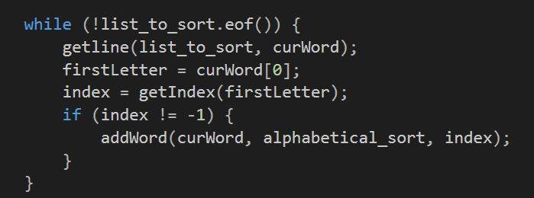
Consumption
Accepts any text files containing any characters (includes preprocessing)
Formatting
Sorting
Removes special characters except apostrophe
Puts all letters to lowercase
Removes common words defined in additional file
Sorts words in array of lists
Alphabetically sorts each list

Slide 8
Preprocessing Example
Hello world, I’m Emma and this is my tag
cloud capstone!
hello
world
i’m
emma
and
this
is
my
tag
cloud
capstone
hello
world
emma
tag
cloud
capstone

Slide 9
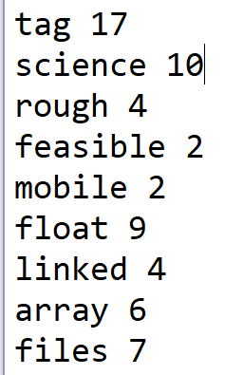
Analysis
Determines the frequencies of the words in the file
Find Frequency
Output
Count number of same word in each index of the array
Delete duplicates
Text file that contains the word and its frequency in the file to be consumed by the visualization program

Slide 10
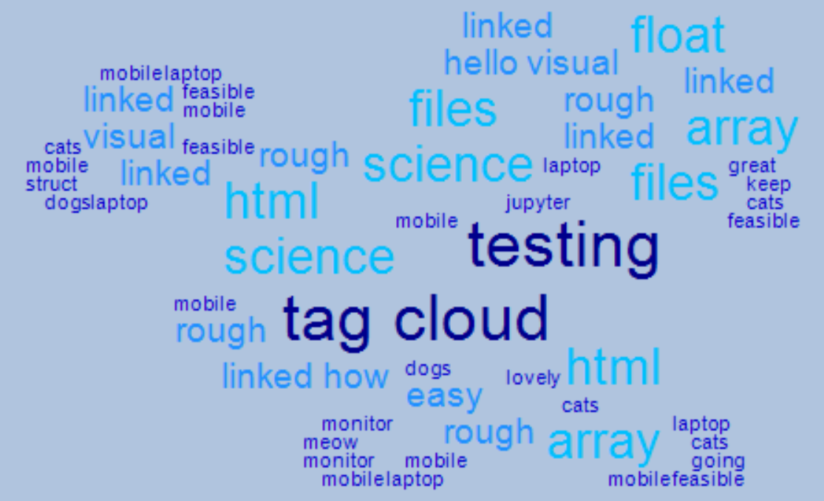
Visualization
Displays the results of the analysis in a tag cloud
C# Windows Form
8 directional placement on Panel object with grid underlay represented by a 2D array
Choices for color/shape

Slide 11
Demonstration

Slide 12
Strategies
Start Early
Use Your Resources
Plan Everything
Little progress > no progress
Stack Overflow/Google
Microsoft C# Documentation
Wordle Documentation
Professors / Classmates / Walkthroughs
Draw pictures and explain them to other people – this is the easiest way to find gaps in your logic!

Slide 13
Extensions
Whitespace Efficiency
Rotated Words
Mobile Application
Color Patterns
Tag Database

Slide 14
Q & A ?

