Slide 1
Moth-Man (Map Maze Game)
Ben Engelstad

Slide 2
Definition & Requirements
Description: Develop an application that enables the user to play a Pac-Man game on a Google map of their choosing.
The application should obtain a Google Map, using the user’s location or allow the user to enter a location
The user should be able to alter the map displayed by zooming and moving
The user should be informed of how to move their character
The characters in the game should stay on the roads of the map
The main character is controlled by the user and pursues various objects of interest while avoiding enemies

Slide 3
Requirements CONTD.
Enemies should have some sort of behavior assigned to them
Develop a scoring system
Determine how the game ends or how to move on to the next level

Slide 4
Solution
Android application
Using Android Studio
Programming in Java
Never used any of these before!

Slide 5
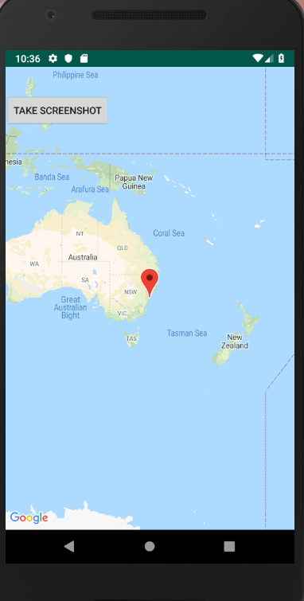
Map
Android has a map app template
Attempt to capture the map
Need bitmap for manipulation

Slide 6
Map analyzation
Altered the JSON file to make the map easier to analyze
“Overlay” array over the image
Checks color of pixels
Marks as valid or invalid

Slide 7
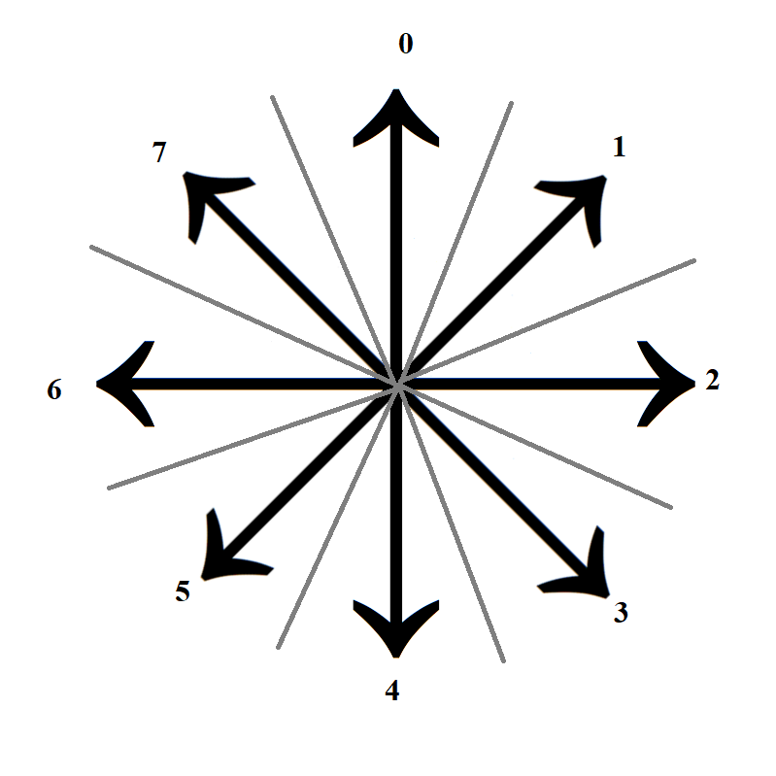
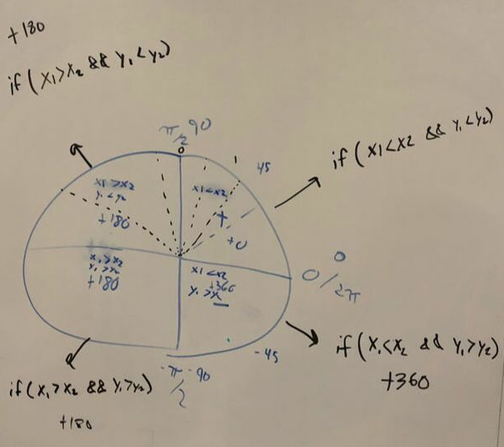
User Control
OnFling Gesture
Calculates tangent (in radians) from π/2 to –π/2
Convert to degrees
Alter depending on direction to fit 360 degree scale

Slide 8
Character Movement
Uses the array created during map analyzation
Updates location every “tick”
Moves in input direction or 2 adjacent

Slide 9
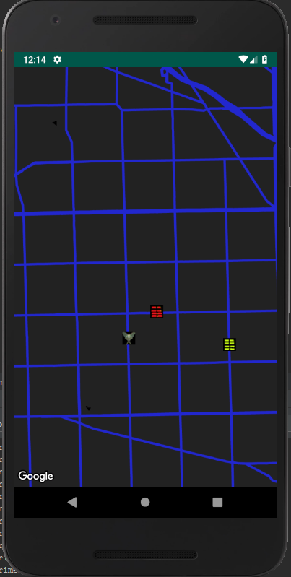
AI (Artificial Idiots) movement
Two enemies have different behaviors
One attempts to pursue the user
Other just moves randomly
AI is hard to make work well

Slide 10
Exceptions
The application should obtain a Google Map, using the user’s location or allow the user to enter a location
The user should be able to alter the map displayed by zooming and moving
The user should be informed of how to move their character
The characters in the game should stay on the roads of the map
The main character is controlled by the user and pursues various objects of interest while avoiding enemies
Enemies should have some sort of behavior assigned to them
Develop a scoring system
Determine how the game ends or how to move on to the next level

Slide 11
Demo!

Slide 12
Strategies
Android App Development book (CS 350 book)
Stack Overflow/Google
Classmates
Android documentation
Tutorials, YouTube videos, Blogs

Slide 13
Extensions
Better AI – More like Pac-Man with multiple modes of movement
Preselected maps available
Draw own maps

Slide 14
Questions?

Slide 15
Where did the name come from?

