Slide 1
Dance Like Me
Camille Jacobson

Slide 2
Definition & Requirements

Slide 3
Objective
Teach your computer to dance like you* - teach it moves and allow it to create routines
*Well, at least someone that CAN dance.

Slide 4
Overview
4 Requirements:
1) Visually show that the computer is following your lead
2) The computer learns a series of dance moves and stores them for playback
3) Allow the computer to put its own routines together based on learned moves
4) Give the computer a dance partner so it can multitask and coordinate routines

Slide 5
My Process & Solution

Slide 6
Getting Kinect-ed
Kinect for Windows V1
A webcam-styled motion detector
Features color stream, depth stream, and skeleton stream sensors

Slide 7
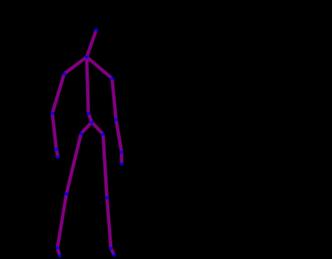
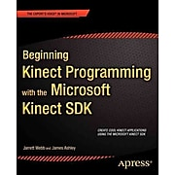
Getting Kinect-ed (cont.)
Began experimenting with the Developer Toolkit’s skeletal tracking app
Measured distances, mapped out the coordinate grid, toyed with the idea of gestures and cursors
Read sections from Beginning Kinect Programming with the Microsoft Kinect SDK by Jarrett Webb and James Ashley and referenced the Microsoft website
Provided code samples, explanations of the classes, and made suggestions

Slide 8
How Things Are Displayed
Essentially 2 coordinate grids superimposed
The Kinect uses an X-Y-Z coordinate plane where X and Y values vary between -1 and 1
Typical 640 by 480 plane

Slide 9
Program Basics
Language: C#
Environment: Microsoft Visual Studios 2017
Hardware: Microsoft Kinect for Windows V1
Application Type: Windows Presentation Foundation (WPF), Microsoft Kinect Application

Slide 10
Home Screen
Requirement 1
Requirement 2
Requirement 3
Requirement 4

Slide 11
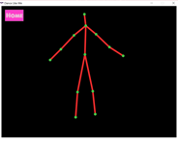
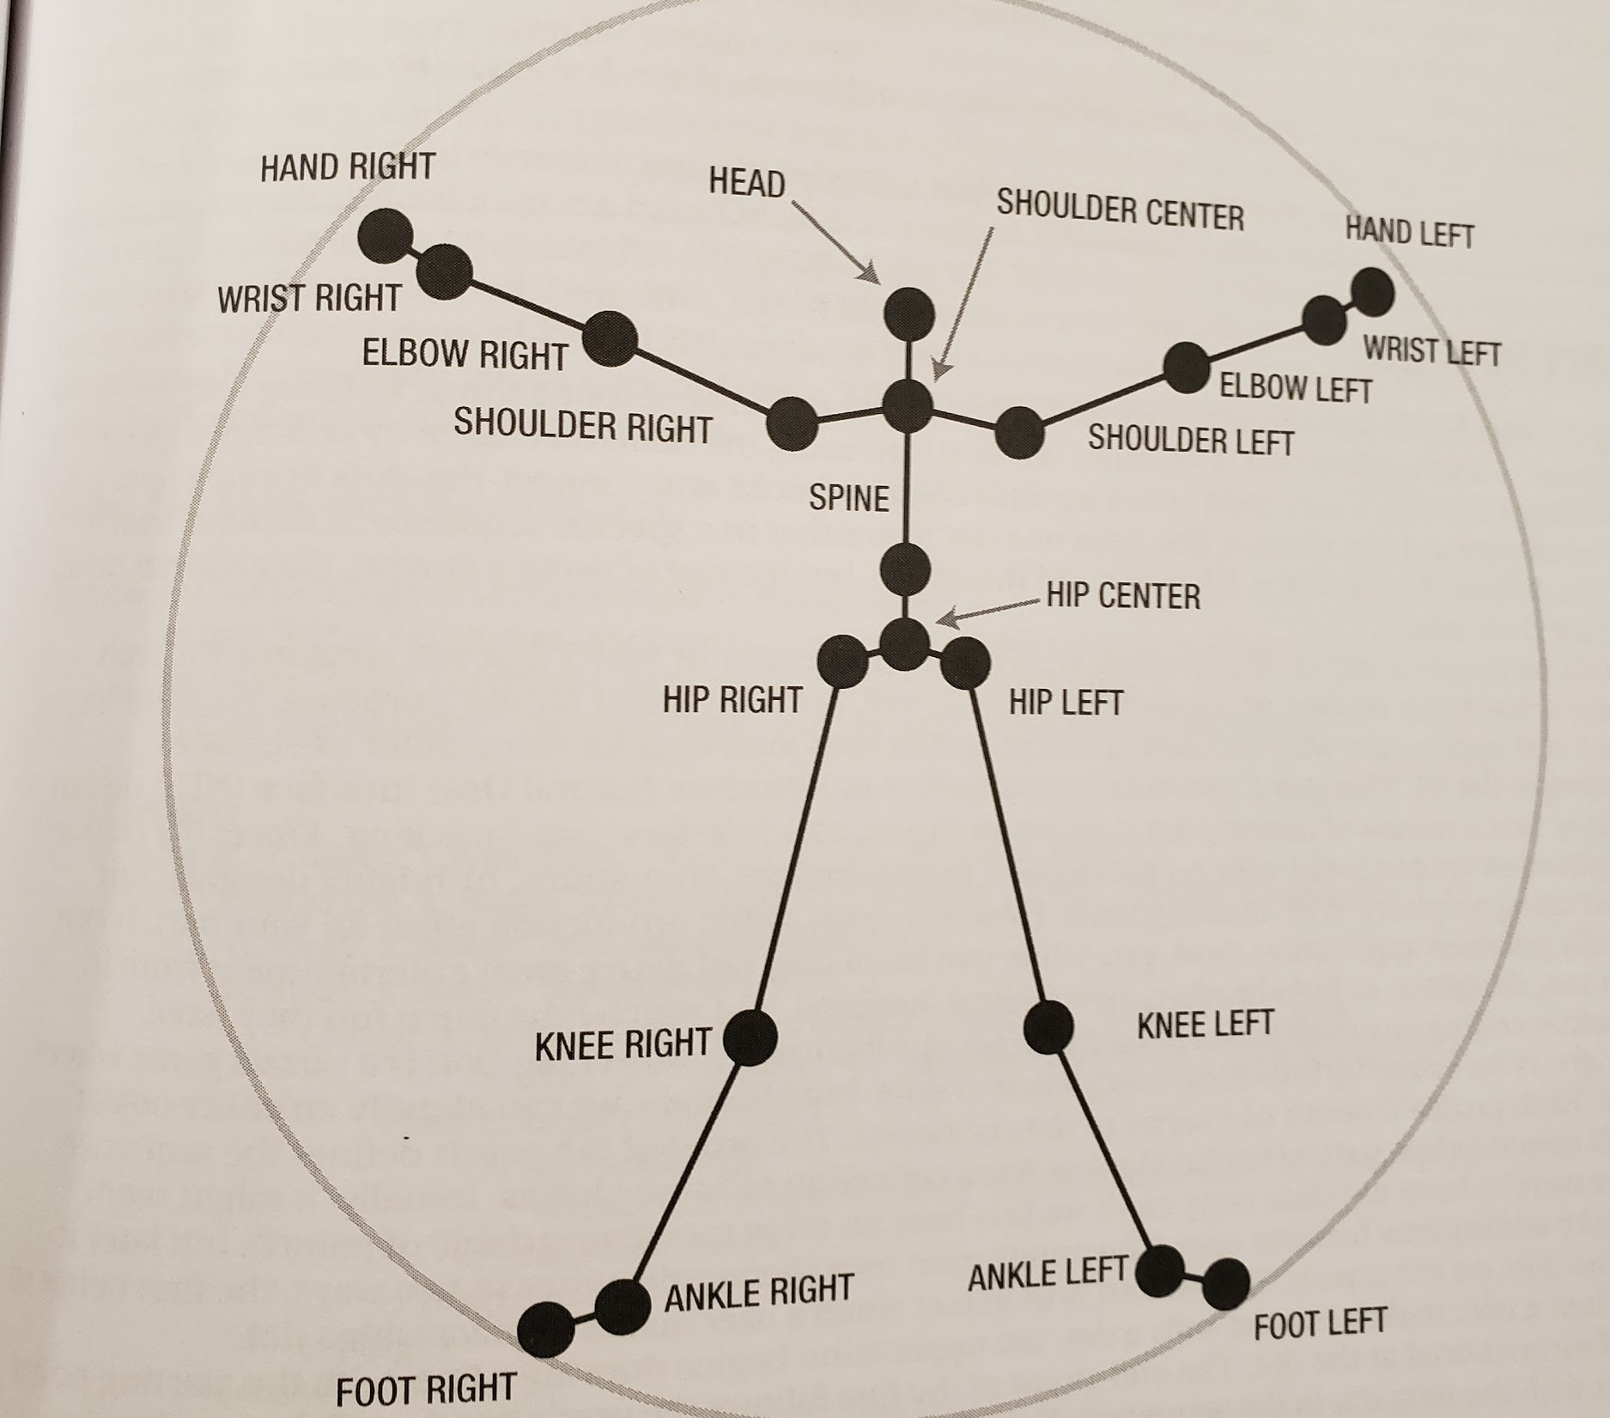
Meet Tiny Dancer!
Reduced the total number of joints from 20 to 13
(Eliminated: feet, hands, spine, hips)

Slide 12
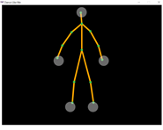
Recording Moves
Line up with the 5 dots to “lock in” and start recording. Repeat to stop.
Reduced frame count
From 30 frames per second to 10 frames per second
Information is placed in an array of lists and is then written to a file

Slide 13
Cutting a Rug
The computer randomly selects 3 saved moves and strings them into a routine
The 5 circles in Bust A Move allow the dance moves to be stitched together (fairly) seamlessly
Information is read from text files into a 2D array

Slide 14
Partner Dance
The computer has its own dance partner
Unfortunately, it’s not you
The two skeletons are mirror reflections of each other over the X=0 line
Again, 3 randomly selected dance moves done simultaneously

Slide 15
Exceptions & Extensions

Slide 16
Exceptions
Can’t block a second skeleton from being displayed on the screen if more than 1 person is in view of the Kinect
The most it will draw is 2 (draws closest 2)
If Kinect is unplugged during execution, the program closes - you have to restart the program after the Kinect is plugged in to be able to execute
The size of the window does not expand

Slide 17
Extensions
Allow users to create their own routines by selecting the 3 moves
Allow users to name the moves they save
Allow users to delete saved moves
Allow for partner dances to be recorded (so 2 skeletons are being recorded and that routine is played back as one dance)
Right now, I do not allow 2 skeletons to be tracked at a time
Use a different application type (not WPF)

Slide 18
Demonstration

Slide 19
Q & A

Slide 20
Back-Up Demonstration

Slide 21
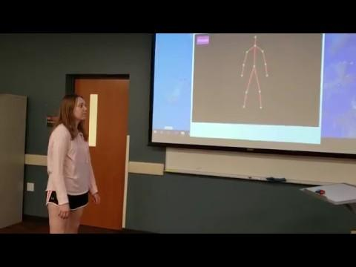
Freestyle

Slide 22
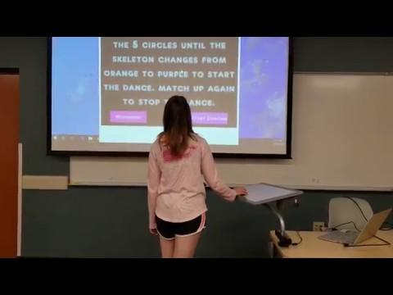
Bust A Move

Slide 23
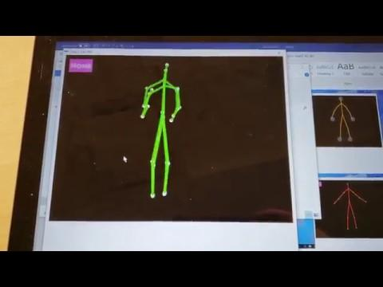
Routines

Slide 24
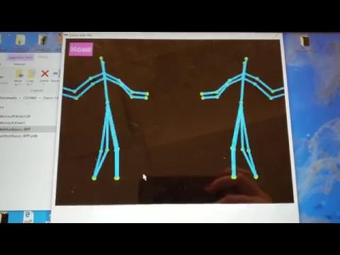
Partner Up

Slide 25
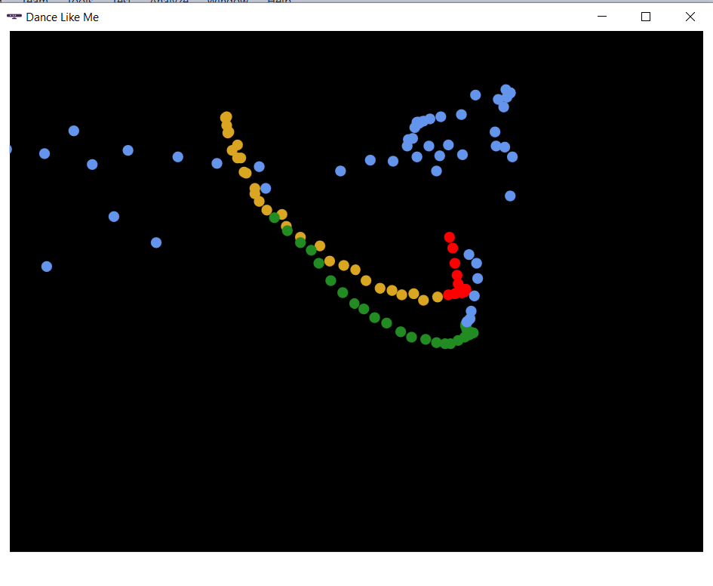
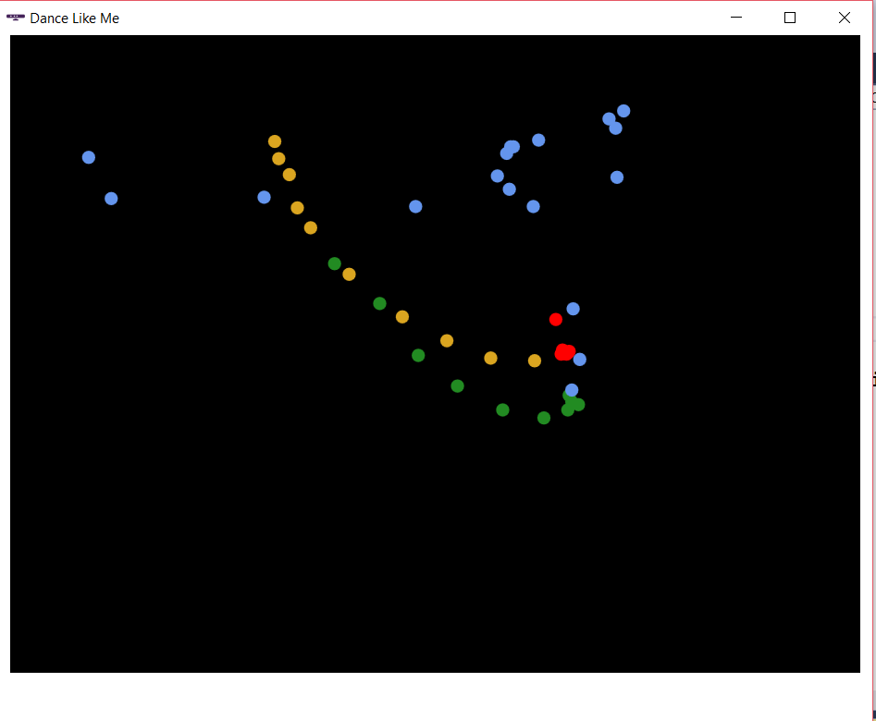
30 Frames per Second
10 Frames per Second
Why A Reduced Frame Count?

