Slide 1
Steganography
By: Brian Kennelly

Slide 2
Project Definition
Develop an application that employs various techniques of steganography to embed and recover hidden messages that are really images within another image file.
Research steganography giving examples of techniques and usage.
Compare the use of steganography versus cryptography.
The application should allow the user to choose from several steganography algorithms to embed or recover a hidden message in an image file.
Display the original image and the altered image side-by-side for visual comparison, with a zoom feature for close examination.
Notes:
Give example of how with cryptography it’s apparent there is a secret message but with steganography there is not. Relevant because in some places cryptography is illegal

Slide 3
Project Definition
Compare efficiency, effectiveness and quality of the different algorithms.
Consider issues like size of the message, modification of image size and distortion.
The application allows an embedded image to be sent to a remote user who can recover the original image based on the embedded algorithm.
Investigate hiding images with videos, or hiding videos within videos.
Notes:
Mention how a more effective and secure algorithm requires a larger picture size for the host. More restrictive

Slide 4
Steganographic Method
The parasite image’s pixel array gets broken down into bits that get planted strategically into the host’s pixel array.
Least Significant Bit as the carrier for the parasite
Step 1: Extract a parasite byte and break it down into bits to feed into 8 different host bytes
Step 2: Correctly change the host bit to the value of the parasite bit without modifying the other 7 bits. More on this in the next slide.
Step 3: Come up with a systematic way to place them into the combined image
Step 4: Find a way to store necessary meta data in the pixel array
Notes:
Get parasite byte
Get 8 host bytes
Change 1 bit for R G and B in the host byte to a parasite bit
Place the bits strategically so they can be retrieved easiest
Need to make sure the extraction method knows how big the parasite picture originally was

Slide 5
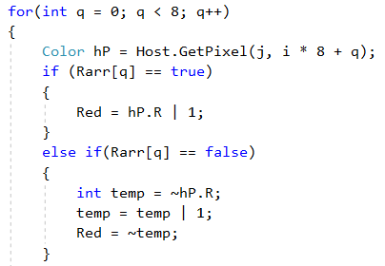
Embedding Process Details
The process of taking an unknown bit and changing it to a 1 or a 0.
Notes:
Explain how the complement operator is needed to change something to a 0

Slide 6
Exceptions
Picking the right way to display pictures is hard.
Choice between original size of pictures or scaling them to the picture box.
Interaction with zoom function
No scroll wheel zoom (nicer UX)
Limited variability in steganographic methods used
No video implementation
Though it would just be a loop through of all frames, an easy modification to make but slow runtime
Notes:
Picturebox display can have actual image sizes or scale to picturebox. I wasn’t able to get the scaling right so I left it as default size
Scroll wheel would make things nicer for the user
Video implementation of this would be the same as image but looping through all frames

Slide 7
DEMO

Slide 8
Strategies
Stack Overflow
Microsoft c# Documentation
In person advising
Stack Overflow again
Notes:
Bitwise operators on MSDN

Slide 9
Extensions
User embedded password
More varied steganographic methods
Implementation of some kind of video handling
Built in file sending functionality
Notes:
Have the user provide a password to embed that another user needs to pass in to complete the extract

Slide 10
Questions?

