Slide 1
Senior Capstone 2019
Word Search
Sam Neville

Slide 2
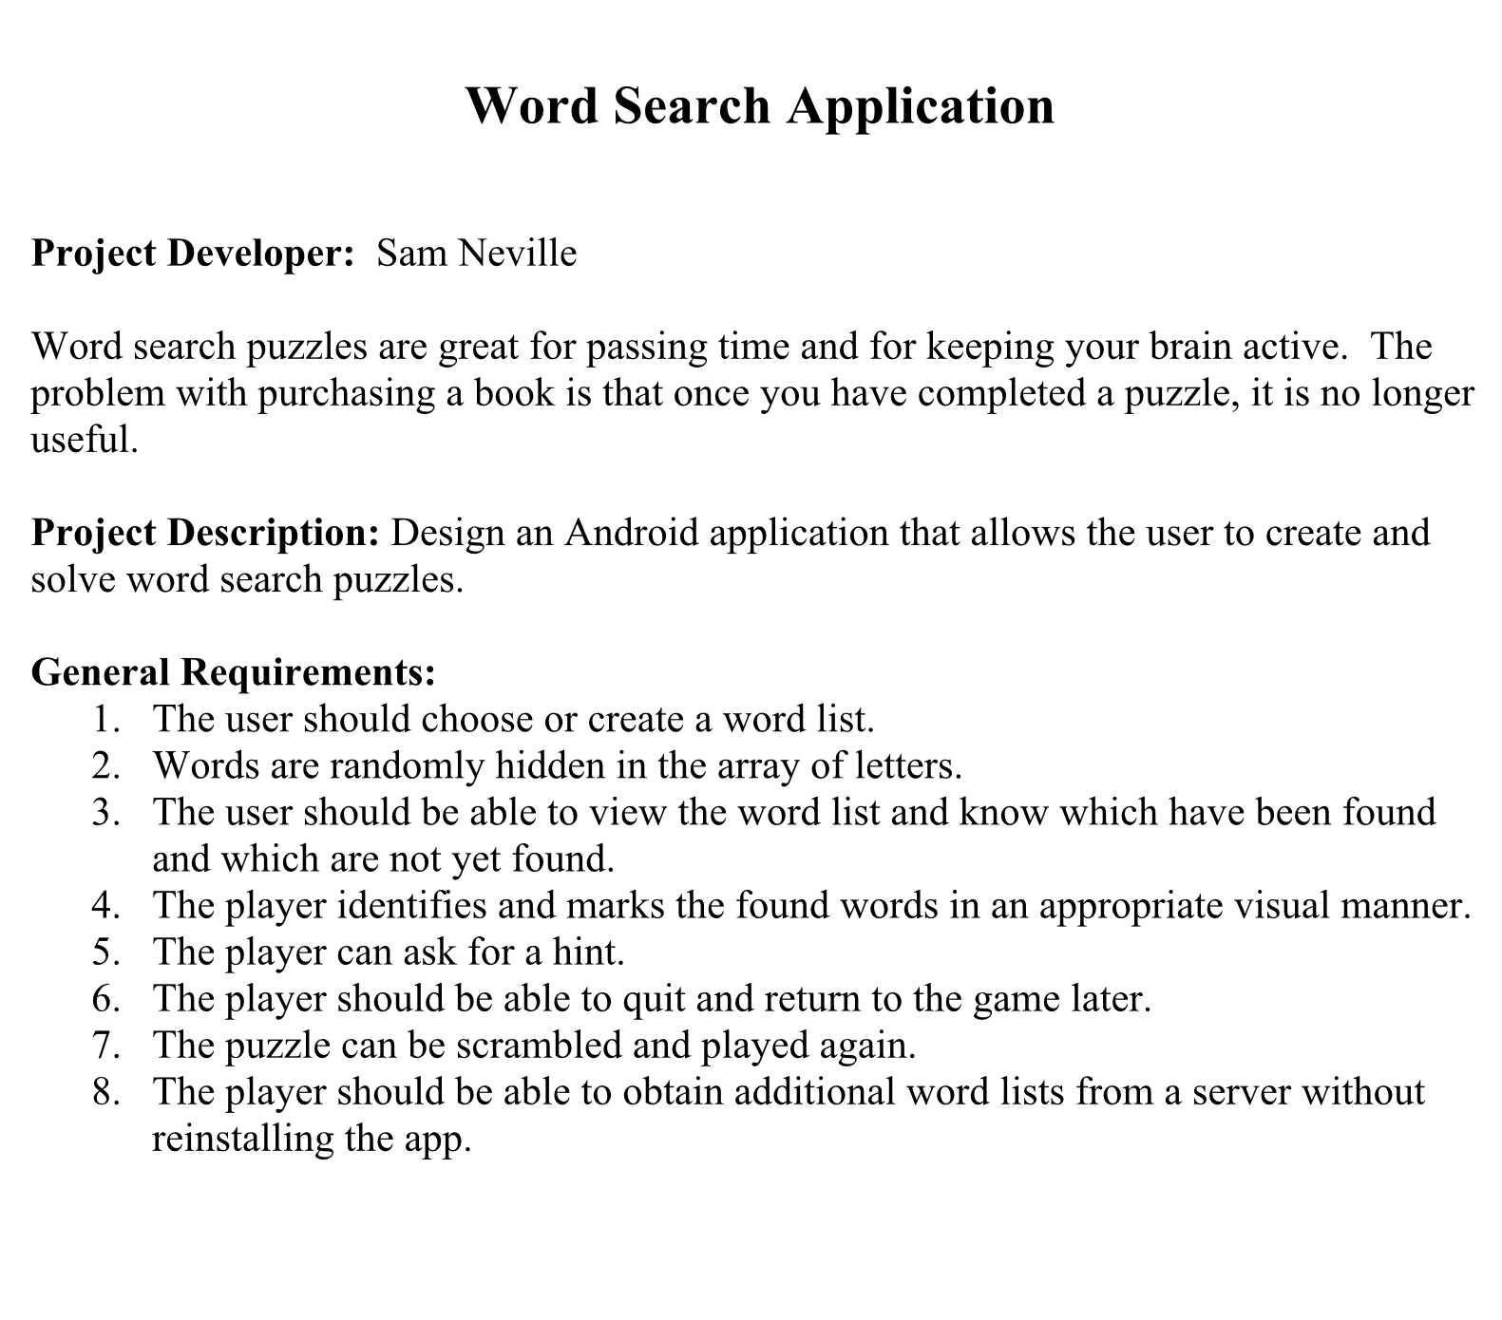
Project Description
Starting Point:
No Java
No XML
Opened AS one time
So with that....

Slide 3
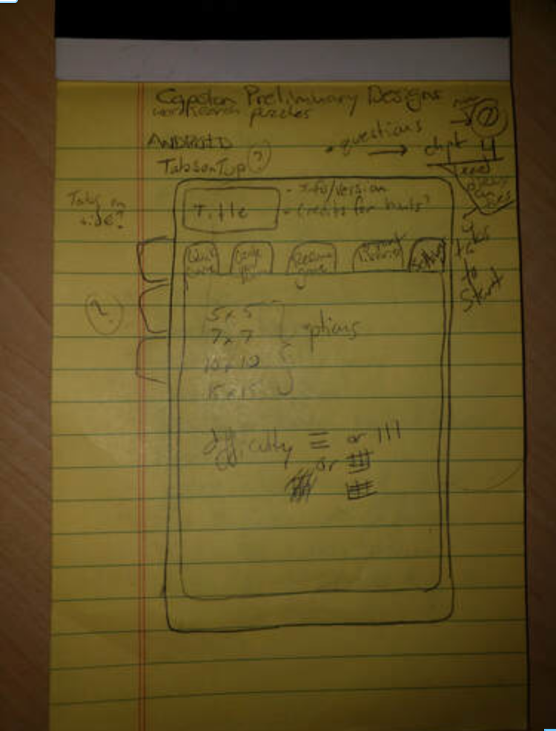
A Bit Too Ambitious
Actually starting from scratch
Rollercoaster
Goals
I set a lot of them
Several were achieved
Many were not...

Slide 4
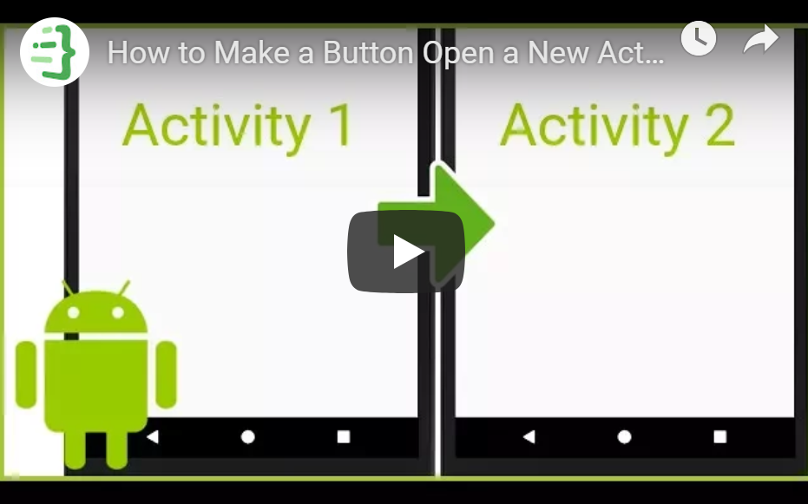
Baby Steps
How to make a button open an activity
Videos
The best way to start from nothing

Slide 5
Bump In The Road
All was going well…
A week in
Losing everything
Git
Lesson learned
No more problems

Slide 6
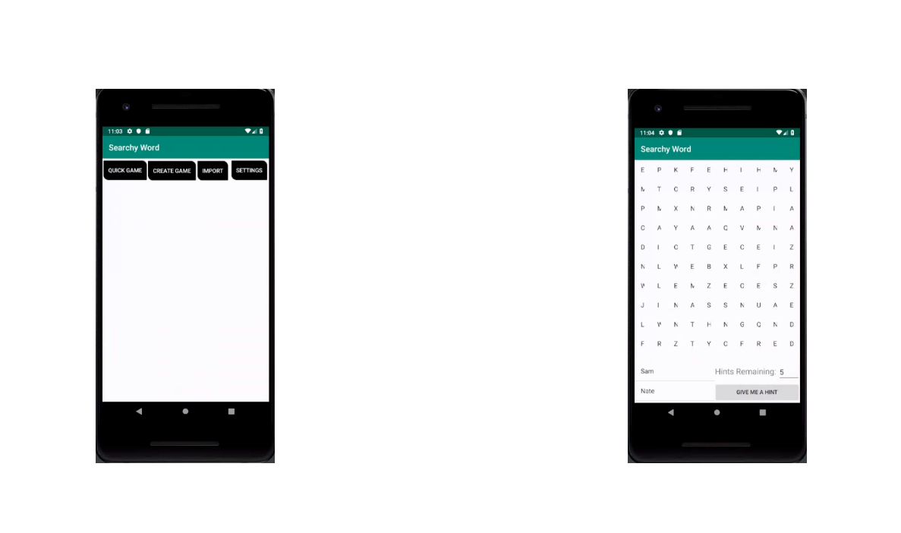
Recovery
A quick recovery
Getting the board
The algorithm
Words in
Testing locations x1000
Save them if OK
Words and location
Place on board
Fill empty spaces
Add them to the list

Slide 7
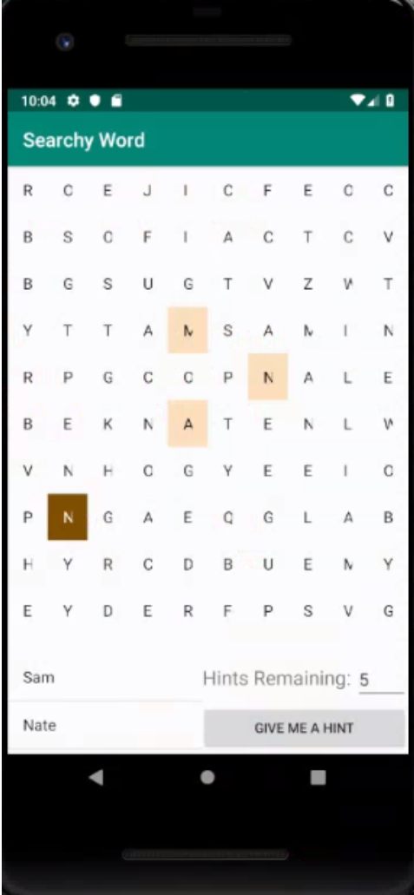
Progress
User Input
Array conversion
Highlight locations

Slide 8
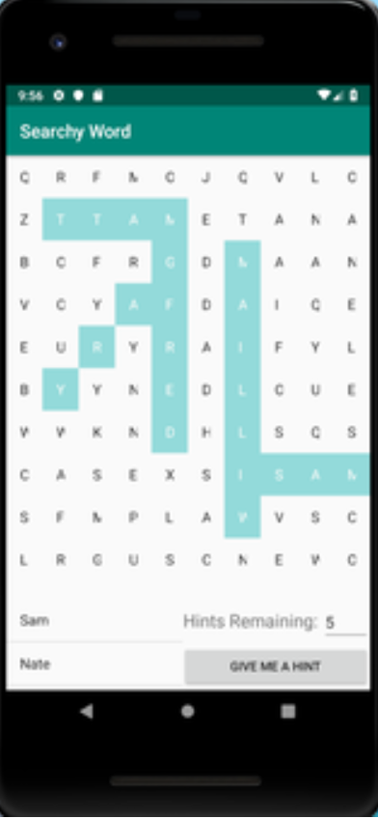
More...
User input
Highlight Words

Slide 9
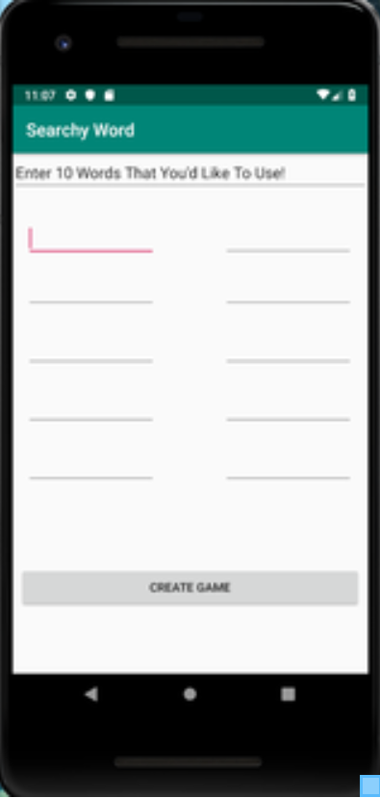
Create A Game
Create your own
Enter 10 words
Start next activity
Re-using code
Passes words to the same service
Generates similarly

Slide 10
Save A Game
Text files suck
Tedious
Maintaining integrity
Lack of constraints
Inconsistency

Slide 11
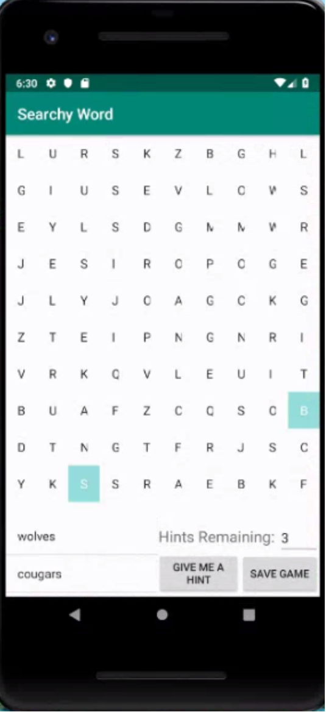
Take A Hint
Hints
Valid location
Take words left
Select random number in range
Take x and y data
Highlight first position

Slide 12
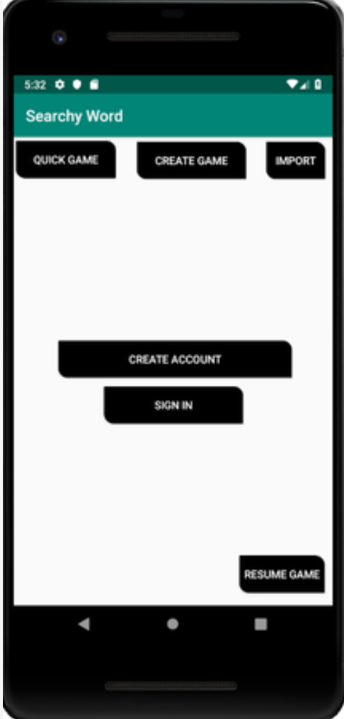
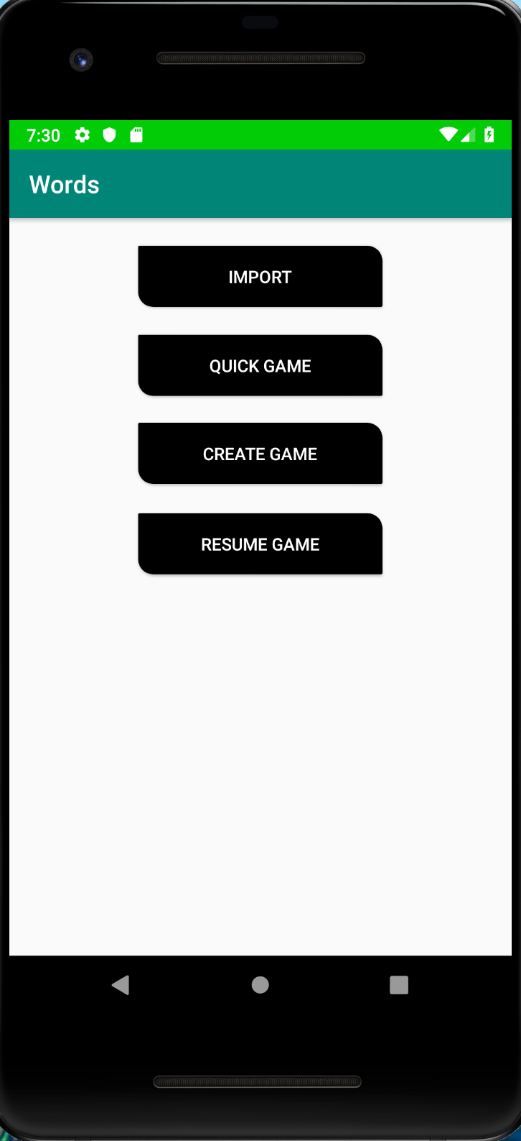
Resume A Game
Re-formatted home
Decisions made
Creating account
Not necessary
Signing in
Not longer possible
Resume game
Quite tricky to parse saved data
Split( )
Re-create objects
Re-generate game
Words Left
Existing issue with highlights...

Slide 13
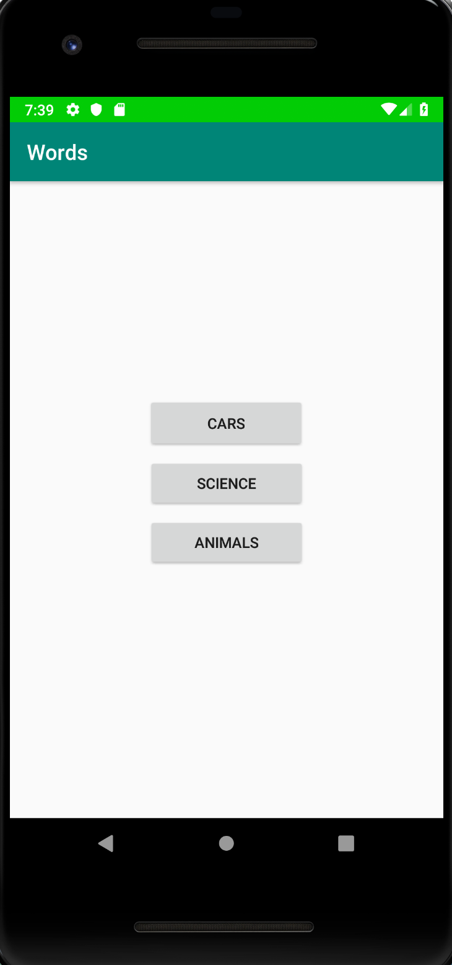
Fetch A Game
Import game genres
6 hours is a lot of wasted time
Security issues
A hero from Stack Overflow
Fetch a text file of words
Re-use code
Easily expand genres
Existing network issues

Slide 14
Get One
Import game genres
6 hours is a lot of wasted time
Security issues
A hero from Stack Overflow
Fetch a text file of words
Re-use code
Easily expand genres
Existing network issues

Slide 15
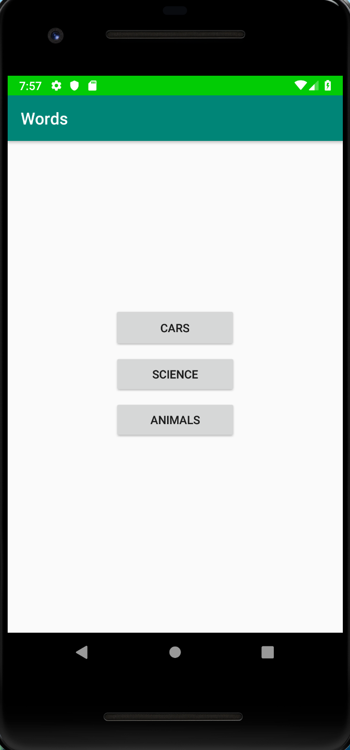
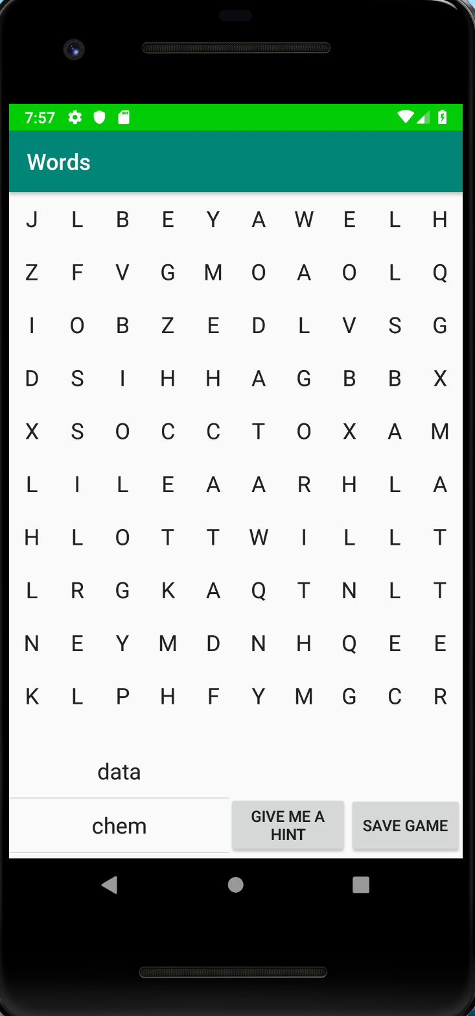
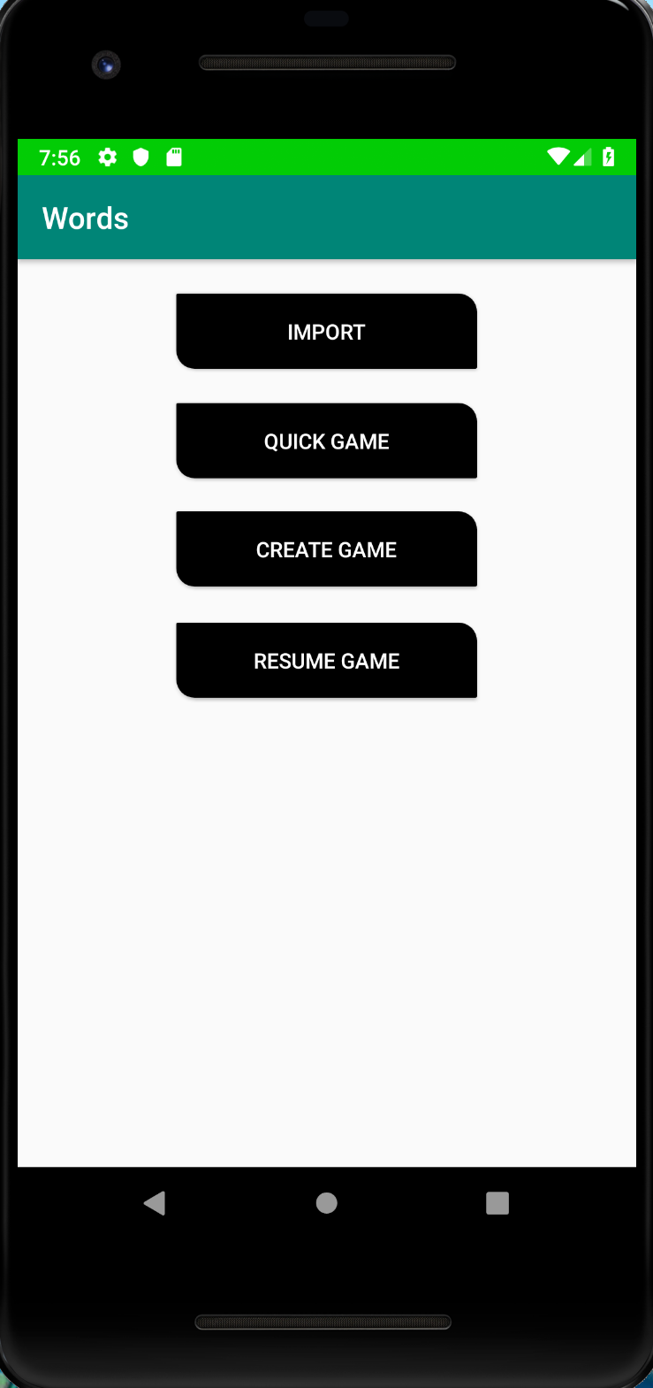
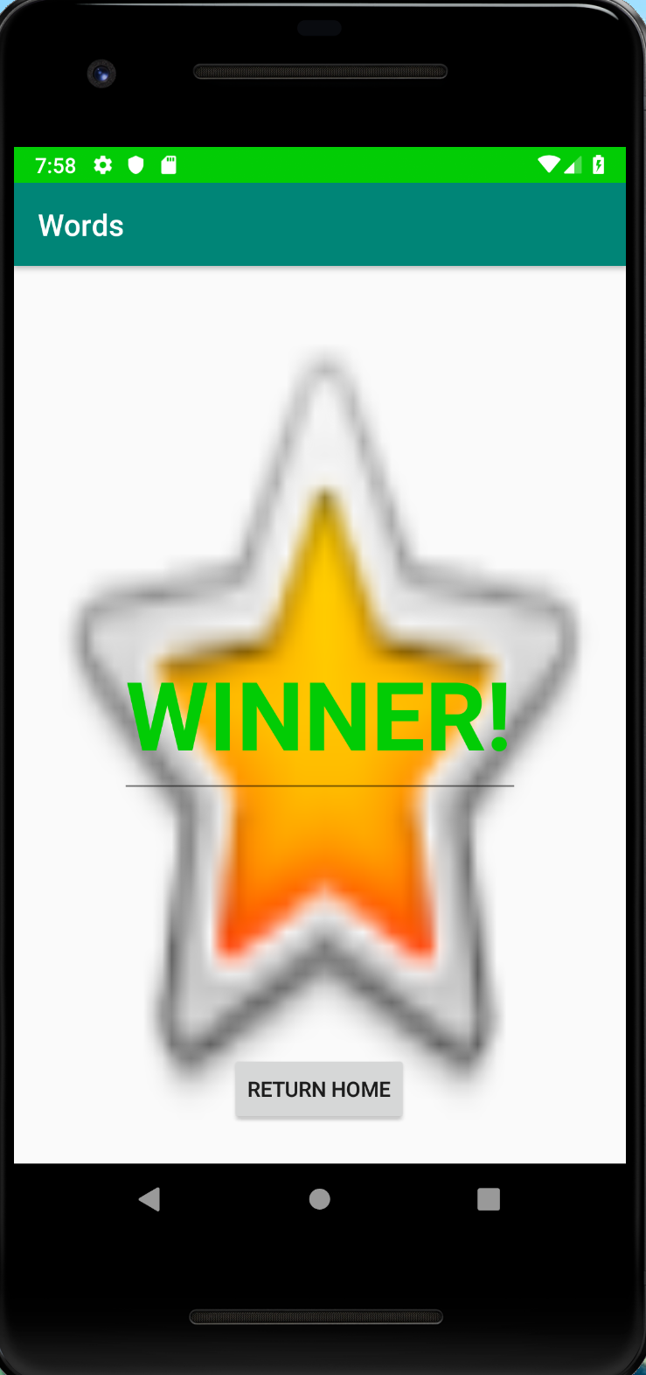
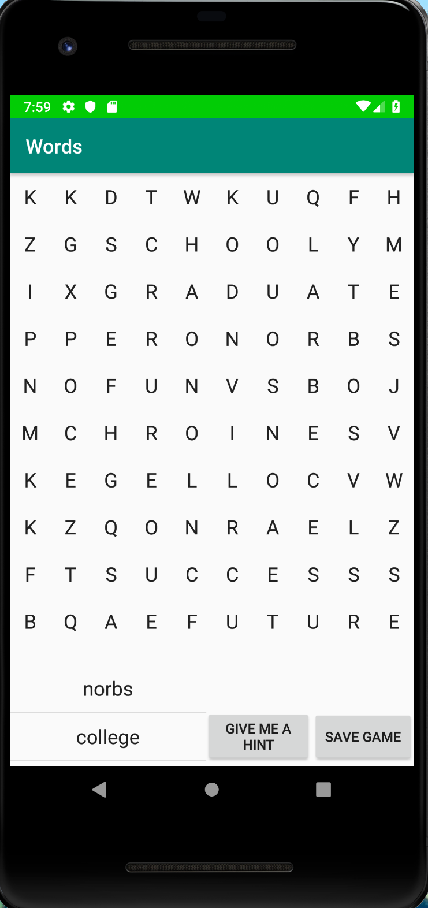
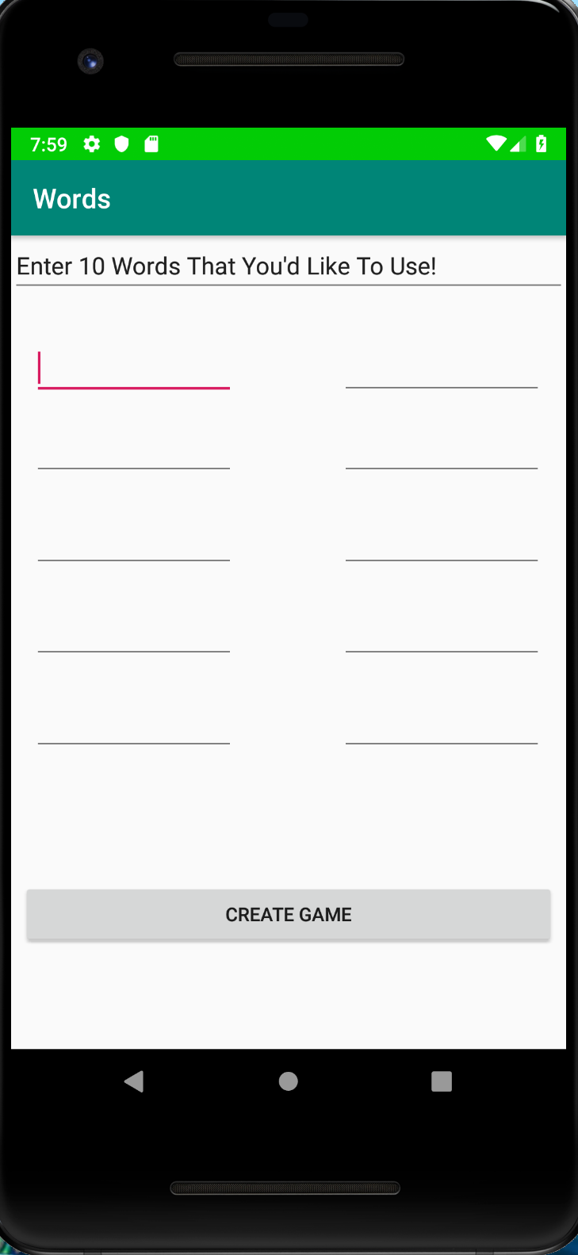
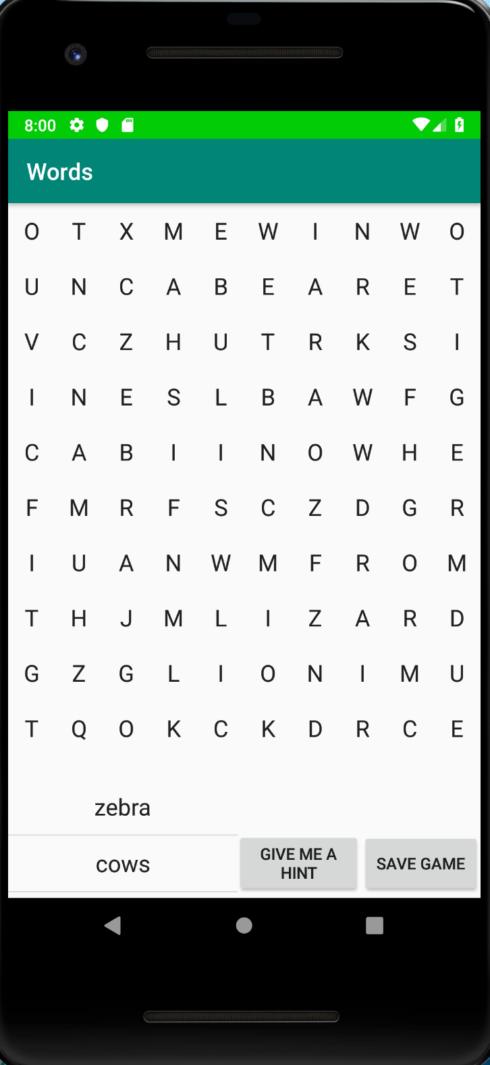
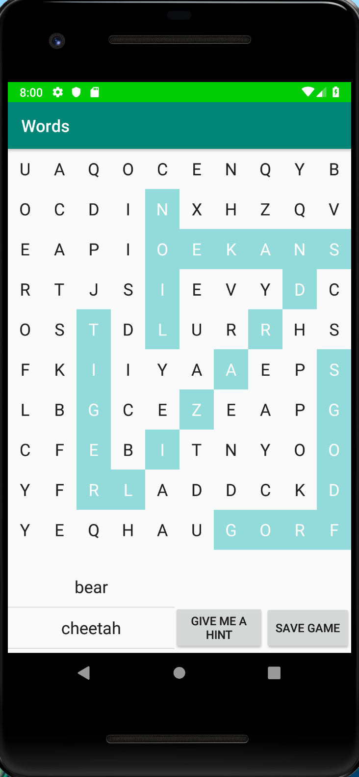
Flow

Slide 16
Exceptions
Quick game
Works well about 98% of the time
Still haven’t found the solution…
It’s a null reference exception
Create a game
Uses the same code as quick game
Same problem
Resume a game
Uses the same code as create
Same problem
Also
Unable to re-highlight words found until after a click

Slide 17
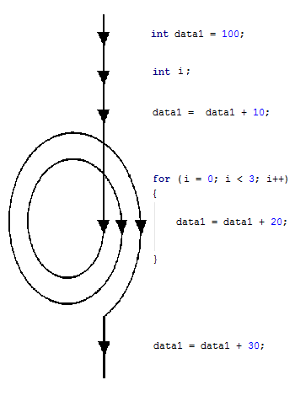
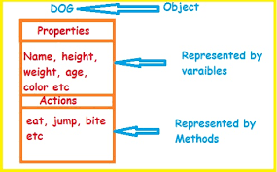
Methods
For Loops
In 9 Java files, I used 47
Arrays
Essential to grids
Conversions between 1D and 2D
Other Objects/Classes
Game
All words objects
Experiments included
Testing UI to see back-end effect

Slide 18
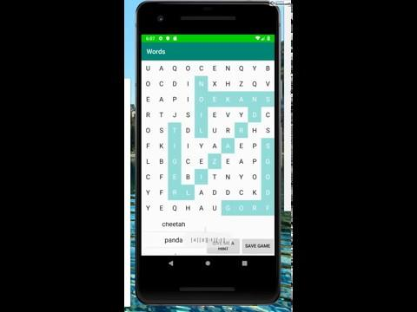
Demo

Slide 19
Learning and Development Process
Strategies
Stack Overflow
YouTube
Dr. McVey
Dr. Pankratz
Classmates

Slide 20
Extensions
Make it a bit prettier
That victory screen is just sad
Click and drag for words selection
It might be more intuitive than plain taps
Add a multiplayer option
People like to compete
Accounts and shared games
Save your created games automatically so anyone can play
Make sure it can be played on many different device sizes
Current state, it doesn’t scale to smaller screens

Slide 21
Questions?

