Slide 1
Security Camera Placement
Trever Schaut, 2019

Slide 2
Project Description:
Develop an application that allows a user to graphically
illustrate the positioning of security cameras to
view all areas of an enclosed location with obstructions.

Slide 3
Requirements
Allow the user to illustrate the enclosed area and its obstructions.
Allow the user to place a camera in the area, illustrating which regions of the enclosure are covered by that camera and reporting what percentage of the region is covered by that camera.
Allow the user to move a camera, updating the regions in real time that it sees.
Maintain the total area to be covered and the total area currently covered.
Consider restrictions as to the placement of cameras.
Given coordinates of an object (the mouse, a touch, an intruder), which camera(s) sees it?
Implement an algorithm that programmatically computes the minimum number of cameras needed and their locations.

Slide 4
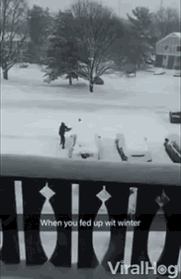
First things first

Slide 5
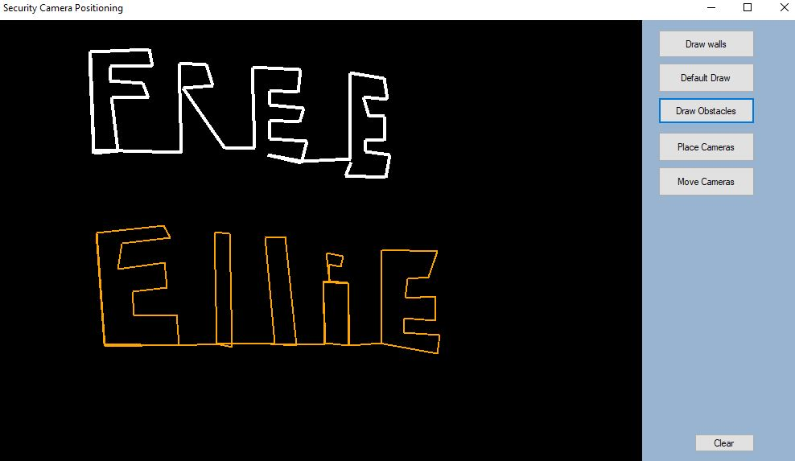
Drawing
Mouse clicks are recorded into lists of points from which I am able to run through and draw lines between

Slide 6
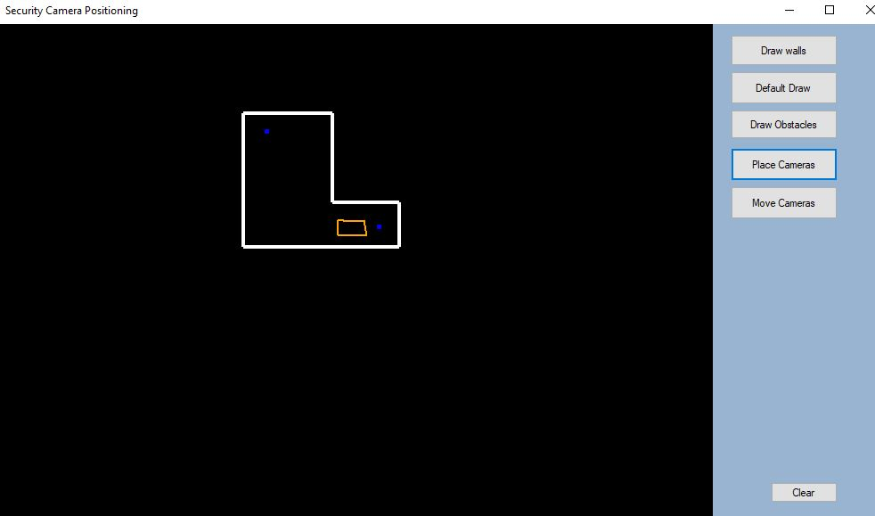
Placing the goods
The second thing I tackled was placing cameras within the layout and determining restrictions on them

Slide 7
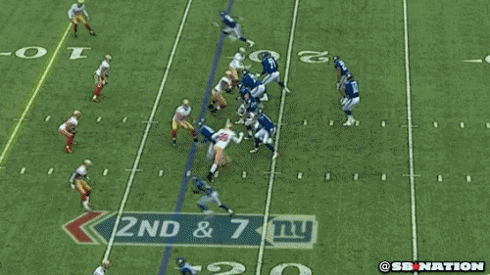
Moving the camera
Accurate (The opposite of Eli)
Put a pixel buffer in place
Mousedown, Mouseup, and Mousemove functions
Real time updates
Notes:
Originally had to click 1 pixel in a sea of thousands

Slide 8
Steps toward coverage
{0,0,0,0,0,0,0,0,0,0,0,0,0,0,0,0,0,0,0,0,0,0,0,0},
{0,0,0,0,0,0,0,0,0,0,0,0,0,0,0,0,0,0,0,0,0,0,0,0},
{0,0,0,0,0,0,0,0,1,1,1,1,1,1,0,0,0,0,0,0,0,0,0,0},
{0,0,0,0,0,0,0,0,1,0,0,0,0,1,0,0,0,0,0,0,0,0,0,0},
{0,0,0,0,0,0,0,0,1,0,2,0,0,1,0,0,0,0,0,0,0,0,0,0},
{0,0,0,0,0,0,0,0,1,0,0,0,0,1,0,0,0,0,0,0,0,0,0,0},
{0,0,0,0,0,0,0,0,1,0,0,2,0,1,1,1,1,1,0,0,0,0,0,0},
{0,0,0,0,0,0,0,0,1,0,0,0,0,0,0,0,0,1,0,0,0,0,0,0},
{0,0,0,0,0,0,0,0,1,1,1,1,1,1,1,1,1,1,0,0,0,0,0,0},
{0,0,0,0,0,0,0,0,0,0,0,0,0,0,0,0,0,0,0,0,0,0,0,0},
{0,0,0,0,0,0,0,0,0,0,0,0,0,0,0,0,0,0,0,0,0,0,0,0},
Copy the screen to a bitmap
Use nested for loops with get pixel to populate the array
Count and store the number of 0’s inside the enclosure

Slide 9
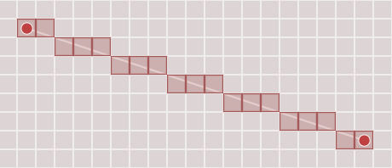
Super cover line
https://www.redblobgames.com/articles/visibility/
By far the hardest part of the project
Tried ray casting
Uses the points to determine the slope and then checks if each pixel along the way is above or below the line

Slide 10
Maintaining the percentage
I had the amount of zeros so once I manipulate the array with my cover function it’s as easy as reading the amount of pixels changed and doing some basic math

Slide 11
Exceptions
Given coordinates of an object (the mouse, a touch, an intruder), which camera(s) sees it?
Implement an algorithm that programmatically computes the minimum number of cameras needed and their locations.

Slide 12
CS Concepts
Event Programming
Data Structures - arrays/lists
Dark GDK
Software Engineering

Slide 13
Experimenting
Messagebox.Show()
Writing to the console

Slide 14
DEMO TIME

Slide 15
Strategies
Try and try again (car rides and hot showers help when stuck)
Dr. McVey and Dr. Pankratz
Youtube tutorials
Stack Overflow
Red Blob Games

Slide 16
Extensions
Use Unity instead (game engine)
Cameras that see outward in a cone rather than 360 degrees (Look up Sundaram Ramaswamy cone vision)
Two bitmaps for smoother running (Thank you Emily)
Curved enclosures
Undo button

Slide 17
Q/A

