Slide 1
Visualization of Convex Hulls
Mike Schiger

Slide 2
Phases of the App Development
Capture the user’s location in the background at defined intervals
Take these points and construct the convex hull
Find union and intersection of N convex hulls
Find area of a convex hull

Slide 3
Send Me Your Location
Capturing the locations

Slide 4
Capture the User’s location
LocationRequest Object
Sends a request for the current location and calls a callback function once the request has been found.
Cannot use the recommended FusedLocationProviderClient
Does not update location itself but retrieves the location in the cache.

Slide 5
Capture the User’s location
Automatic Start
Starts at a given time and ends at a given time
Timed Manual
Start anytime and record for a given amount of time
Fully Manual
Start recording and do not end until explicitly told to stop
Capture a single point

Slide 6
Connecting the Dots
Constructing the convex hull

Slide 7
Algorithm Used to Construct the Convex Hull
(q.x - r.x) * (p.y - r.y) >= (q.y - r.y) * (p.x - r.x)
(q.x - r.x) * (p.y - r.y) >= (q.y - r.y) * (p.x - r.x)
Andrew's Monotone Chain Convex Hull Algorithm
Build’s the convex hull in two phases:
Upper convex hull
Lower convex hull
Computes whether a coordinate should be a vertex
For coordinates x, y, z, a coordinate is not a vertex if
[(q.x - r.x) * (p.y - r.y)] >= [(q.y - r.y) * (p.x - r.x)]

Slide 8
Algorithm Used to Construct the Convex Hull
(q.x - r.x) * (p.y - r.y) >= (q.y - r.y) * (p.x - r.x)
(q.x - r.x) * (p.y - r.y) >= (q.y - r.y) * (p.x - r.x)

Slide 9
Construct a Convex Hull from the data points

Slide 10
Construct a Convex Hull from the data points

Slide 11
Intersections and Unions
Time for the fun

Slide 12
Union
The union of two convex hulls is not convex
It is therefore necessary to recompute the convex hull after combining them
Let’s say hypothetically we have two convex hulls we want to find the union of

Slide 13
Union
To find the union I add non-repeating points to a List
Remember the union of convex hulls is not a convex hull
Once I get all the necessary points I construct the convex hull from these points

Slide 14
Intersection
The intersection of a convex hull can be interpreted in two ways
Common coordinates amongst the convex hulls
Overlapping regions of the convex hulls

Slide 15
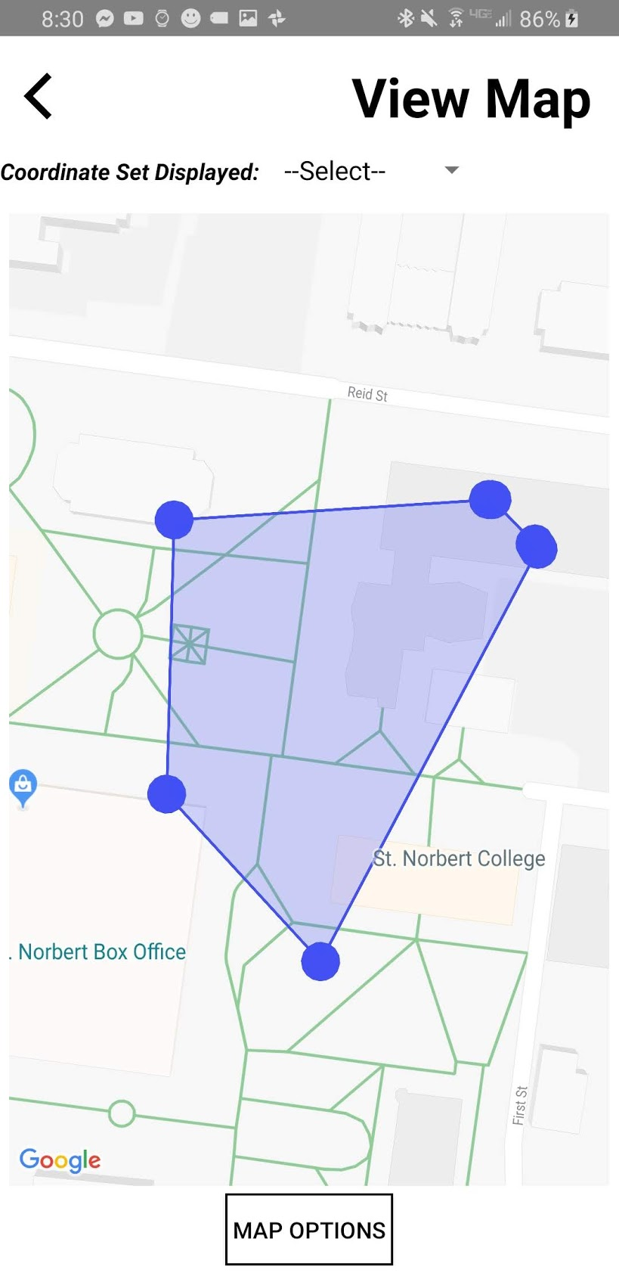
Intersection
Computing the overlapping area is complex
Actually a Topology problem
To accomplish this task I use the JTS Topology suite
Open source Java Library
Used by professionals

Slide 16
Area
Compute the Area of a convex hull

Slide 17
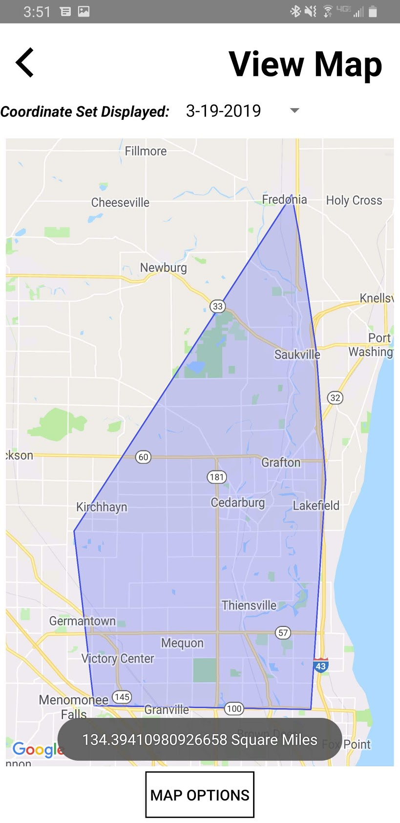
Area
Finding the area of a Convex Hull is rather simple
To ensure the greatest accuracy possible I enlist the help of Google Maps API’s built in area function
Area is reported as square kilometers…since we are in the United States I convert it to square miles

Slide 18
Demo Time
How does my App Function

Slide 19
Application
Disease outbreak
Build Containment area
Determine the hospitals in the containment area
Hospitals closer to the weighted center should be sent more supplies

Slide 20
Thank You for Listening!
Any Questions?

