Slide 1
What is a puzzle piece? And other important implementation decisions.

Slide 2
Initial Implementation Questions and Decisions
-Type of app
-Web, desktop, or mobile
-Use of framework
-Canvas?
-Canvas library and other tools
First Thoughts
Framework
Sample Projects
Django (Python) vs. node.js (Javascript)
Making the puzzle on the backend vs. frontend
Final Implementation
Node.js web application
Web app
Use a canvas or other tool – dependent on framework/language I decided
No use of canvas library, handled with built-in Javascript/canvas methods
Fabric.js and other canvas rendering libraries

Slide 3
What makes a puzzle?
width (in pixels)
height (in pixels)
coordinate of top left of puzzle on canvas
puzzle dimensions (rows, columns, and number of pieces)
puzzle image
width/height of piece
tolerance - allowance for snapping pieces into place
draw priority of each piece
clicked - index of clicked piece (or -1 if none)
connectedPieces - pieces connected to currently clicked piece
offsetX & offsetY - difference between where click is taking place from top left of piece
drag - boolean indicating whether using drag/drop or click/release
backgroundColor - light or dark background
edgeOnly - boolean indicating whether puzzle is currently showing all pieces or only edge pieces.
ghostImage - boolean for whether translucent puzzle image is shown
fullscreen - boolean for whether puzzle is in fullscreen mode

Slide 4
What makes a piece?
index of piece
coordinate for current location
coordinate for correct location
Top, left, bottom, and right edges
correct (boolean value indicating whether piece is in correct location)
orientation (correct, rotated 90, 180, or 270 degrees)

Slide 5
Creating a Puzzle

Slide 6
Calculations
Given: screen dimensions, puzzle image, number of rows and columns for puzzle
Calculate puzzle size in pixels
Find best ratio to take up a good portion of the screen – max of about 75% of height/width of canvas
Calculate piece info
Correct location defined from top left of puzzle
Random location on canvas initially
Random edge info
Type: in or out (excluding outer edges)
Width of key/lock along edge
Location of key/lock
Size of each side of key/lock

Slide 7
Drawing a Puzzle Piece
Save canvas state – saves full canvas as clipping region
Translate canvas context to midpoint of piece and rotate canvas if necessary
Start path at top left of piece
Draw edges in order: top, right, bottom, left
Draw 3 Bezier curves per edge (excluding outer edges)
Complete path (connect start and end)
Clip canvas – limits all drawing to inside this clipped path (until context is restored)
Draw puzzle image at top left of puzzle, scaling image to puzzle dimensions
Restore canvas state to last saved – canvas region set back to entire canvas

Slide 8
Completing a Puzzle

Slide 9
List of Events
Element | Event Type | Description
Settings Button | Click | Show form for modifying puzzle
Close Form Button | Click | Don’t display form
Create New Puzzle Button | Click | Initialize a puzzle given user input from form
Shuffle Button | Click | Shuffle pieces in arranged rows
Ghost Image Button | Click | Toggle translucent puzzle image in background for reference
Show Image Button | Hover | Show puzzle image over puzzle for reference when user hovers over button
Edge Only Button | Click | Toggles whether canvas displays only edge pieces or all pieces
Hint Button | Click | Animates moving a random piece into correct location
Background Color Button | Click | Toggles light/dark background image for background
Fullscreen Button | Click | Toggles fullscreen option
Canvas | Mousedown | Checks if user clicked on a piece and if so, saves piece
Canvas | Mousemove | If user clicked on a piece, that piece moves with the mouse
Canvas | Mouseup | If user is moving a piece, checks if piece is near final position or another piece to connect to. Also checks if puzzle is completed
Canvas | Contextmenu | If coordinate is on a piece, rotates the piece 90 degrees

Slide 10
Application Screenshots

Slide 11
Settings (creates a new puzzle)
Organized Shuffle
Show “ghost image”
Show puzzle image
Timer display
Initial load of 7 x 10 puzzle in light theme
Toggle edge pieces only
Hint (moves one piece)
Switch between light and dark theme
Fullscreen

Slide 12
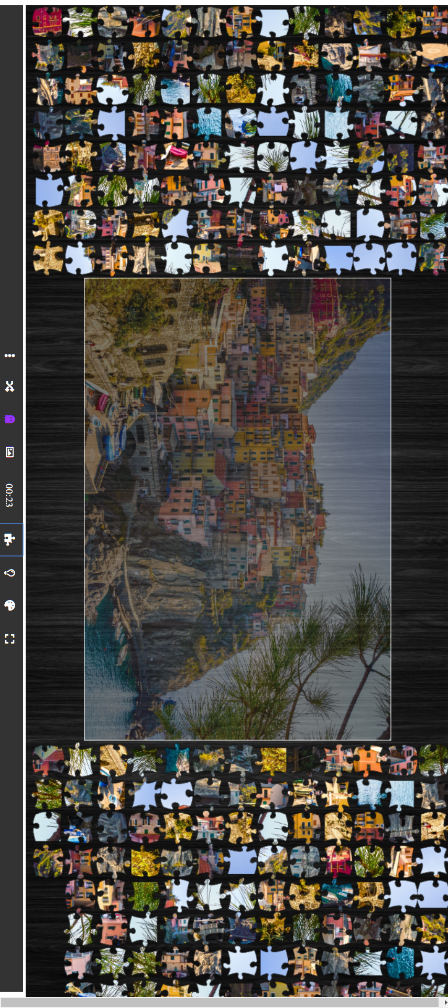
12 x 18 puzzle in dark theme after clicking “organized shuffle.” Ghost image is displayed.

