Slide 1
Puzzle Master
Emily Simon

Slide 2
Project Definition
Create an application for jigsaw puzzle addicts that creates fun puzzles and allows you to solve them.

Slide 3
Requirements (Part I)
1. Create puzzles from galleries of pictures.
2. Select the number of pieces.
3. Snap pieces into place.
4. Animate an auto-solution.
5. Completed puzzle option.
6. Full screen mode.
7. Shuffle the pieces.

Slide 4
Requirements (Part II)
8. Start over.
9. Auto save to return later.
10. Rotate option.
11. Display only edges.
12. Display only pieces that are “close” to a selected color.
13. Can the app create puzzles more challenging than others?
14. Solution is timed.

Slide 5
Solution
Node.js web application
HTML Canvas

Slide 6
How It Works – Making the Puzzle
Given image and puzzle dimensions, generates puzzle and piece info
Finds best puzzle dimensions
Random position on canvas initially
Random rotation
Random edge type
Random key/lock size and placement

Slide 7
Making the Puzzle – Drawing a Piece
Saves canvas state
Canvas translated to midpoint of piece and rotated
SVG path for each piece
Calculates position to place image and clips within piece path
Restores canvas state

Slide 8
Making the Puzzle – Paths and Quadratic Curves

Slide 9
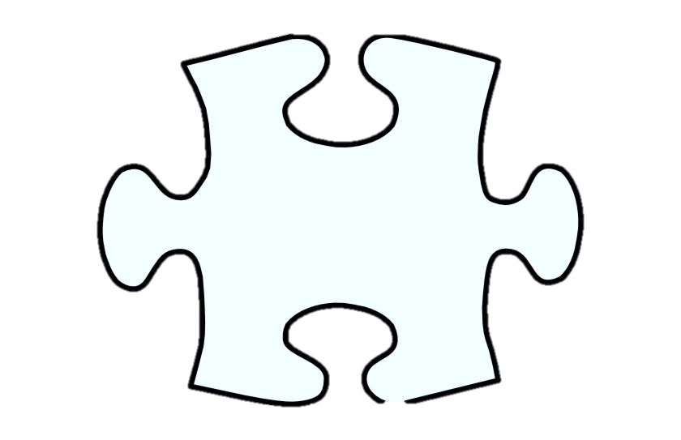
Making the Puzzle – Bezier Curves
2
9
3
8
10
1
4
7
5
6

Slide 10
How It Works – Completing the Puzzle
Events: mousedown, mousemove, mouseup, contextmenu
Redraws with two canvases on mousedown
Find connected pieces
Snaps pieces together

Slide 11
Demonstration

Slide 12
Exceptions
Save
Show pieces “close” to color

Slide 13
Obstacles
Canvas library vs. no canvas library
Path drawing
Optimizing canvas rendering

Slide 14
Strategies
Professors and peers
Stack Overflow
w3schools.com
Looking at similar projects
Writing algorithms out by hand

Slide 15
Knowledge
CS 220 – Advanced Data and File Structures
CS 350 – Event programming
CS 322 – Programming Languages

Slide 16
Extensions
Different shaped pieces
Sharing capabilities
Animated images
Sounds

Slide 17
Questions

