Slide 1
eParking

Slide 2
Project Definition
Construct a mobile application that assists commuters in locating open parking spaces on campus

Slide 3
Project Requirements
Determine available spaces in multiple lots
Pay for parking using a debit type arrangement
View time remaining on your eMeter and add additional time
Check to see if you were given a parking ticket
Reserve a space for a specific date/time
Implement the app for several locations

Slide 4
Project Requirements
Determine available spaces in multiple lots
Pay for parking using a debit type arrangement
View time remaining on your eMeter and add additional time
Check to see if you were given a parking ticket
Reserve a space for a specific date/time
Implement the app for several locations

Slide 5
Planning

Slide 6
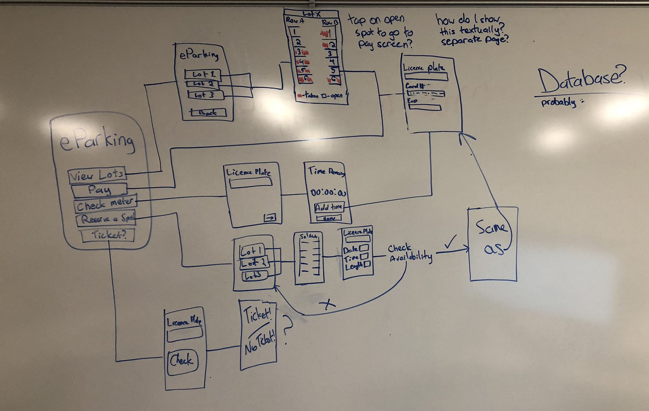
Breaking It Up
Pay for a spot
Check meter
Reserve a spot
Ticket

Slide 7
Decisions, Decisions...
Environment - Android Studio w/ Java
Visuals - Parking Lot, Open/Taken Spots
Gestures - Recognize Touch
External Database - Data Storage

Slide 8
Getting Started

Slide 9
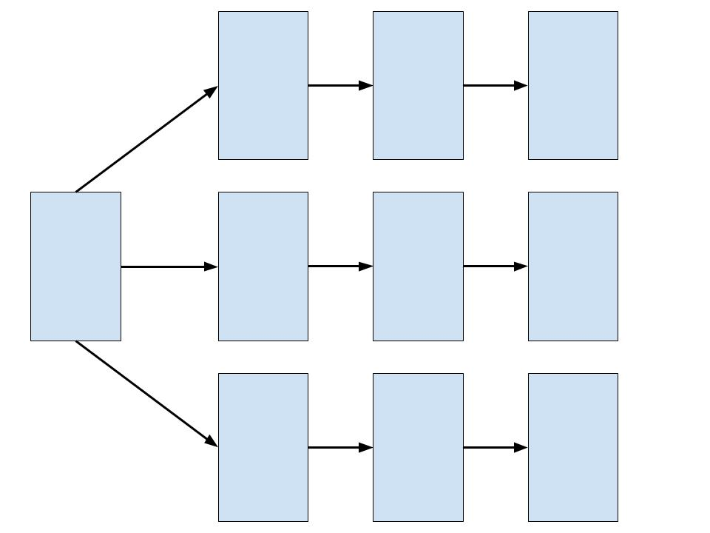
Bringing it to Life
Created a project with all necessary pages
Allowed user to navigate from page to page

Slide 10
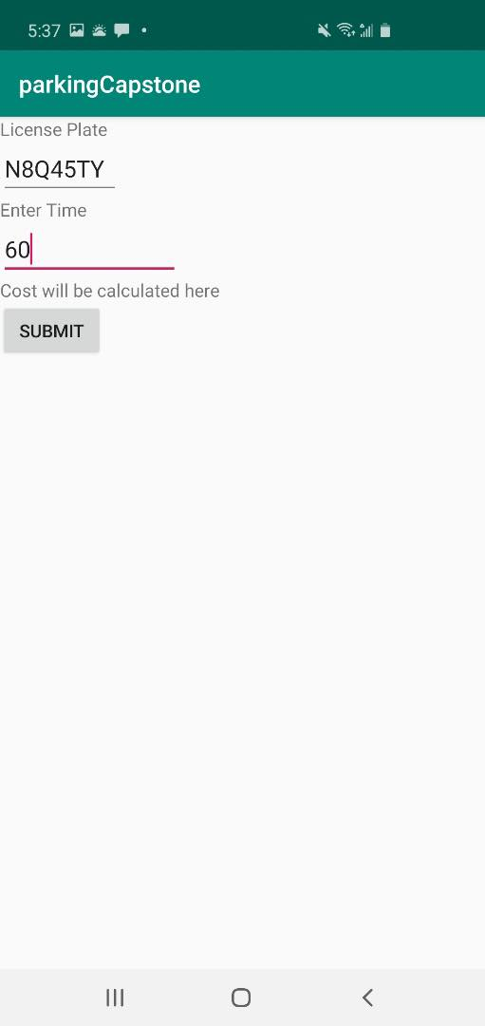
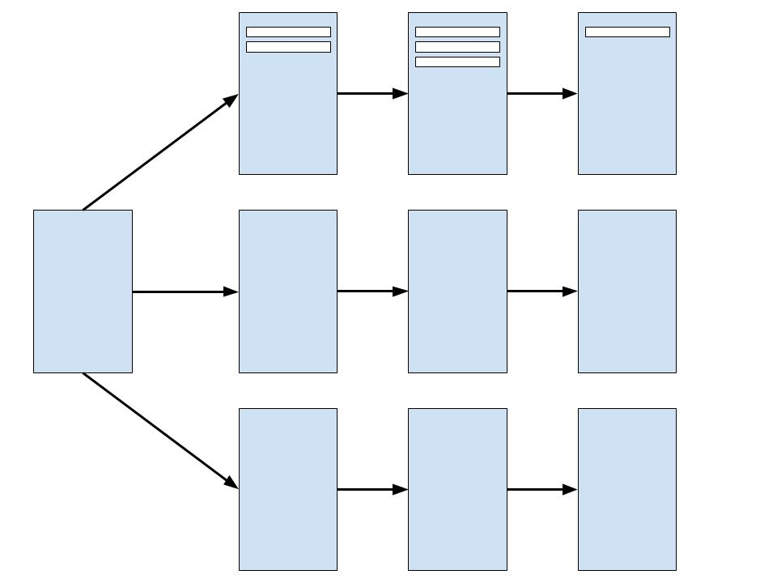
Starting to Manage Data
Allowed input from user
Lot, Spot, License Plate, Start/End Time
Where does it all get stored?

Slide 11
Database - Original Plan
Lot | Spot | Plate | Time Start | Time End

Slide 12
Database - Original Plan
Connect to the database from the app and store data
Pull data from the database

Slide 13
Database - Original Plan
x
Connect to the database from the app and store data
Pull data from the database

Slide 14
Visuals

Slide 15
Starting Images
Created 3 images
Parking Lot Layout
Open Spot
Spot Taken

Slide 16
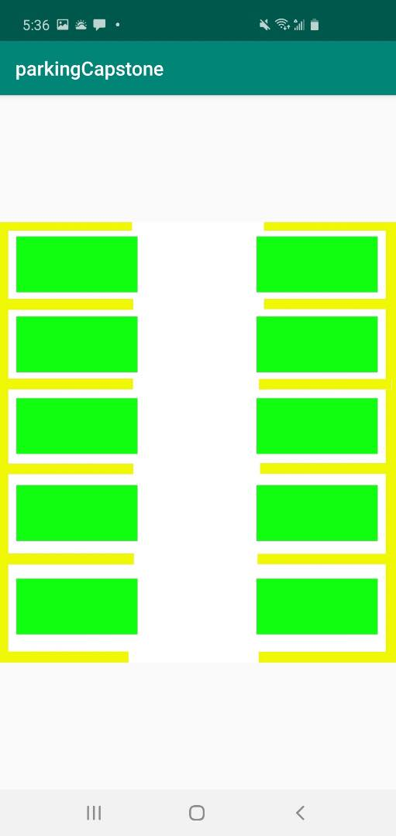
Starting Images
Threw some code together and created a parking lot!

Slide 17
Gestures

Slide 18
Handling Touch and Gathering Data
0
5
1
6
2
7
3
8
4
9

Slide 19
Returning to Database

Slide 20
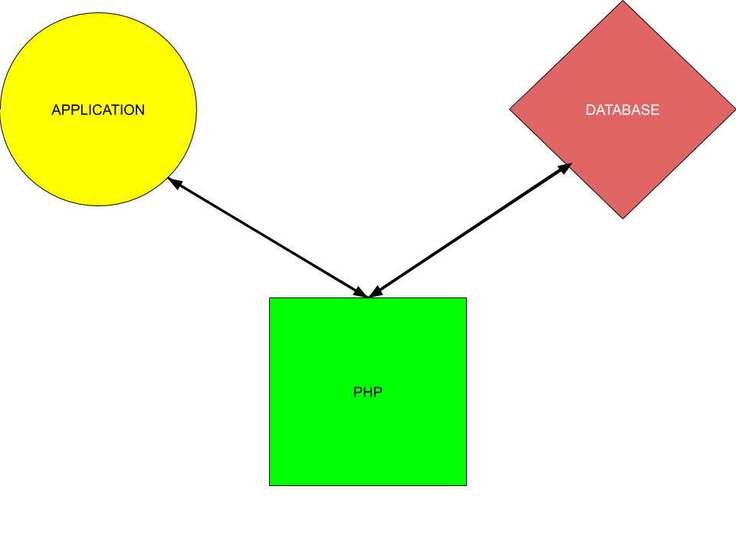
Adding PHP to the Mix

Slide 21
Successfully Using the Database

Slide 22
DEMO

Slide 23
VIDEO WILL GO HERE

Slide 24
Strategies

Slide 25
Resources
StackOverflow
Dr. McVey && Dr. Pankratz
YouTube Tutorials
Android App Development book
Java Development book
Classmates && Alumni

Slide 26
Extensions

Slide 27
Extensions
Develop for both Android and iOS
Allow user to enter more information (Car, Color, etc)
Can be reflected in visual parking lot
Send user a notification when their time is almost up

Slide 28
Questions?

