Slide 1
VR Air Hockey
CSCI 460 - Capstone Experience - Spring 2021
By: Myles Cruz

Slide 2
Part I: Project Description

Slide 3
Description & Requirements
Develop a VR application that allows a user to play Air Hockey against a computerized opponent.
Determine how the player will control the “paddle” .
Provide for different skill level of players.
Make it realistic using correct angles and velocity.
Provide various strategies for the computer “player”.
Keep score.
Make it fun and exciting.

Slide 4
Solution: Unity
Cross Platform Game Engine
3D Video Game Design
Scripting in C#
Oculus: “Build Your First App”
Game Objects, Colliders, Rigidbodies

Slide 5
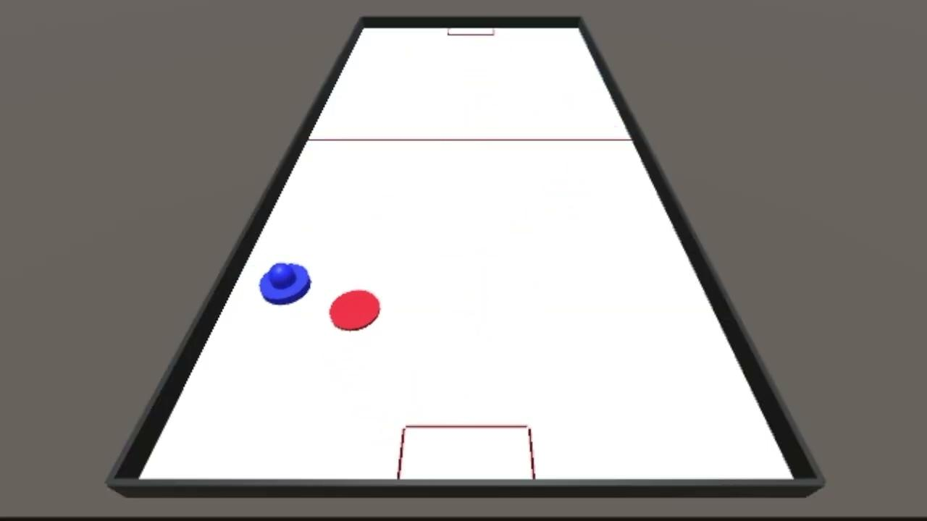
Make realistic with using correct angles and velocity
Table
Ice Floor
Bouncy Wall
Puck and Striker
Originally used velocity formula (speed * time)
Rigidbody physics

Slide 6
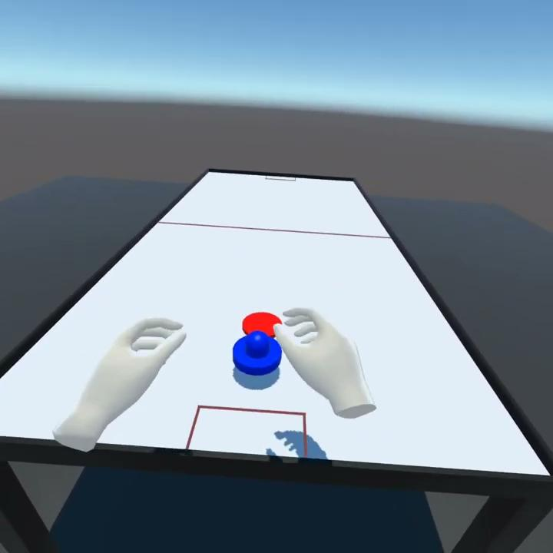
Determine how the player will control the “paddle”
Oculus Integration Package
OVR Player Controller
OVR Grabber
OVR Grabbable

Slide 7
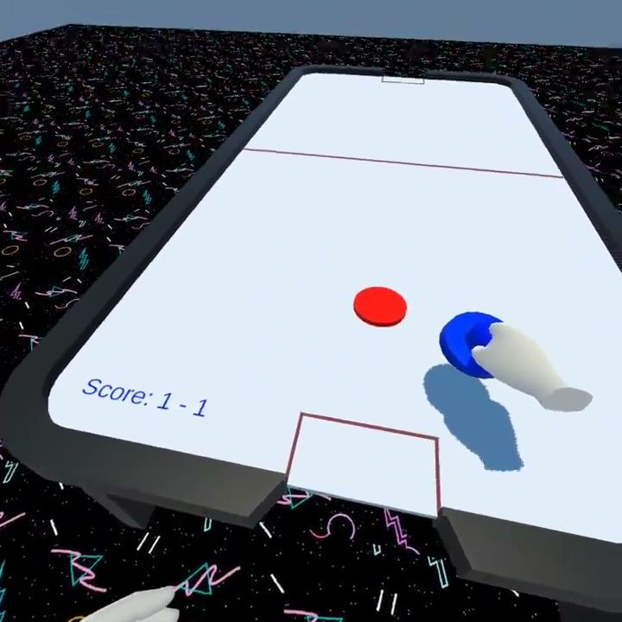
Keep score
OnCollisionEnter
Introduction of Game Manager
Timer
Play
Pause
Quit

Slide 8
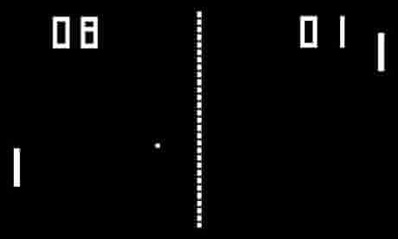
Provide various strategies for the computer “player”
Pong (1972)
CPU tracks position of ball along y-axis
Inspired by The Weekly Coder’s Computer AI video on Youtube
Test Striker Function
Track position of puck on x and z-axis
CPU’s x position < Puck’s x position
Move Right
CPU’s x position > Puck’s x position
Move Left
CPU’s z position < Puck’s z position
Move Forward
CPU’s z position > Puck’s z position
Move Backward

Slide 9
Provide for different skill level of players
Different force added for each level of Test Striker
Easy: 0.1f
Medium: 0.25f
Hard: 1.0f

Slide 10
Make it fun, exciting, and simple
Environment Design
User Interface (UI)
Audio
Visuals

Slide 11
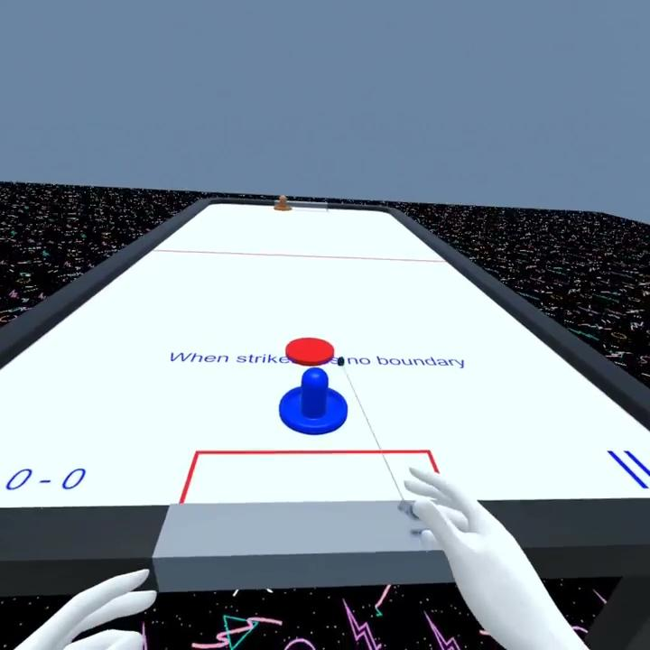
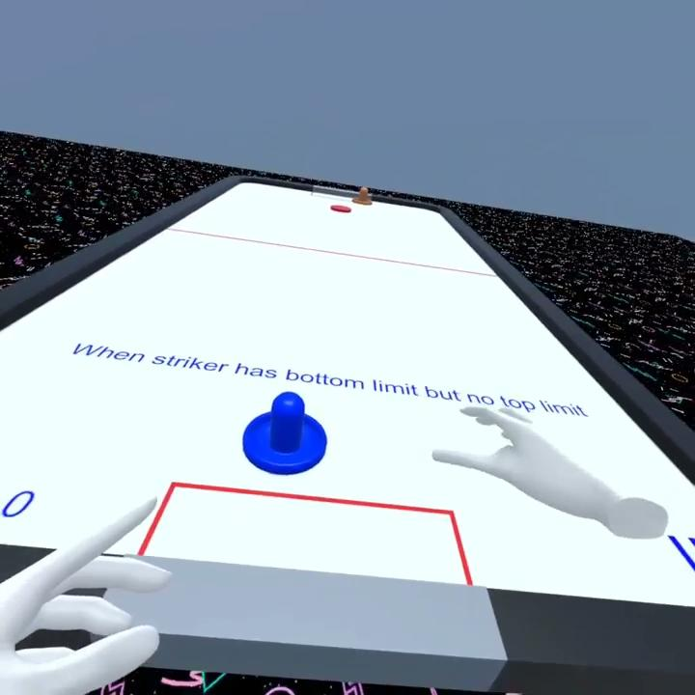
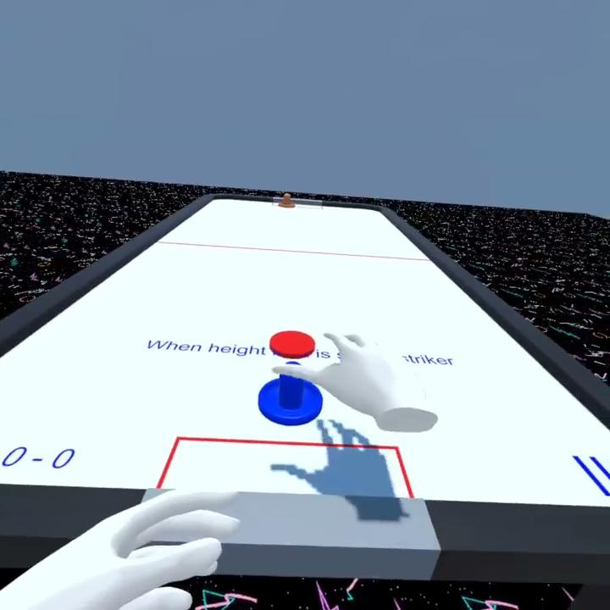
Exceptions
Striker and puck collision
CPU and puck interaction

Slide 12
Part II: Demonstration

Slide 13
Part III: Learning & Development Process

Slide 14
Strategies
Unity/Oculus Documentation
Scripting
Unity Tutorials
UI/Gameplay Ideas
Youtube
UI/Gameplay Ideas

Slide 15
Extensions
Ideas for future projects
XR Rig vs. Oculus Integration Package
Mounting striker to user’s hand
Computer Strategy
Environment Design
Customization options

Slide 16
Part IV: Q&A

Slide 17
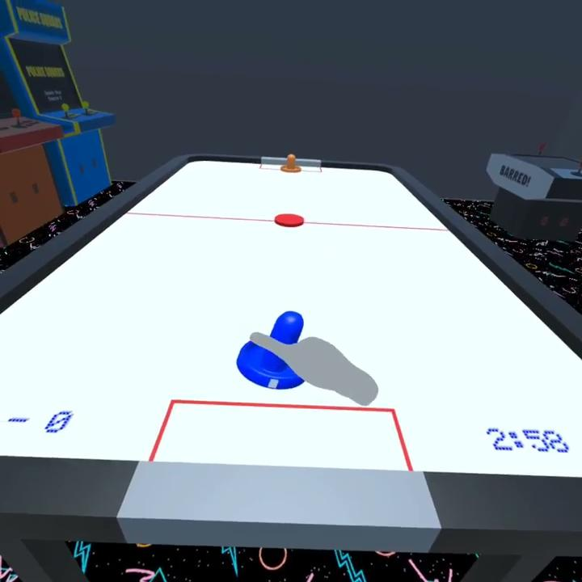
In Case Things Go Wrong

Slide 18
Extra Stuff
The Weekly Coder’s - Computer AI

