Slide 1
BeatBox Virtual Reality Rhythm Game
Created by Derek Huber
5/1/2021

Slide 2
Project Description
“Develop a virtual reality (VR) application that determines the beat to an audio file and encourages the user to move to get a high score.”

Slide 3
Project Requirements
The user can use the music of their choice.
The software should determine the beat.
Develop a scoring mechanism to make it fun.
The user must move to score.
Provide different levels of activity.
Use random events to make each routine more interesting.

Slide 4
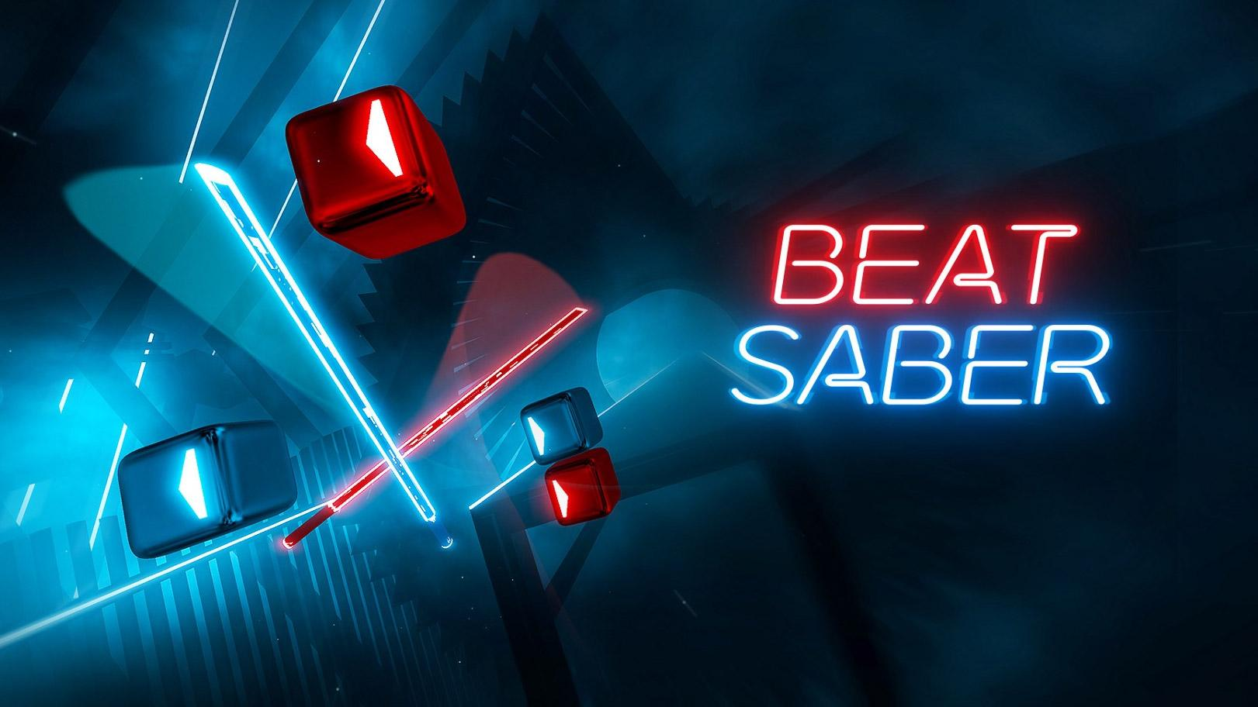
My VR Experience + Inspiration
Classmates Eric Herman + Rick Gonzalez
Oculus Rift CV1
Inspired by Beat Saber

Slide 5
Solution: Unity
Recommended by Dr. McVey
C# scripting language (very similar to C++)
Oculus Integration Package -> XR Interaction Toolkit (relatively new)
Headset Compatibility

Slide 6
Methods
Five main scripts:
GameScript
UI navigation, score, gameBeingPlayed, etc.
SoundManagerScript
Audio management
SpawnScript
Cube spawning
MoveCube
Attached to each cube (movement + collisions)
MyAudioProcessor
Beat detection

Slide 7
Methods cont.
Two game modes:
BPM
Beat Detection
Two difficulty settings:
Cube Spawn Range (Max distance left + right)
Cube Speed (more/less time to react)

Slide 8
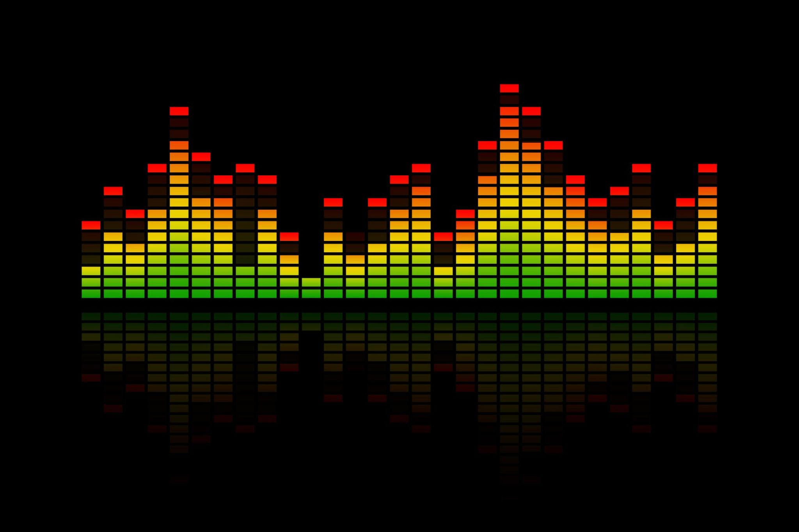
Difficulties: Mainly Beat Detection
Overwhelmed start - no game engine experience
Beat detection - how do you make a computer know when the “beat” is?
Audio Analysis
vs.

Slide 9
Audio Analysis
1 second of song history
43 chunks of energy values
1024 samples per chunk
Instant energy > past energy average * constant C (1.4 or 1.5)
Beat!
Minimum beat separation value
Bass drum lasting more than 1/43 of a second

Slide 10
Live Demonstration

Slide 11
Development Strategy
Brainstorm ideas
Research if idea is possible within platform
YouTube, articles, Reddit
Explore documentation, forums, and videos for use cases
Official Unity Documentation, Forums - Stack Overflow, Unity forums, etc, YouTube
Implement idea in most basic form
Debug if necessary
Myself, otherwise utilize aforementioned resources, professors
Expand functionality
Debug...again…
Repeat!

Slide 12
Extensions
Beat detection by frequency bins
Pre-processed instead of real time
Height adjustment (accessibility)
Song highscores/leaderboard
BPM mode save settings button
Load on startup
Better randomness factor - special blocks/hits?

Slide 13
Thank you!
Professors - Dr. Pankratz, Dr. McVey, Dr. Diederich, Dr. Geisler, Dr. Meyer
Classmates + Roommates

Slide 14
Thanks for watching!
Questions?

