Slide 1
SCRAPELY
BY: BRENDAN AIRD

Slide 2
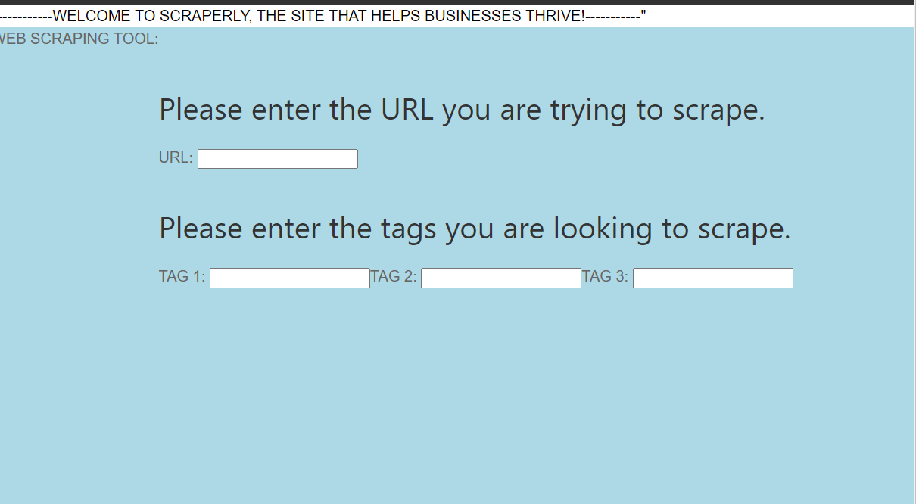
PROJECT DEFINITION
First Design: 2/11/2023
Develop an application that can be used by individuals looking to automatically scrape internet reviews from websites. This application would look at a website like TripAdvisor for a particular hotel and grab all the individual reviews posted from all pages. These collected reviews would then need to be presented with appropriate visualizations of the important data.

Slide 3
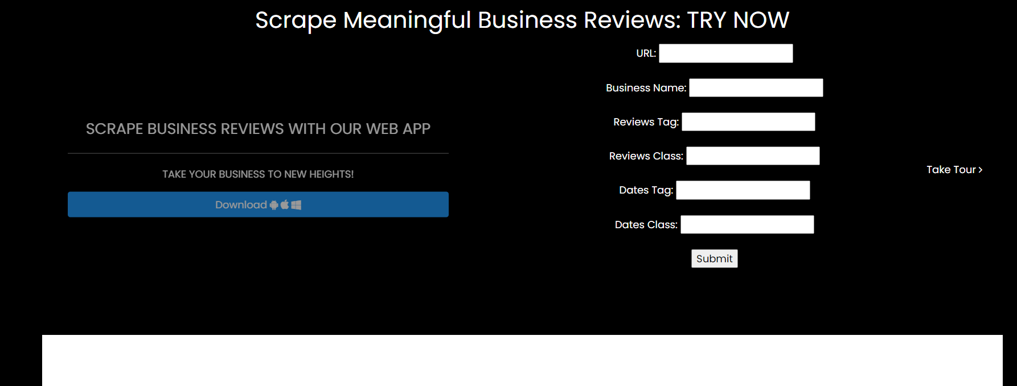
WHAT IS MY PROJECT, WHY AM I CREATING IT
What: Web Scraping Application for Businesses (ex. Sites like TripAdvisor, Yelp, etc..)
Why: Helping businesses improve based off really data and customer feedback

Slide 4
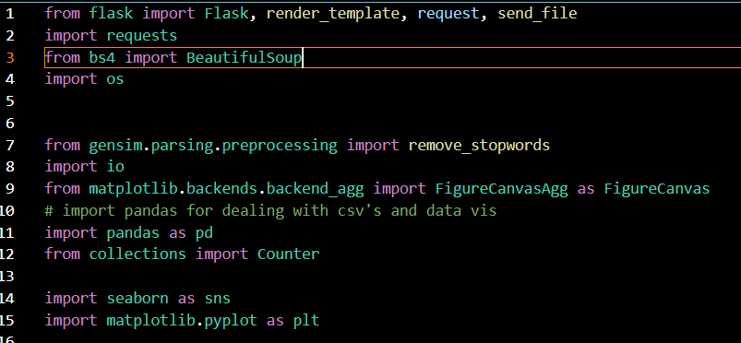
PYTHON LIBRARIES I’M USING SO FAR
Libraries:
Flask
requests
render_template
send_file
BeautifulSoup
os
gensim
io
matpotlib
seaborn (built on top)
pandas
collections(for future)

Slide 5
FLOW AND DESIGN FOR MY PROJECT
App.run() will start my web application
Index() will run and create first page (index.html)
User enters specific inputs
Python will process and scraping begins
Scraped() runs
Go to local host
On Submit
Scraped() calls Scraped_Reviews
Loop runs, scrapes pages
Transferred into dataframe, saved csv
Scraped2.html webpage load
Result page with graph
Based on user input
Hits max requests
visiulizecount () embedded in scraped.html

Slide 6
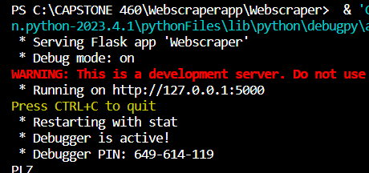
ROADBLOCKS
Challenges I had throughout my project creation:
Learning curve python, web scraping
Flask
Debugging(getting my data through)
Data visualization lib. & tools
GREAT FEELING!!

Slide 7
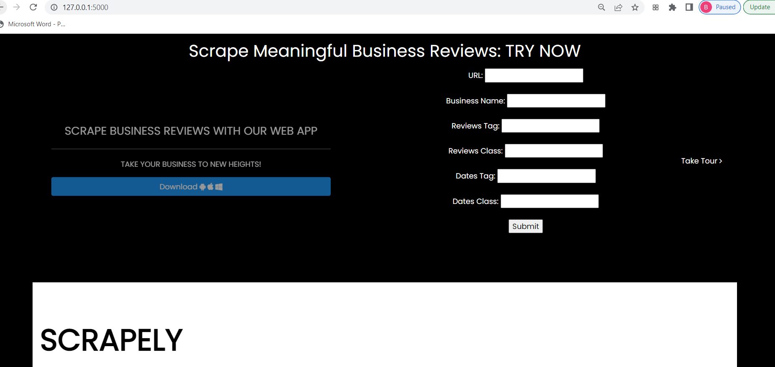
My Project Visually at the Moment

Slide 8
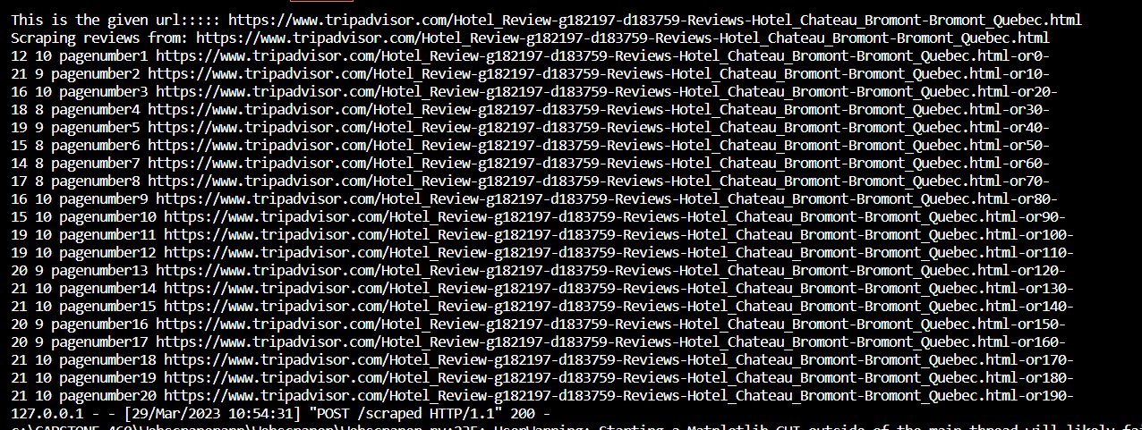
My Project Visually at the Moment

Slide 9
My Project Visually at the Moment

Slide 10
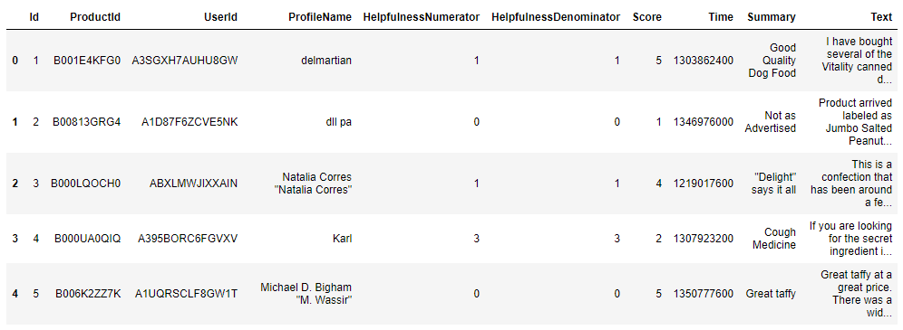
IMMEDIATE NEXT STEPS
After chatting with Dr. Diederich on my progress with my project
Next Steps:
Understand
Sentiment Analysis (TextBlob,VADER)

Slide 11
DEMO
ONE MOMENT!!

